Slide 1

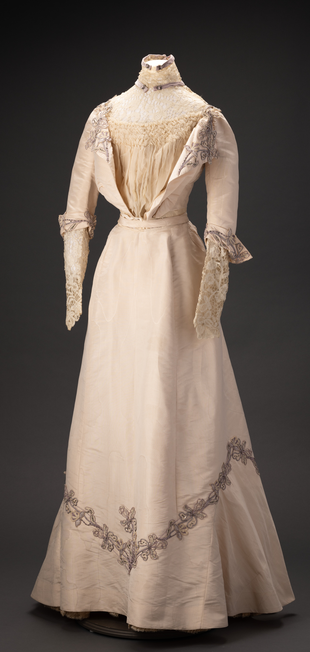
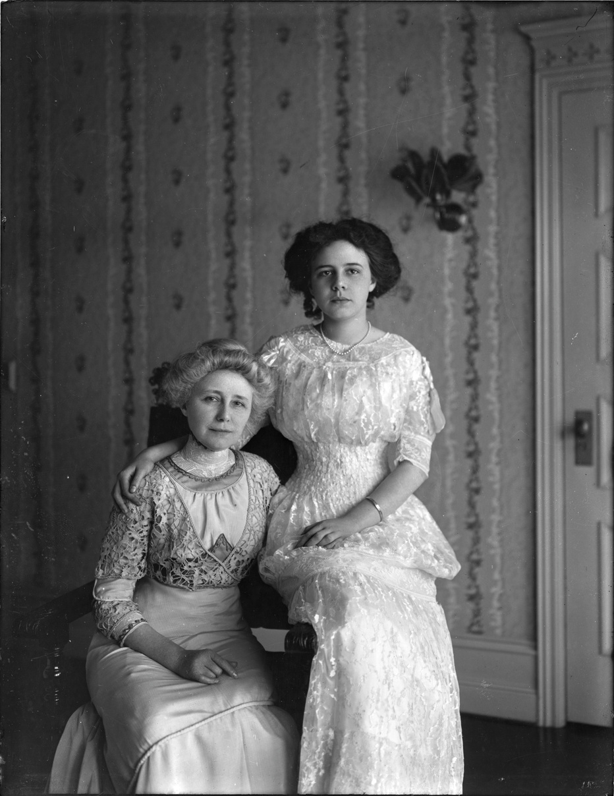

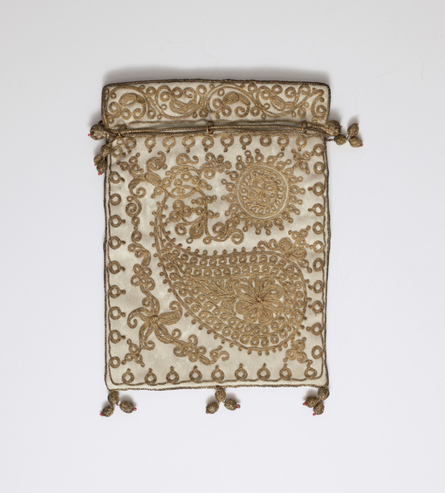
Campbell House
Fashion
1898-1924
Grace and Helen Campbell
The Joel E. Ferris Research Archives, Campbell House Collection, 1908, L91-119.3
Learning with primary sources at the MAC: Grace Campbell’s Clothing
Northwest Museum of Arts & Culture
784.21, Grace Campbell Evening Gown, 1900-1910
Gift of Mrs. Helen Campbell Powell, 1930
Northwest Museum of Arts and Culture
784.20, Helen Campbell purse,1890-1910, Gift of Helen Campbell Powell, 1930

Slide 2
TIMELINE
Helen Campbell
Trip to Egypt
Helen Campbell Diary
Grace Campbell Death
born 1892
1903
1913-1917
Campbell House Built
1924
Amasa and Grace Campbell Marriage
1898
European Grand Tour Trip
Helen Campbell and Bill Powell Wedding
1909-1910
Amasa Campbell Death
1890
1917
1912

Slide 3
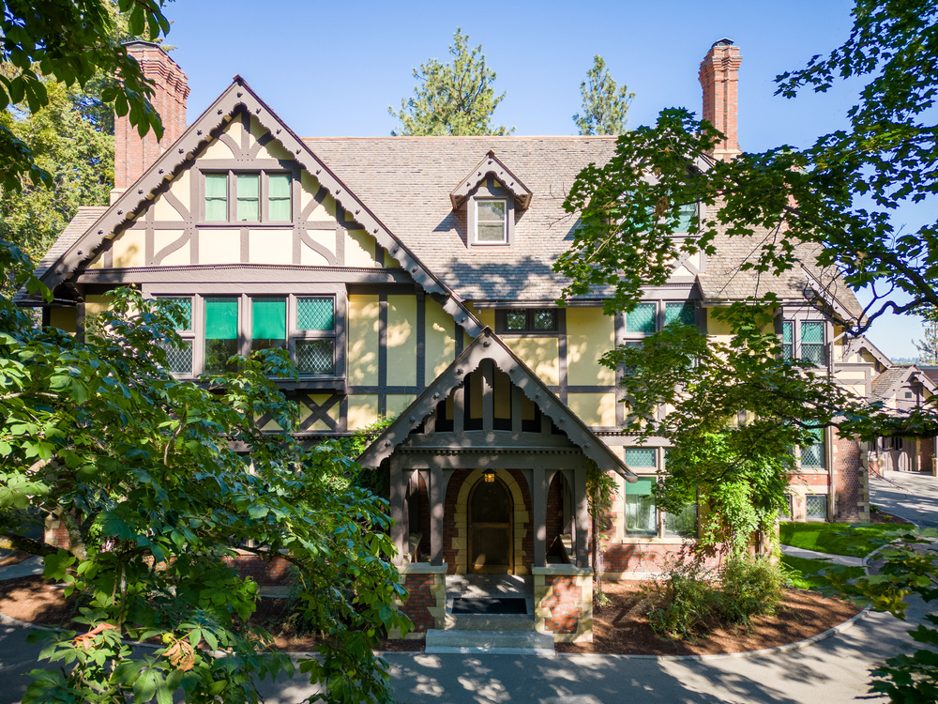
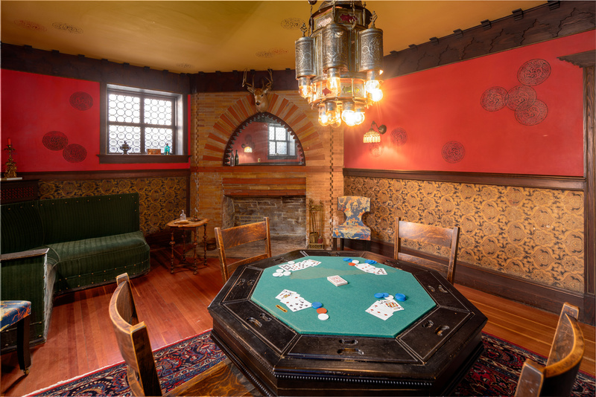
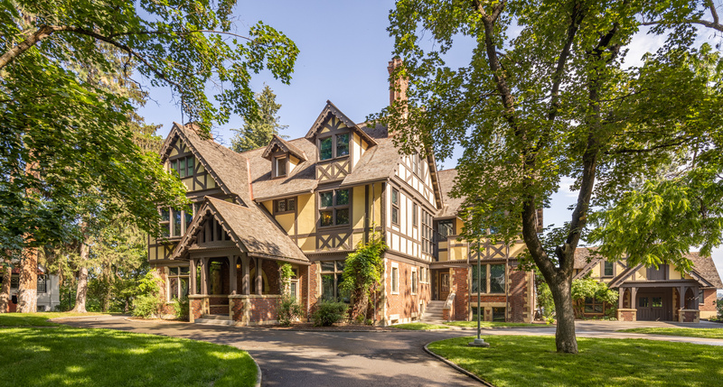
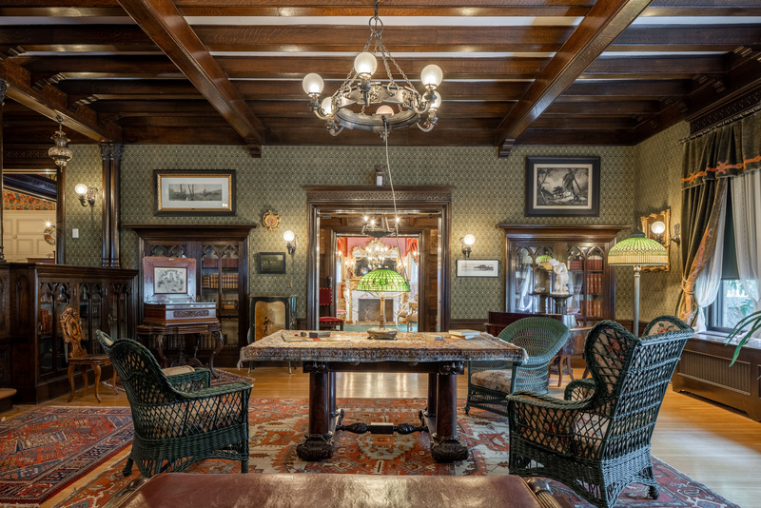
Campbell House
Campbell House, located on the campus of the Northwest Museum of Arts and Culture in Spokane’s Browne’s Addition, was built by Amasa and Grace Campbell in 1898.
In 1887, a group of Youngstown, Ohio investors sent Amasa B. Campbell (1845-1912) and associate John A. Finch to investigate the tales of Idaho's fabulous Coeur d'Alene Mining District. The partners quickly determined that there were fortunes to be made. They invested $25,000 in the Gem mine, built a mill to work the ore, and soon were earning thousands of dollars a month. His fortune assured, Campbell returned to Ohio to marry schoolteacher Grace Fox (1859-1924), and they moved to Wallace, Idaho, a raucous mining town that was a far cry from the sedate life of Youngstown.
The Campbell's daughter, Helen (1892-1964), was born in Spokane during the same year that labor and management conflicts erupted in the Coeur d'Alene Mining District. Financial panics and the collapse of world silver prices accelerated these disputes, and Idaho governors twice placed the mining district under martial law. In 1898 Campbell and Finch moved their mining operations and their residency from Idaho to Spokane, which afforded greater security and more educational, social, and business opportunities.
Mr. Campbell’s Den
Photo Credit: Dean Davis
Campbell House Exterior
Amasa and Grace Campbell hired architect Kirtland Cutter of Cutter and Malgren, to design their home. Cutter specialized in the popular Arts and Crafts Revival architectural styles and the Campbell’s chose to build a Tudor Revival. Following Grace Campbell’s death in 1924, Helen Campbell (then Mrs. W.W. Powell), gave the house to the Eastern Washington State Historical Society in memory of her mother.
Campbell House Library

Slide 4

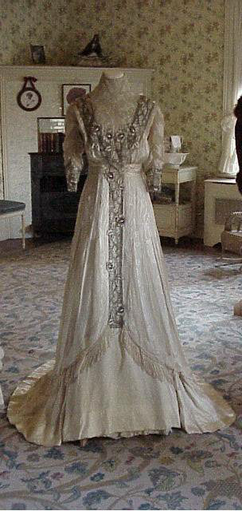
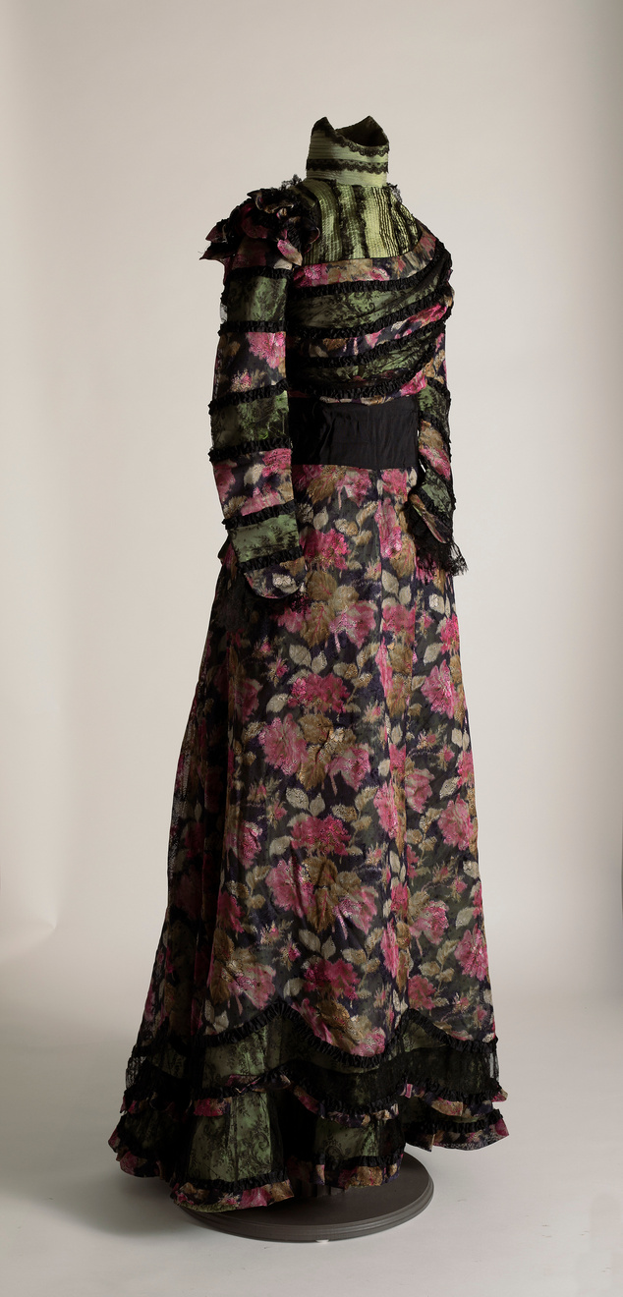
Grace Campbell’s clothing represented her family’s vast silver mining wealth and their place in Spokane society. Primary sources from the museum’s collections reveal that shopping was a frequent part of Grace and Helen Campbell’s weekly routine. The clothing found in the MAC’s textile collection confirms their taste in elegant and fashionable dresses.
Grace wrote checks to Spokane dressmakers such as May Stiffens-Jones and Mrs. J.M. Shaefer and jewelry stores such as Dodson’s. They traveled to New York City yearly to shop the latest fashions. Helen noted in her diary on Thursday, February 26th, 1914, during their New York City visit, “Took my skirt back to Hickson, then went to Meuller-Graves & found two pretty summer dresses. Mrs. Wadsworth & Vera were here. Went to "Peg O' My Heart" with Mr. Webber. Afterward got mother & went to supper. Quite nice.” Hickson and Company’s clothing store in New York was considered among the most fashionable retailers in 1914.
Grace and Helen’s trips to New York could be quite expensive. During their 1915 winter trip to New York, Helen and Grace spent $3,380.99. According to the consumer price index in 2026, that trip was the equivalent of spending $108,878.59!
Grace Fox Campbell was born February 2, 1859. She grew up in Youngstown, Ohio. After her marriage to Amasa Campbell in 1890, she moved first to Wallace, Idaho and then to Spokane Washington, where she raised her daughter, Helen. Grace died in her home in 1924.

Slide 5
Grace Campbell and her peers were seeped in what we now refer to as the “Cult of Domesticity” or “Cult of True Womanhood” where gender roles were very rigid. Piety, purity, submissiveness, and domesticity were promoted as important virtues. Women were seen to have superior morals, but who were also weaker, more vulnerable, and whose roles should be kept to domestic activities. They were the keepers of the home. 19th century women’s fashion magazine, Godey’s Lady Book, warned women against participating in politics and debates that were thought to be “injurious to their natures”.
A man demonstrated his wealth and power by how his wife dressed. The dress “perpetuated an air of opulence” while the actual wardrobe showed an idle life. Dresses like these were elegant, but constricted movement.
Northwest Museum of Arts & Culture
3965.3 Grace Campbell Silk Dress,
1895-1915
Gift of Mrs. Helen Campbell Powell, 1930

Slide 6
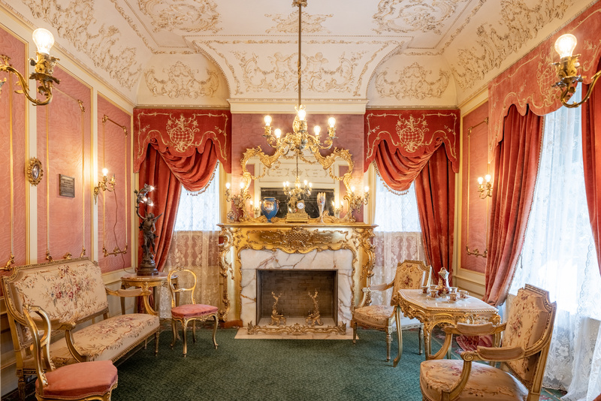
In 1905 or 1906, Grace Campbell contracted Spokane dressmaker and “ladies’ tailor”, May Steffins, to custom-make this two-piece dress of white Moire silk with lavender trim.
As a lady of means and fashion, Grace’s dresses retained many late Victorian features such as a high collars, tight sleeves, corseted waists, and wide skirts. This dress was designed to greet guests during formal occasions such as Reception days in the Campbell House’s gilded gold and pink Reception room.
Campbell House Reception Room.
Photo Credit: Dean Davis
Browne’s Addition neighborhood Receiving days were on Thursdays and were marked by strict etiquette rules that could be found in Spokane’s Blue Book. Grace wore this dress to welcome her guests into her home during these days.
The 1909 Spokane Blue Book Rules of Etiquette stated, “A caller should greet his host on first entering the drawing room before speaking to other guests. Formal calls should not exceed fifteen minutes. The hostess should rise and offer her hand to the caller. When they leave, she accompanies them to the parlor door.”
Northwest Museum of Arts & Culture
784.21 Grace Campbell Evening Gown,
1900-1906
Gift of Mrs. Helen Campbell Powell, 1930

Slide 7
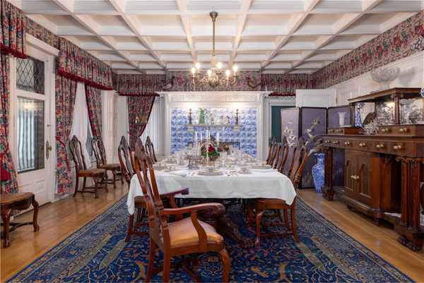
An unidentified dressmaker custom-made this evening gown of ecru silk fabric with beaded, woven silk flowers, and bugle bead trim for Grace Campbell c1900-1910.
Imagine an evening dinner party at the home of Grace and Amasa Campbell in which Grace wears this gown while greeting her guests. The elegant Campbell Home and festive dinner parties were crucial props in convincing potential shareholders to invest in Amasa Campbell’s various business ventures.
Did all women buy into the “Cult of True Womanhood”? Not completely. Many women worked to support their families or themselves. There was also a growing suffrage movement. Grace Campbell did embrace the role of mother, society woman, and keeper of the home. However, she also espoused many of the ideals of the early 20th century Progressive movement.
Campbell House Dining room
Photo Credit: Dean Davis
Before marrying Amasa at the age of 32, Grace had a career as a schoolteacher. Once married, her role as a wife was defined by societal norms, however, that role included managing a large home with a staff of servants that was akin to running a small business. She organized social events that promoted her husband’s growing mining corporation. She supported popular social movements such as Temperance and financed various Spokane charities like the Washington Children’s Home Society. All were visible signals of the family’s wealth and success.
Northwest Museum of Arts & Culture
784.23 Grace Campbell Evening Gown,
1900-1910
While we are unsure if Grace voted after Washington women secured the right to vote in 1910, we know she attended a reception in 1916 for Harriet Stanton Blatch, daughter of suffragist Elizabeth Cady Stanton, and her Congressional Union for Woman’s Suffrage when they visited Spokane. The reception was held at the home of Mrs. Turner, wife to Washington Senator, George Turner.
Gift of Mrs. Helen Campbell Powell, 1930

Slide 8
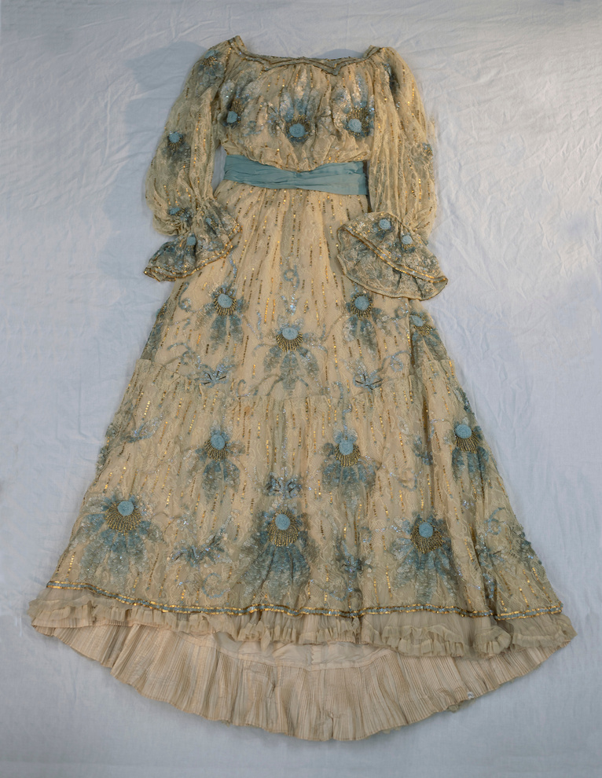
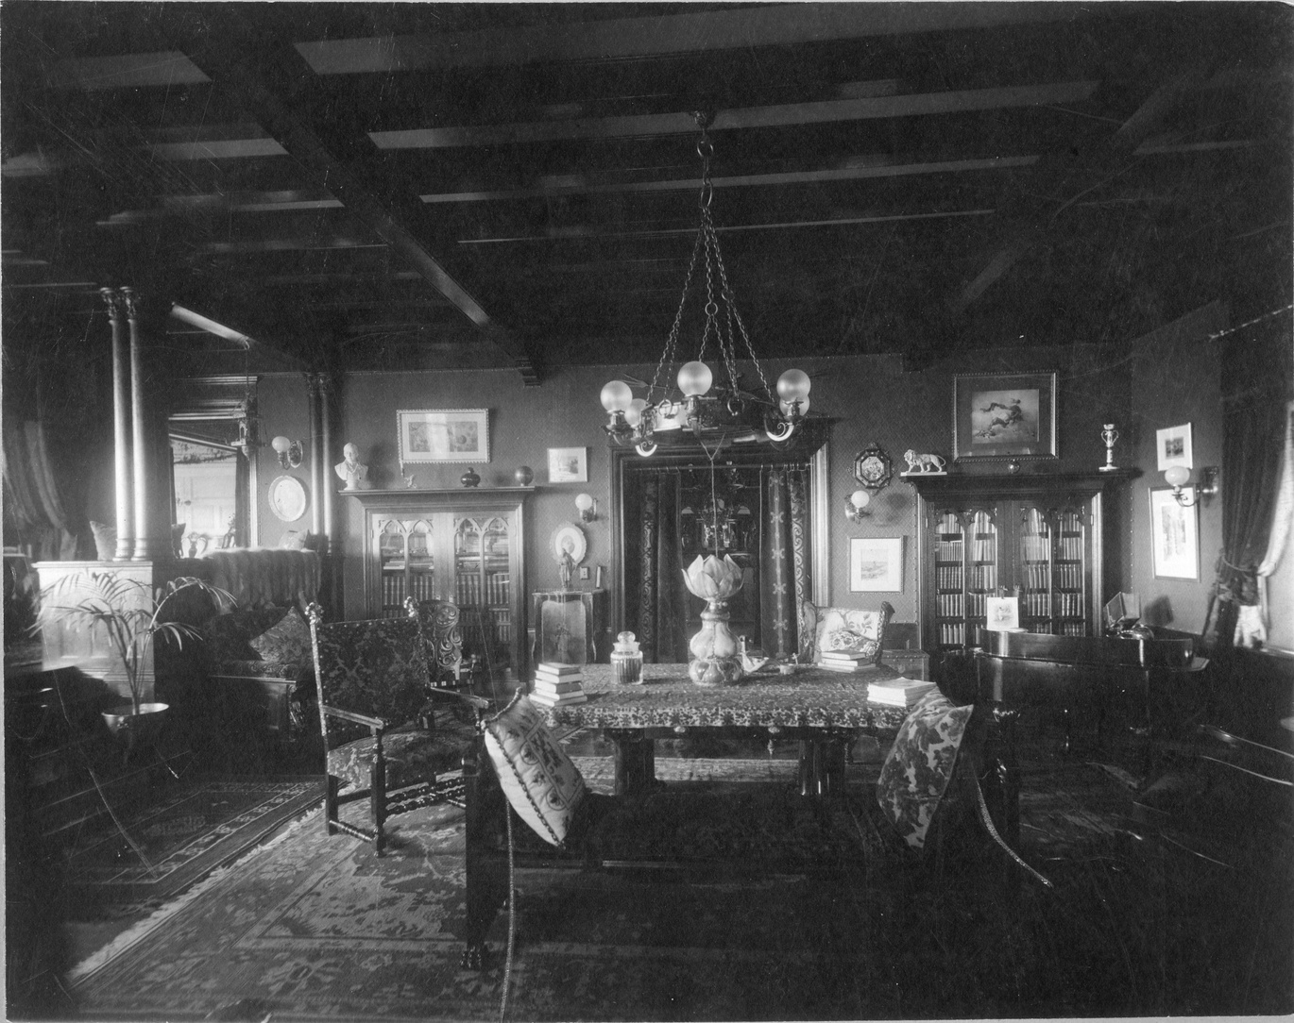
This lace overdress with satin lining, square neckline, and full sleeves is decorated with blue flowers, sequins of ivory, blue and gold, and gold beads. It is made of taffeta with a lace cover. While traveling to New York City, Grace bought this custom-made gown from Hickson and Company, which was described as "the most elegant and expensive specialty shop on Fifth Avenue”.
Northwest Museum of Arts & Culture, 3096.3 Grace Campbell blue flower dress, 1900-1915
Gift of Valarie Powell, 1985
Fashion for women in the first decade of the twentieth century largely did not change much from the previous century. “Health” corsets that pushed the bust forward and the hips back helping to avoid pressure on the abdomen gained popularity. Day dresses emphasized modesty and could be trimmed and accessorized for evening wear. Skirts were bell-shaped and lace was a popular decoration.
Rich fabrics were used with silk satin and chiffon being two popular choices. Colors were light but embellished with decorations. Editor Kathryn Hennessy writes in Fashion: The Ultimate Book of Fashion and Style, “Sumptuous fabrics such as silk, satin, damask, and chiffon, usually in light, soft colors, were decorated with lace, rhinestones, and spangles, often highlighting a part of the body or the face”. Grace Campbell’s blue flower dress matched the prevailing look popular between 1900-1910 of a mature, sophisticated, and graceful woman.
Campbell House Library, Joel E. Ferris Research Archives, Campbell House Collection, 1910, L91-120.29

Slide 9
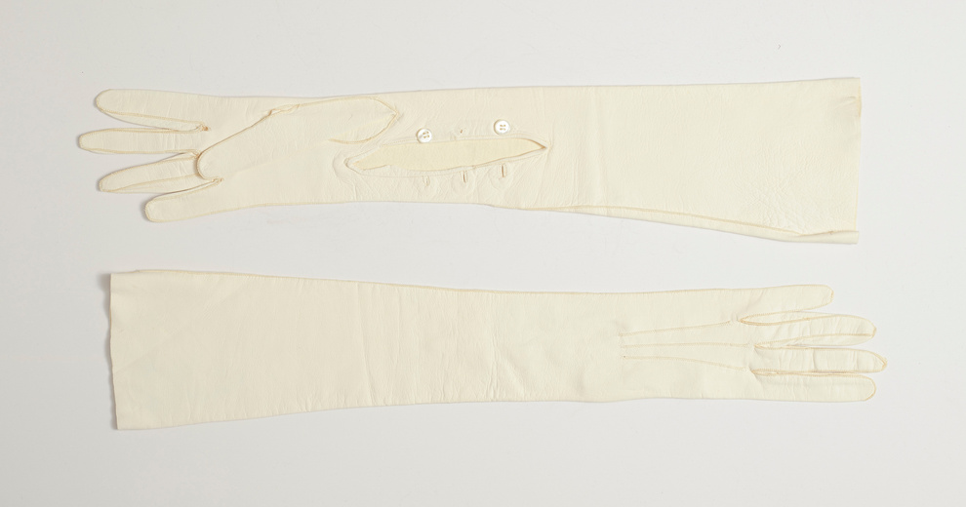
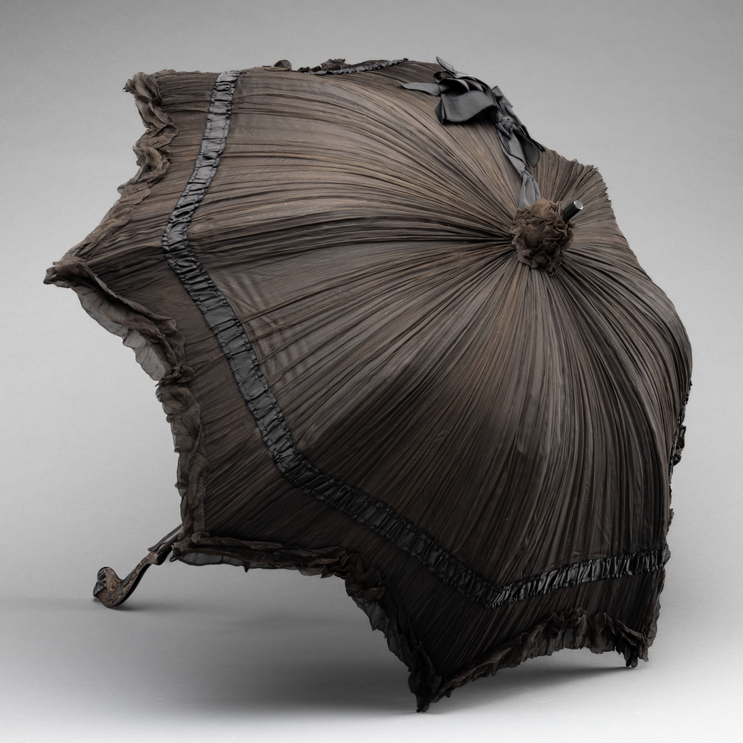
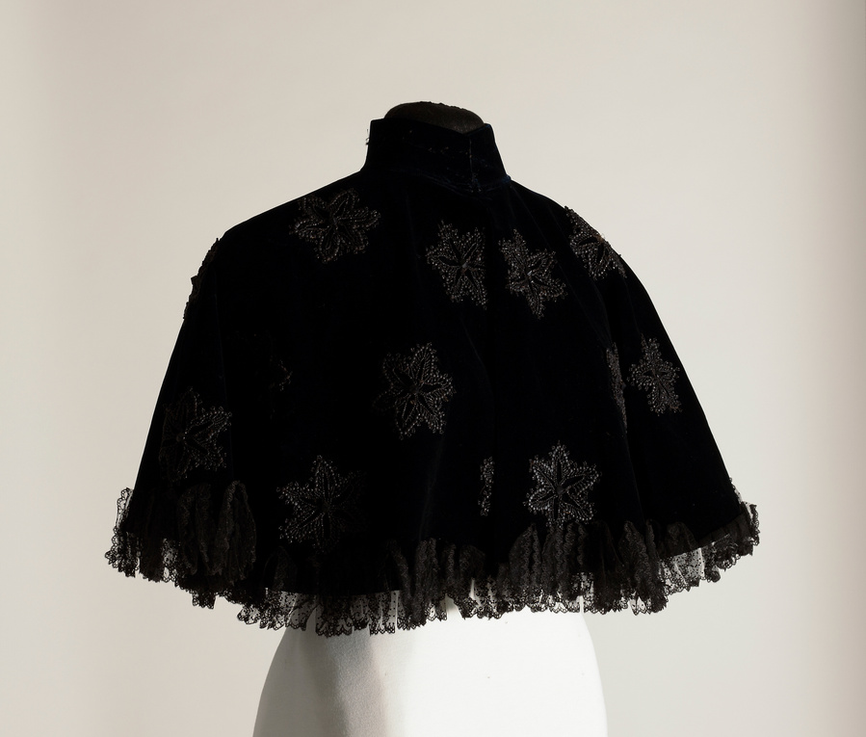
Accessories such as gloves, capes, and parasols were important to finishing the look of each outfit. Kid glove design, material and fit hinted at a woman’s status, and the best were custom-made, sized to the circumference of the woman’s palm. Modesty was important, and women wore tight-fitting gloves everywhere. During the day, long sleeves overlapped gloves of mid-forearm length in soft kid leather or cotton lisle. For evening events, silk or kid over-the-elbow gloves with 12 to 20 buttons allowed a woman to remain covered while wearing short-sleeved evening dresses. Grace Campbell wore these long, kid gloves for such occasions.
Northwest Museum of Arts & Culture
1824.5, 1890-1910 Grace Campbell white kid gloves
Grace Campbell’s husband, Amasa, passed away in 1912. Women of means such as Grace were expected to mourn for their husbands for up to two years. This mourning parasol was used as an accessory to Grace’s black mourning dresses. The black crepe found in the canopy identifies it unquestionably as part of mourning attire. Mrs. Campbell’s mourning parasol is similar to the Metropolitan Museum’s “good example of a mourning parasol for a highly fashionable woman.” High Victorian mourning practices had eased slightly by 1912, however, mourning etiquette was still quite elaborate. Mourning clothing were outward signs that a person had just lost a loved one. Acquaintances understood these mourning rituals and acted accordingly when meeting Mrs. Campbell. Although mourning clothing was somber, stylish individuals still wanted to dress in the latest fashions.
Gift of Mrs. W.C. Howe, 1961
Northwest Museum of Arts & Culture
3096.4, 1917, Grace Campbell Cape, gift of Mrs. Valarie Powell, 1985
Northwest Museum of Arts & Culture
3096.5, 1900-1924 Grace Campbell Mourning parasol, gift of Mrs. Valarie Powell, 1985

Slide 10
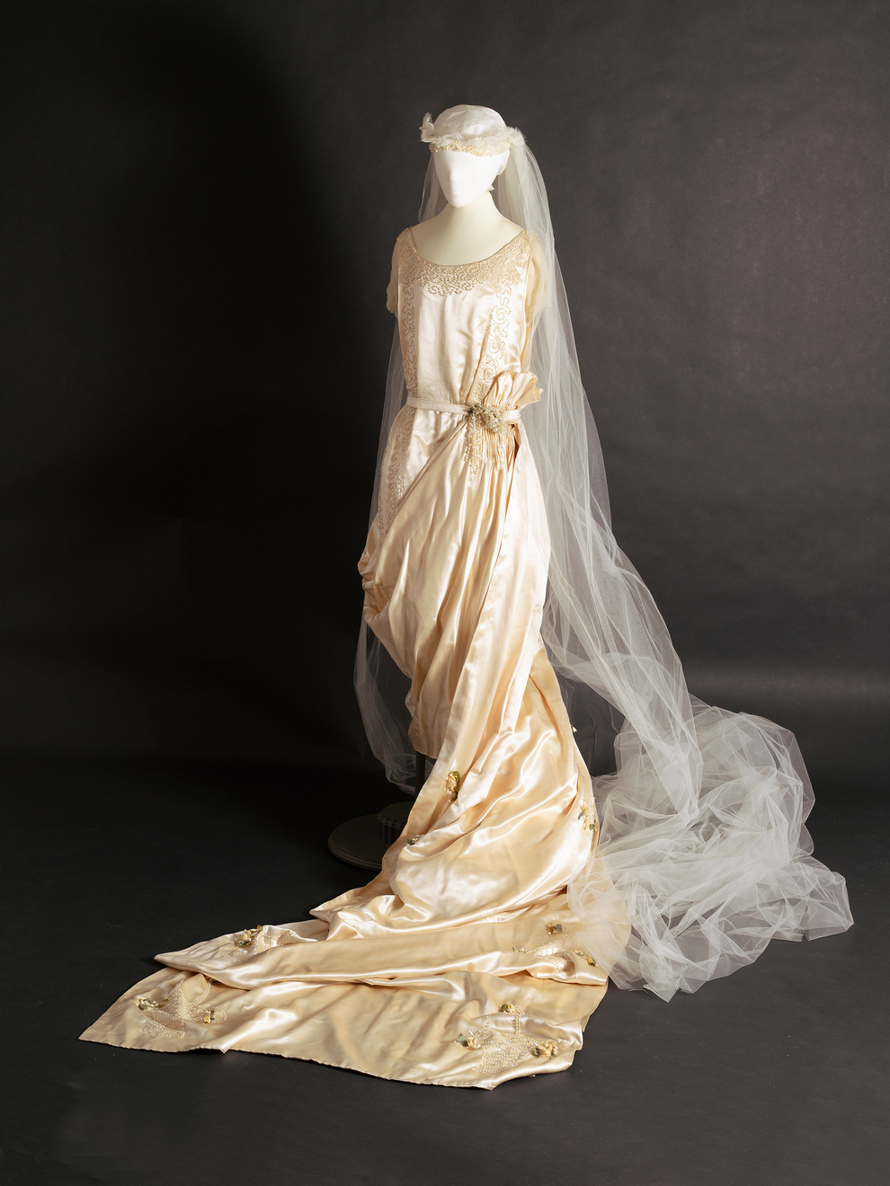
Mary White Gordon, Grace Campbell’s niece, recalled that a typical day in her aunt’s home was one of strictly observed schedules. She described her memory of how a day was spent when visiting Campbell House.
“A typical daily schedule for the family doesn’t seem a very busy one compared to what it would be today. There were always excellent servants that did everything. Breakfast was served rather formally like all other meals… Aunt Grace poured the coffee using the silver service and the maid passed whatever one had for breakfast. After that Aunt Grace went to the kitchen to talk to the cook and plan and order the meals for the day. She wrote it all down as that seemed to be the way houses were run as my mother [Maude White] did the same way. There was a telephone in the front hall to the stable where Joseph, the coachmen, was told when to bring the horses around and which carriage to use. If we children behaved ourselves we could go shopping too as Aunt Grace and my mother always seemed to go to the Crescent or Dodsons… We returned to the house for lunch about one o’clock which was a very complete meal and served formally as all the others. There was the afternoon “rest” for Aunt Grace and ladies always came during the afternoon for talking and informal visiting. Later everyone changed for dinner, not in formal dining clothes, but ladies always had pretty lacy dresses and always wore jewelry. Aunt Grace highly disapproved of liquor in any form so there was never the cocktail hour to liven the dinner which was long, served in courses.”
Northwest Museum of Arts & Culture
3513.1, 1920 Mary White Gordon wedding dress,
Mary White was married in this wedding gown in Campbell House in 1920.
Gift of Mary Gordon Mellor, 1990

Slide 11
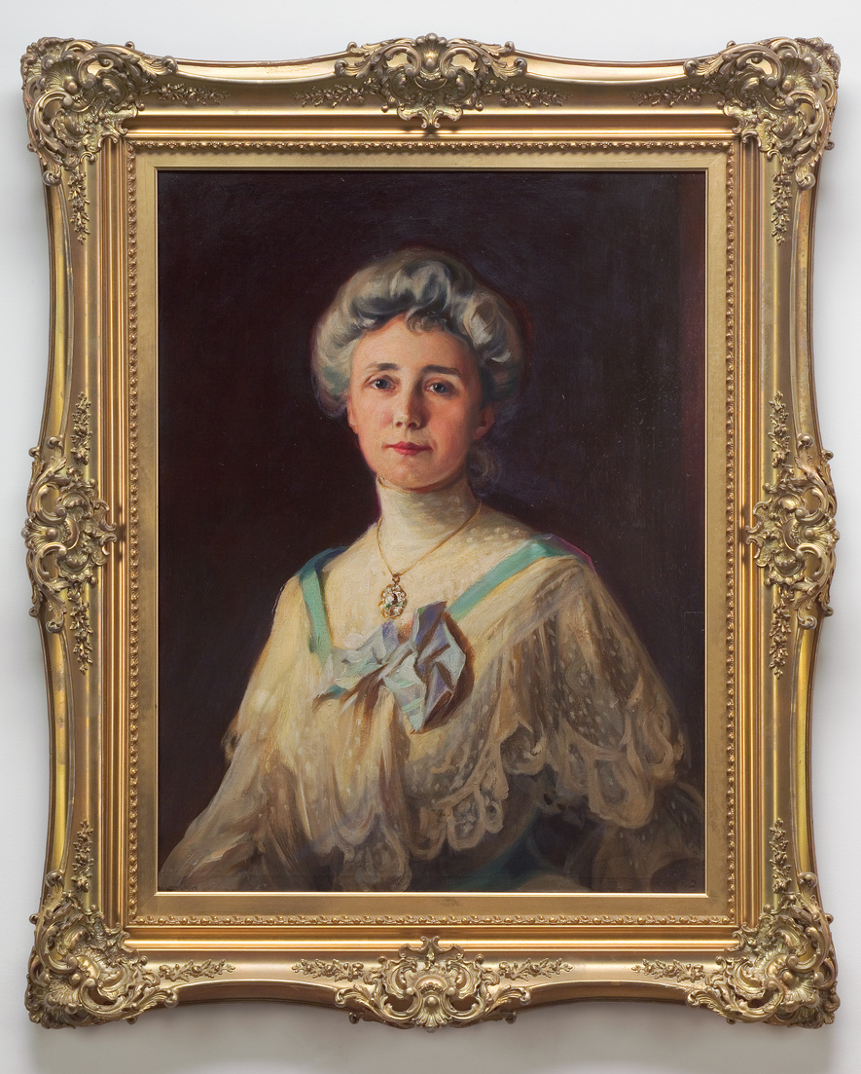
Studying Primary objects helps us learn about the world that the Campbell family lived in. Their clothing speaks to their wealth, their values, and the historical context in which they lived. Looking at their clothing helps us imagine what their lives were like when they occupied Campbell House.
Fashion is a form of non-verbal communication that informs the audience about the time period we are studying. Changes in fashion from one generation to the next reflect both individual expression and societal norms. Fashion for women between the 1890s and early 20th centuries enlighten us about the evolving culture, the advances in technology, and rapid changes in world events. At the height of Grace Campbell’s reign as a mother, society leader, and wife of a wealthy mine owner, dresses were opulent, restrictive, and a sign of her husband’s success.
By the time of Grace’s death in 1924, dresses had become shorter, less restrictive, and a symbol of women’s ability to vote, drive cars, and participate more actively in society. They reflected the world’s tragic experiences in World War I, the advent of electric appliances, airplanes, movies, and radios. These changes can be seen in how her daughter, Helen Campbell, presented herself to the world.
Northwest Museum of Arts & Culture 2485.2, 1904 Portrait of Grace Campbell
Fashion is a mirror that reflects the complex interplay between human identity, social structures, and historical contexts. We can see all of these aspects at play when studying Grace and Helen Campbell’s clothing and accessories.
Gift of Mrs. W.W. (Helen Campbell) Powell

Slide 12
Historians study objects, the material culture that people from the past left behind, in order to understand history. Objects are the products of human workmanship - of human thought and effort - objects tell something about the people who designed, made, and used them. What questions do historians ask themselves when they analyze objects?
  First impressions: What are your first impressions of this object? Do you have any ideas what the object might have been used for?
  A closer look at the physical features: What is it made of? Why was this material chosen? What is the texture and color? What does it smell like? Can it be held? Is it heavy or light? Is it intact, or does it look like parts are missing? Does it look new or old?
  Construction: Is it handmade or made by machine? Where was it made? Who made it?
  Function: How is this object used? Does it have a practical use or is (was) it used for pleasure? Has it been used? Is it still in use? Has the use changed? Where could it have been found? What value does it hold to you and to others?
  Design: Is it designed well? Is it decorated? How is it decorated? Is it aesthetically pleasing? Would it make a good gift? Does it remind you of anything else?
  Who may be connected with the object? What type of person might have used this object? What type of person might have made this object? What does this object tell us about the maker and user?
  Thinking further: Is this type of object still being made today? Is it still in use? If not, why do you think it isn’t used today? Should this object be in a museum collection? Why or why not? What questions do you have about the object that you can’t answer from just looking at it?

Slide 13
Photographs provide us with images of past events. Today, historians study the content and meaning of these visual images to locate information about a particular topic, time, or event. Photographs can convey countless details about life. For historians and for us, “A picture is worth a thousand words.” Photographers can manipulate, intentionally or unintentionally, the record of the event. It is the photographer – and the camera’s frame – that defines the picture’s content. Thus, the photographer chooses what will be in the picture, what will be left out, and what the emphasis will be. When analyzing photographs, ask yourself the following questions:
  Take a closer look: Make sure to examine the whole photograph. Make a list of any people in the photograph. What is happening?
  Looking more closely: Are there any captions? A date? Location? Names of people? What kind of clothing is worn? Are there any words on signs or buildings?
  Thinking Further: If people are in the photograph, what do you think is their relationship to one another? Can you speculate on a relationship between the people pictured and someone who is not in the picture?
  What do you think happened before and after the photo was taken? Who do you think took the photo and why?
  What does this photograph suggest to you? What questions do you have about the photo? How could you try to answer them?
  What is the one thing that you would remember most about this photograph and why?
  What questions do you have about the photograph that you cannot answer through analyzing it? Where could you go next to answer these questions?

