Slide 1

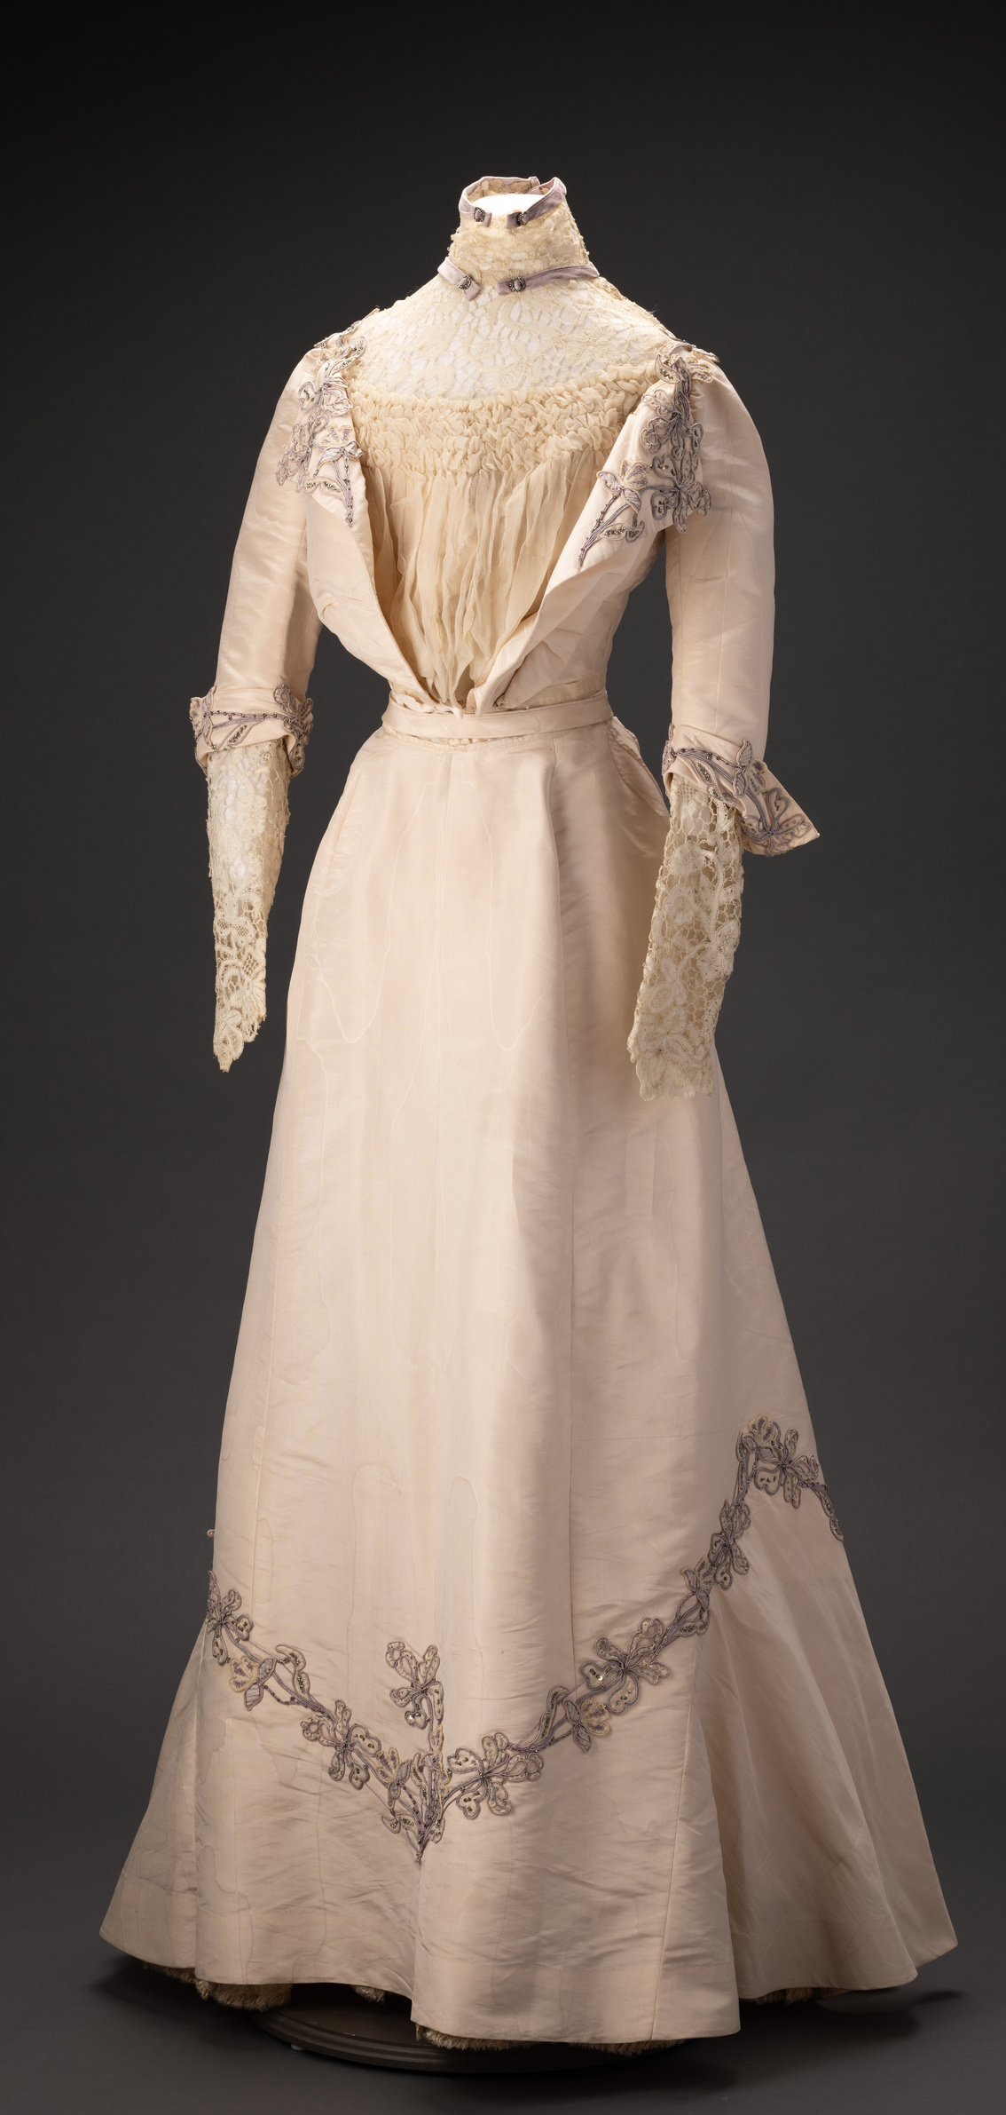

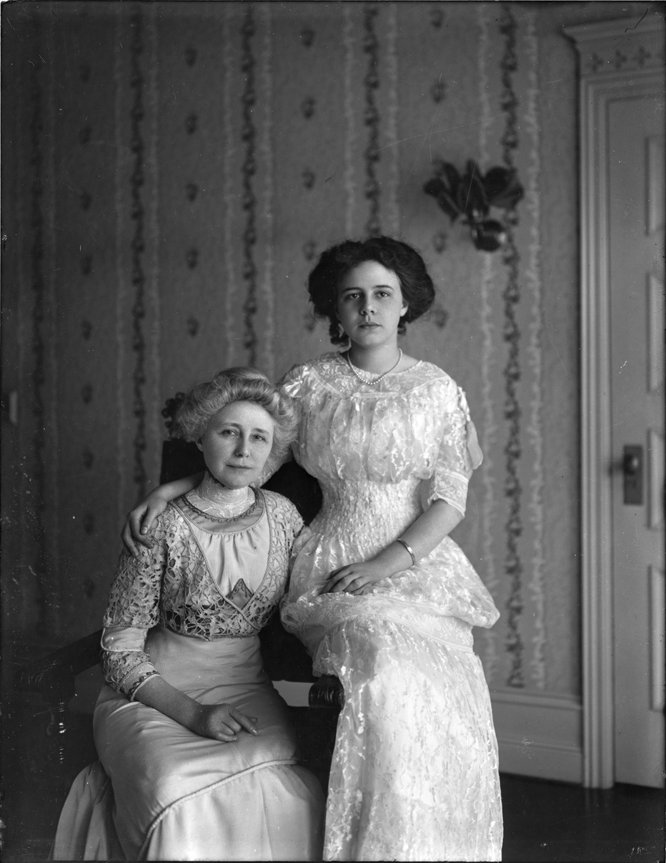

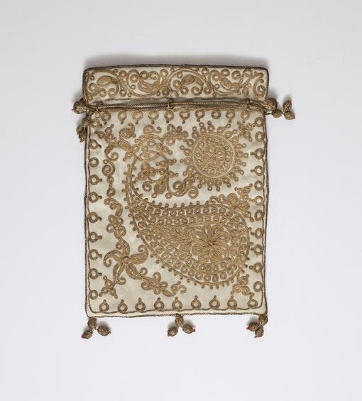


Campbell House
Fashion
1898-1924: Part One
Learning with primary sources at the MAC: Grace Campbell’s Clothing
Grace and Helen Campbell
The Joel E. Ferris Research Archives, Campbell House Collection, 1908, L91-119.3
Northwest Museum of Arts & Culture
784.21, Grace Campbell Evening Gown, 1900-1910
Gift of Mrs. Helen Campbell Powell, 1930
MAC Packs are Sponsored by
Northwest Museum of Arts and Culture
784.20, Helen Campbell purse,1890-1910, Gift of Helen Campbell Powell, 1930

Slide 2
TIMELINE
Helen Campbell
Trip to Egypt
Helen Campbell Diary
Grace Campbell Death
born 1892
1903
1913-1917
1924
Campbell House Built
1898
European Grand Tour Trip
Helen Campbell and Bill Powell Wedding
Amasa and Grace Campbell Marriage
1909-1910
1890
Amasa Campbell Death
1917
1912

Slide 3
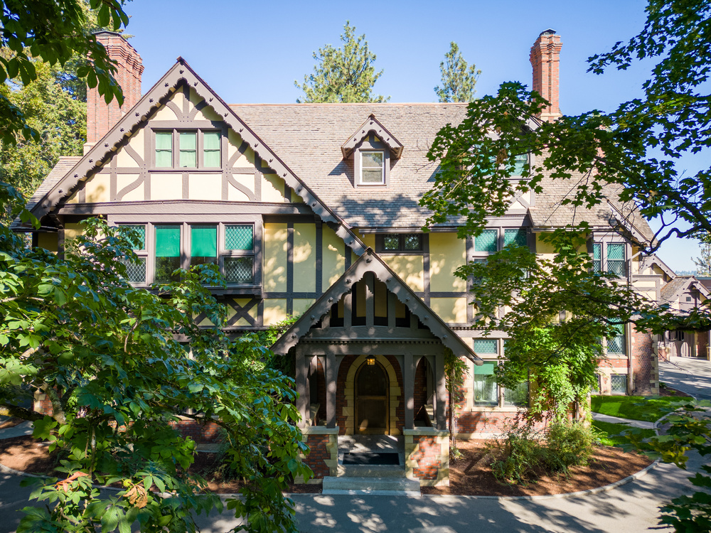
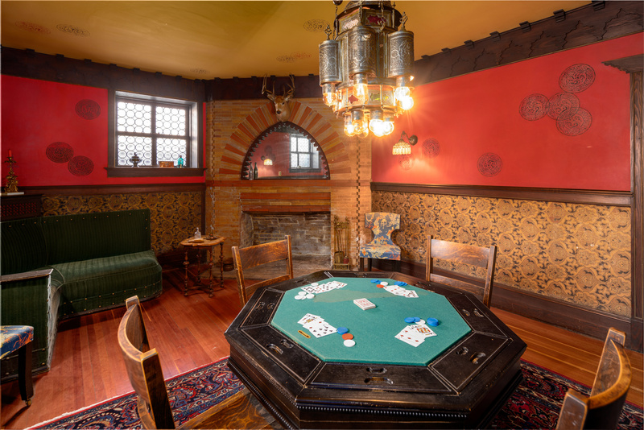
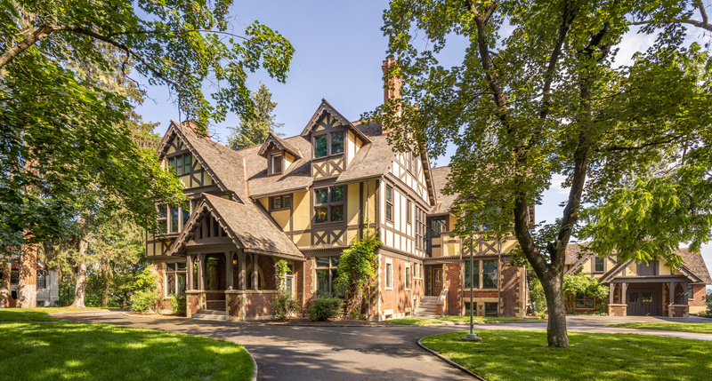
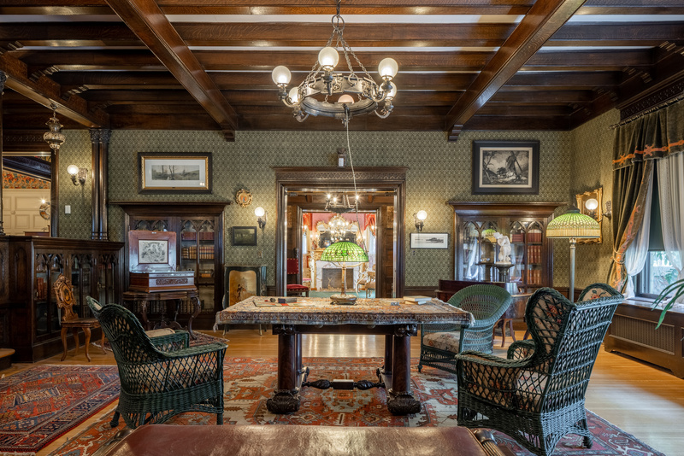

Campbell House, located on the campus of the Northwest Museum of Arts and Culture in Spokane’s Browne’s Addition, was built by Amasa and Grace Campbell in 1898.
In 1887, a group of Youngstown, Ohio investors sent Amasa B. Campbell (1845-1912) and associate John A. Finch to investigate the tales of Idaho's fabulous Coeur d'Alene Mining District. The partners quickly determined that there were fortunes to be made. They invested $25,000 in the Gem mine, built a mill to work the ore, and soon were earning thousands of dollars a month. His fortune assured, Campbell returned to Ohio to marry school teacher Grace Fox (1859-1924), and they moved to Wallace, Idaho, a raucous mining town that was a far cry from the sedate life of Youngstown.
The Campbell's daughter, Helen (1892-1964), was born in Spokane during the same year that labor and management conflicts erupted in the Coeur d'Alene Mining District. In 1898 Campbell and Finch moved their mining operations and their residency from Idaho to Spokane, which afforded greater security and more educational, social, and business opportunities.
The MAC has collected a vast number of primary sources including original furniture, clothing, photos, and oral histories that help us tell the story of early Spokane. In this Digital MAC Pack you will learn about the importance fashion played in the lives of wealthy Spokane families like the Campbells.
Mr. Campbell’s Den
Photo Credit: Dean Davis
Campbell House Exterior
Amasa and Grace Campbell hired architect Kirtland Cutter of Cutter and Malmgren, to design their home. Cutter specialized in the popular Arts and Crafts Revival architectural styles and the Campbells chose to build a Tudor Revival home. Following Grace Campbell’s death in 1924, Helen Campbell (then Mrs. W.W. Powell), gave the house to the Eastern Washington State Historical Society in memory of her mother.
Campbell House Library

Slide 4

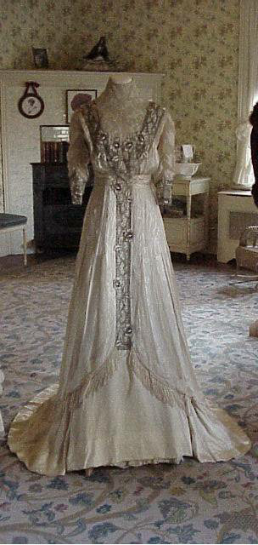
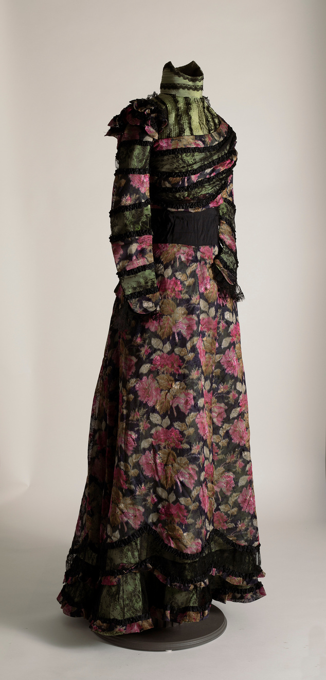
Grace Campbell’s clothing represented her family’s vast silver mining wealth and their place in Spokane society. Primary sources from the museum’s collections reveal that shopping was a frequent part of Grace and Helen Campbell’s weekly routine. Grace had a taste for elegant and fashionable dresses that she bought both in Spokane and in New York City. Across the country, women were copying the fashions worn by East Coast socialites such as Caroline Astor and her group of “The Four Hundred”. Grace was no exception to this trend.
Grace wrote checks to Spokane dressmakers such as May Stiffens-Jones and Mrs. J.M. Shaefer and jewelry stores such as Dodson’s. She and her daughter, Helen, traveled to New York City yearly to shop the latest fashions. Helen noted in her diary on Thursday, February 26th, 1914, during their New York City visit, “Took my skirt back to Hickson, then went to Meuller-Graves & found two pretty summer dresses. Mrs. Wadsworth & Vera were here. Went to "Peg O' My Heart" with Mr. Webber. Afterward got mother & went to supper. Quite nice.” Hickson and Company’s clothing store in New York was considered among the most fashionable retailers on Fifth Avenue in 1914.
Grace and Helen’s trips to New York could be quite expensive. During their 1915 winter trip to New York, Helen and Grace spent $3,380.99. According to the consumer price index, that trip was the equivalent of spending $108,878.59 in 2026!
Grace Fox Campbell was born February 2, 1859. She grew up in Youngstown, Ohio. After her marriage to Amasa Campbell in 1890, she moved first to Wallace, Idaho and then to Spokane, Washington, where she raised her daughter, Helen. Grace died in her home in 1924.

Slide 5
Grace Campbell and her peers were steeped in what we now refer to as the “Cult of Domesticity” or “Cult of True Womanhood” where gender roles were very rigid. Piety, purity, submissiveness, and domesticity were promoted as important virtues. Women were seen to have superior morals but were also considered weaker and more vulnerable. As a result, it was believed their roles should be kept to domestic activities. They were the keepers of the home. 19th-century women’s fashion magazine, Godey’s Lady Book, warned women against participating in politics and debates that were thought to be “injurious to their natures”. Grace would have been taught from childhood this was the proper role for women. Women’s clothing of the time reflected these cultural values.
A man, like Mr. Campbell, demonstrated his wealth and power by how his wife dressed. The dress “perpetuated an air of opulence” while the actual wardrobe showed an idle life. Dresses like these were elegant, but constricted movement. This Edwardian era green and pink silk dress with black lace trim was an example of the fashions Grace and her peers wore when entertaining in their home or attending a public function.
This dress was a symbol of Mrs. Campbell’s status as a wealthy Spokane socialite and emulates the belief in the “Cult of Domesticity”. The dress was constrictive, but beautiful. This is not a dress of an owner whose work would include house cleaning or manual labor. Unfortunately, we do not know where this dress was purchased or who created it. It could have been purchased in Spokane as the city had an array of dressmakers. Not only did the city have dressmakers, but it also contained retailers who imported silk from Asia. If this dress was made in Spokane, the dressmaker could have purchased silk from Spokane merchant, Sue Ah Yen. He moved to Spokane from China in the 1870s and set up a store that imported silk from China to be sold to Spokane residents.
Northwest Museum of Arts & Culture
3965.3 Grace Campbell Silk Dress,
1895-1915
Gift of Mrs. Helen Campbell Powell, 1930

Slide 6
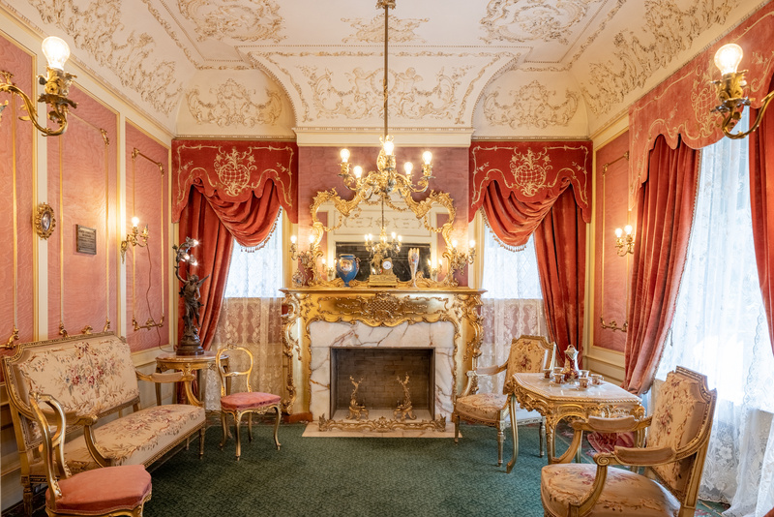
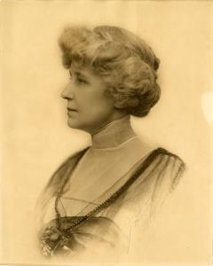
In 1905 or 1906, Grace Campbell contracted Spokane dressmaker and “ladies’ tailor”, May Steffins, to custom-make this two-piece dress of white Moire silk with lavender trim.
As a lady of means and fashion, Grace’s dresses retained many late Victorian features such as high collars, tight sleeves, corseted waists, and wide skirts. This dress was worn to greet guests during formal occasions such as reception days in the Campbell House’s uncomfortable, but beautiful, French Rococo reception room pictured to the right.
Browne’s Addition neighborhood receiving days were on Thursdays and were marked by strict etiquette rules that could be found in Spokane’s Blue Book. The Blue Book was exclusively used by Spokane’s socialites to learn the agreed upon etiquette rules and other information about their peers, such as when reception days for each neighborhood occurred. Grace wore this dress to welcome her guests into her home during these days.
Campbell House Reception Room.
Photo Credit: Dean Davis
Grace Campbell, The Joel E. Ferris Research Archives, Campbell House Collection, 1914, L84-187
The 1909 Spokane Blue Book Rules of Etiquette stated, “A caller should greet his host on first entering the drawing room before speaking to other guests. Formal calls should not exceed fifteen minutes. The hostess should rise and offer her hand to the caller. When they leave, she accompanies them to the parlor door.” Wearing this dress during Reception Days projected Grace’s wealth and her understanding of the social etiquette rules that governed Spokane’s elite society. You can imagine her wearing this dress while rising and offering her hand in greeting to her guest.
Northwest Museum of Arts & Culture
784.21 Grace Campbell Evening Gown,
1900-1906
Gift of Mrs. Helen Campbell Powell, 1930

Slide 7
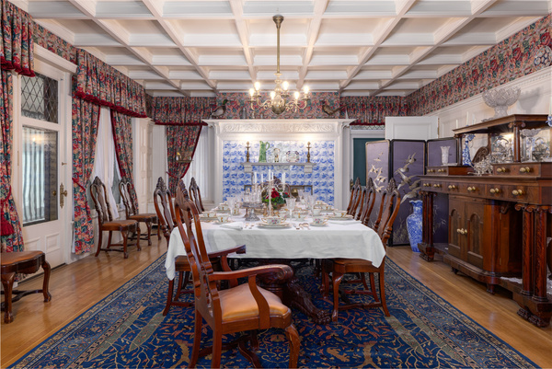
An unidentified dressmaker custom-made this evening gown of ecru silk fabric with beaded, woven silk flowers, and bugle bead trim for Grace Campbell c1900-1910. Imagine a dinner party at the home of Grace and Amasa Campbell in which Grace wears this gown while entertaining her guests. The elegant Campbell home and festive dinner parties were crucial props in convincing potential shareholders to invest in Amasa Campbell’s various business ventures. Grace’s dresses were an essential means of creating an aura of success and elegance.
Did all women of Grace’s generation buy into the “Cult of True Womanhood”? Not completely. Many women worked to support their families or themselves. There was also a growing suffrage movement. Grace Campbell did embrace the role of mother, society woman, and keeper of the home. However, she also espoused many of the ideals of the early 20th-century Progressive movement.
Before marrying Amasa at the age of 32 and as a sign of her independence, Grace had a career as a schoolteacher. Once married, her role as a wife was defined by societal norms. However, that role included managing a large home with a staff of servants that was akin to running a small business. She organized social events that promoted her husband’s growing mining corporation. She supported popular Progressive era movements such as the Temperance movement. She financed various Spokane charities like the Washington Children’s Home Society. Both causes were visible signs of her support for societal reforms.
Campbell House Dining room
Photo Credit: Dean Davis
Northwest Museum of Arts & Culture
784.23 Grace Campbell Evening Gown,
1900-1910
While we are unsure if Grace voted after Washington women secured the right to vote in 1910, we know she attended a reception in 1916 for Harriet Stanton Blatch, daughter of suffragist Elizabeth Cady Stanton, and her Congressional Union for Woman’s Suffrage, when they visited Spokane. The reception was held at the home of Mrs. Turner, wife to Washington Senator, George Turner. The right to vote was a signal that women, such as Grace, felt they had a role in the political society of America, not only a place in the home.
Gift of Mrs. Helen Campbell Powell, 1930

Slide 8
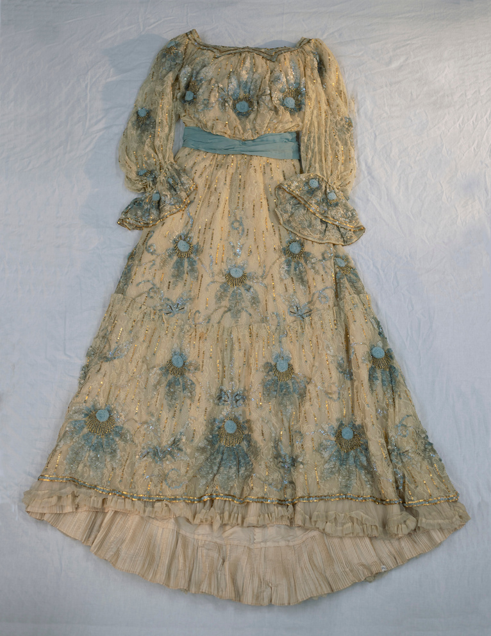
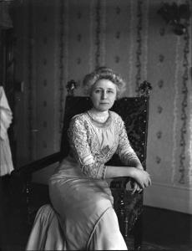
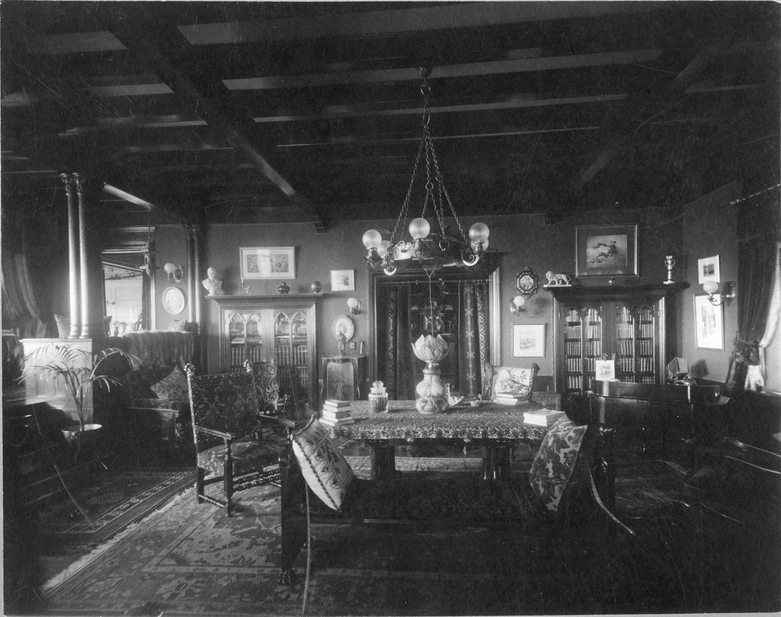
Northwest Museum of Arts & Culture, 3096.3 Grace Campbell blue flower dress, 1900-1915
Gift of Valarie Powell, 1985
This lace overdress with satin lining, square neckline, and full sleeves is decorated with blue flowers; sequins of ivory, blue, and gold; and gold beads. It is made of taffeta with a lace cover. While traveling to New York City, Grace bought this custom-made gown from Hickson and Company, which was described as "the most elegant and expensive specialty shop on Fifth Avenue”.
Fashion for women in the first decade of the twentieth century largely did not change much from the previous century. However, in a nod to comfort, “Health” corsets that pushed the bust forward and the hips back helping to avoid pressure on the abdomen gained popularity. Day dresses emphasized modesty and could be trimmed and accessorized for evening wear. Skirts were bell-shaped and lace was a popular decoration.
Grace Campbell, The Joel E. Ferris Research Archives, Campbell House Collection, 1910-1920, L91-119.8
Rich fabrics were used and colors were light and embellished with decorations. Editor Kathryn Hennessy writes in Fashion: The Ultimate Book of Fashion and Style, “Sumptuous fabrics such as silk, satin, damask, and chiffon, usually in light, soft colors, were decorated with lace, rhinestones, and spangles, often highlighting a part of the body or the face”. Grace Campbell’s blue flower dress matched the prevailing look popular between 1900-1910 of a mature, sophisticated, and refined woman.
Campbell House Library, Joel E. Ferris Research Archives, Campbell House Collection, 1910, L91-120.29

Slide 9
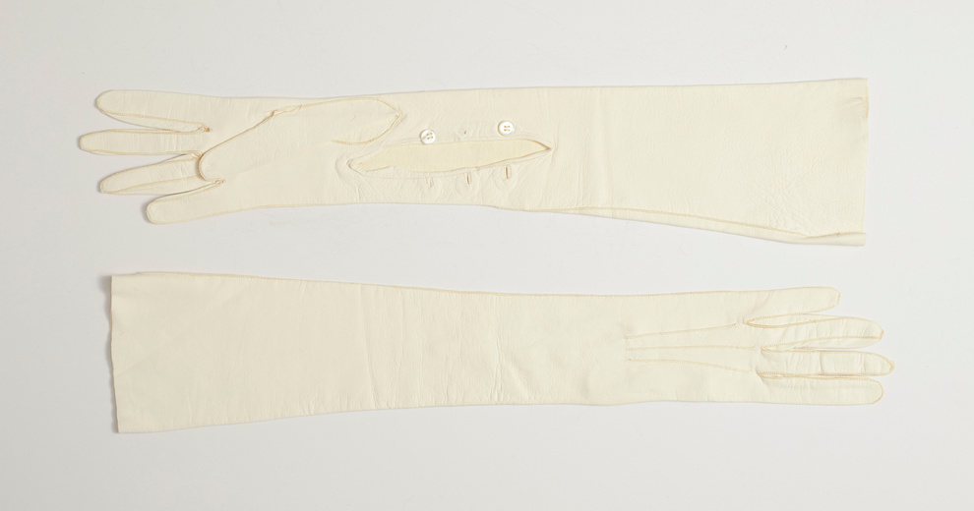
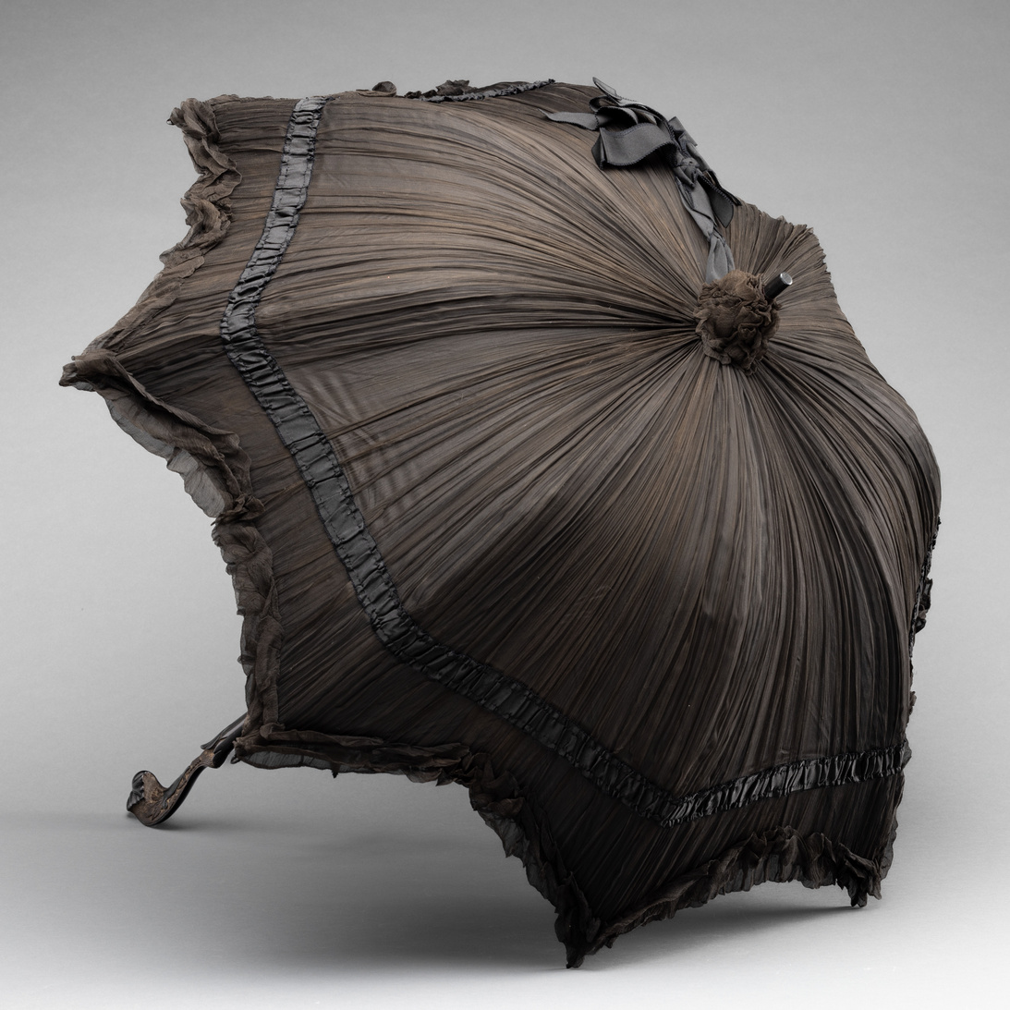
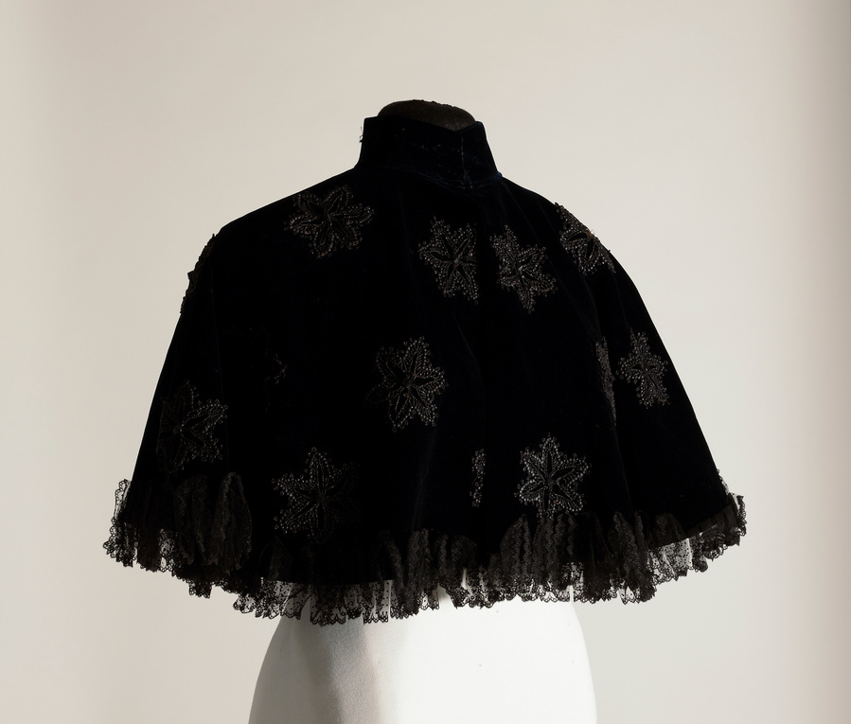
Accessories such as gloves, capes, and parasols were important to finishing the look of each outfit. Kid glove design, material, and fit, hinted at a woman’s status. The best was custom-made and sized to the circumference of the woman’s palm. Modesty was important, and women wore tight-fitting gloves everywhere. During the day, long sleeves overlapped gloves of mid-forearm length in soft kid leather or cotton lisle. For evening events, silk or kid over-the-elbow gloves with 12 to 20 buttons allowed a woman to remain covered while wearing short-sleeved evening dresses. Grace Campbell wore these long, kid gloves for such occasions.
Northwest Museum of Arts & Culture
1824.5, 1890-1910 Grace Campbell white kid gloves
Grace Campbell’s husband, Amasa, passed away in 1912. Women of means such as Grace were expected to mourn for their husbands for up to two years. This mourning parasol was used as an accessory to Grace’s black mourning dresses. The black crepe found in the canopy identifies it unquestionably as part of mourning attire. Mrs. Campbell’s mourning parasol is similar to the Metropolitan Museum’s “good example of a mourning parasol for a highly fashionable woman.” High Victorian mourning practices had eased slightly by 1912, however, mourning etiquette was still quite elaborate. Mourning clothing were outward signs that a person had just lost a loved one. Acquaintances understood these mourning rituals and acted accordingly when meeting a person in mourning. Although mourning clothing was somber, stylish individuals still wanted to dress in the latest fashions.
Gift of Mrs. W.C. Howe, 1961
Northwest Museum of Arts & Culture
3096.4, 1917, Grace Campbell Cape, gift of Mrs. Valarie Powell, 1985
Northwest Museum of Arts & Culture
3096.5, 1900-1924 Grace Campbell Mourning parasol, gift of Mrs. Valarie Powell, 1985

Slide 10
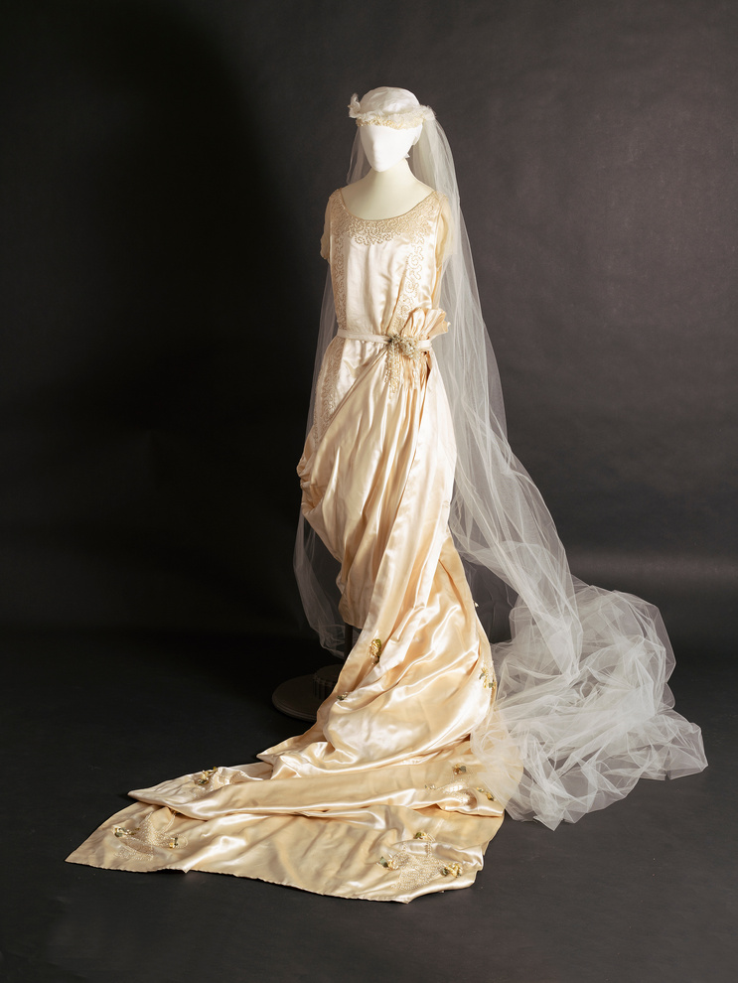
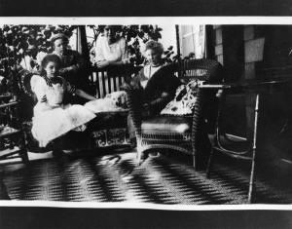
Mary White Gordon, Grace Campbell’s niece, recalled that a typical day in her aunt’s home was one of strictly observed schedules. She described her memory of how a day was spent when visiting her family.
Mary White was married in this wedding gown in Campbell House in 1920.
“A typical daily schedule for the family doesn’t seem a very busy one compared to what it would be today. There were always excellent servants that did everything. Breakfast was served rather formally like all other meals… Aunt Grace poured the coffee using the silver service and the maid passed whatever one had for breakfast. After that Aunt Grace went to the kitchen to talk to the cook and plan and order the meals for the day. She wrote it all down as that seemed to be the way houses were run as my mother [Maude White] did the same way. There was a telephone in the front hall to the stable where Joseph, the coachmen, was told when to bring the horses around and which carriage to use. If we children behaved ourselves, we could go shopping too as Aunt Grace and my mother always seemed to go to the Crescent [department store] or Dodson’s [jewelry store]… We returned to the house for lunch about one o’clock which was a very complete meal and served formally as all the others. There was the afternoon “rest” for Aunt Grace and ladies always came during the afternoon for talking and informal visiting. Later everyone changed for dinner, not in formal dining clothes, but ladies always had pretty lacy dresses and always wore jewelry. Aunt Grace highly disapproved of liquor in any form so there was never the cocktail hour to liven the dinner, which was long, served in courses.”
Mary White’s memory of a typical day included shopping for clothes and jewelry, and dressing for all occasions including dinner at home. Between that core memory and Helen Campbell’s diary, we can be certain that clothing played an important role in the lives of the Campbell women.
Northwest Museum of Arts & Culture
3513.1, 1920 Mary White Gordon wedding dress,
Gift of Mary Gordon Mellor, 1990
Mary, Helen, and Grace on the Campbell House veranda, The Joel E. Ferris Research Archives, Campbell House Collection, 1908, L91-162.84

Slide 11
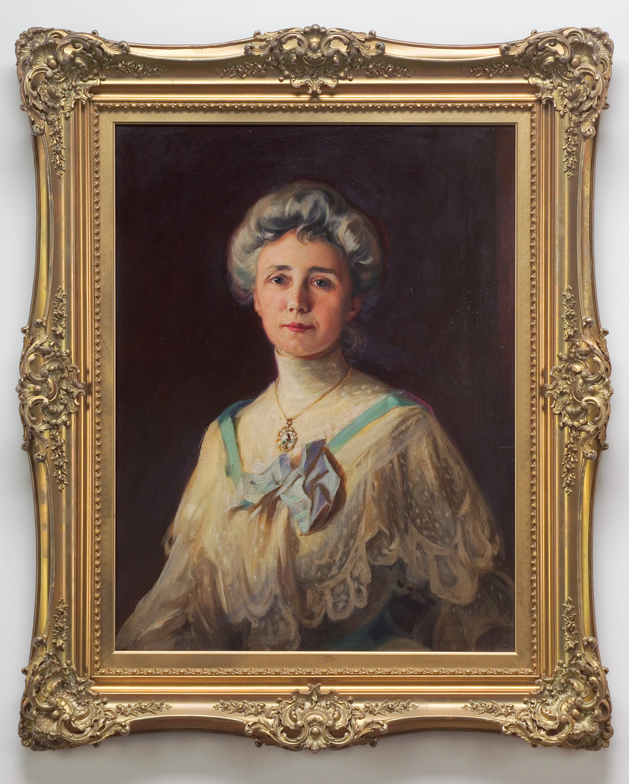
Studying Primary objects helps us learn about the world that the Campbell family lived in. Their clothing speaks to their wealth, their values, and the historical context in which they lived. Looking at their clothing helps us imagine what their lives were like when they occupied Campbell House.
Fashion is a form of non-verbal communication that informs the audience about the time period we are studying. Changes in fashion from one generation to the next reflect both individual expression and societal norms. Fashion for women between the 1890s and early 20th centuries enlighten us about the evolving culture, the advances in technology, and rapid changes in world events. At the height of Grace Campbell’s reign as a mother, society leader, and wife of a wealthy mine owner, dresses were opulent, constrictive, and a symbol of her husband’s success.
By the time of Grace’s death in 1924, dresses had become shorter, less restrictive, and a symbol of women’s ability to vote, drive cars, and participate more actively in society. They reflected the world’s tragic experiences in World War I, the advent of electric appliances, airplanes, movies, and radios. These changes can be seen in how her daughter, Helen Campbell, presented herself to the world (See Campbell House Fashion Part Two).
Fashion is a mirror that reflects the complex interplay between human identity, social structures, and historical contexts. We can see all of these aspects at play when studying Grace’s clothing and accessories. Grace’s clothing reflected her wealth and social standing, and her role as a mother and keeper of the home. Towards the end of her life, her clothing became less constrictive than it had been when she was a young woman. For a time, her clothing also showed her shift from being a wife to becoming a widow.
Northwest Museum of Arts & Culture 2485.2, 1904 Portrait of Grace Campbell
Gift of Mrs. W.W. (Helen Campbell) Powell

Slide 12
Historians study objects, the material culture that people from the past left behind, in order to understand history. Objects are the products of human workmanship - of human thought and effort - objects tell something about the people who designed, made, and used them. What questions do historians ask themselves when they analyze objects?
  First impressions: What are your first impressions of this object? Do you have any ideas what the object might have been used for?
  A closer look at the physical features: What is it made of? Why was this material chosen? What is the texture and color? What does it smell like? Can it be held? Is it heavy or light? Is it intact, or does it look like parts are missing? Does it look new or old?
  Construction: Is it handmade or made by machine? Where was it made? Who made it?
  Function: How is this object used? Does it have a practical use or is (was) it used for pleasure? Has it been used? Is it still in use? Has the use changed? Where could it have been found? What value does it hold to you and to others?
  Design: Is it designed well? Is it decorated? How is it decorated? Is it aesthetically pleasing? Would it make a good gift? Does it remind you of anything else?
  Who may be connected with the object? What type of person might have used this object? What type of person might have made this object? What does this object tell us about the maker and user?
  Thinking further: Is this type of object still being made today? Is it still in use? If not, why do you think it isn’t used today? Should this object be in a museum collection? Why or why not? What questions do you have about the object that you can’t answer from just looking at it?

Slide 13
Photographs provide us with images of past events. Today, historians study the content and meaning of these visual images to locate information about a particular topic, time, or event. Photographs can convey countless details about life. For historians and for us, “A picture is worth a thousand words.” Photographers can manipulate, intentionally or unintentionally, the record of the event. It is the photographer – and the camera’s frame – that defines the picture’s content. Thus, the photographer chooses what will be in the picture, what will be left out, and what the emphasis will be. When analyzing photographs, ask yourself the following questions:
  Take a closer look: Make sure to examine the whole photograph. Make a list of any people in the photograph. What is happening?
  Looking more closely: Are there any captions? A date? Location? Names of people? What kind of clothing is worn? Are there any words on signs or buildings?
  Thinking Further: If people are in the photograph, what do you think is their relationship to one another? Can you speculate on a relationship between the people pictured and someone who is not in the picture?
  What do you think happened before and after the photo was taken? Who do you think took the photo and why?
  What does this photograph suggest to you? What questions do you have about the photo? How could you try to answer them?
  What is the one thing that you would remember most about this photograph and why?
  What questions do you have about the photograph that you cannot answer through analyzing it? Where could you go next to answer these questions?

