Slide 1

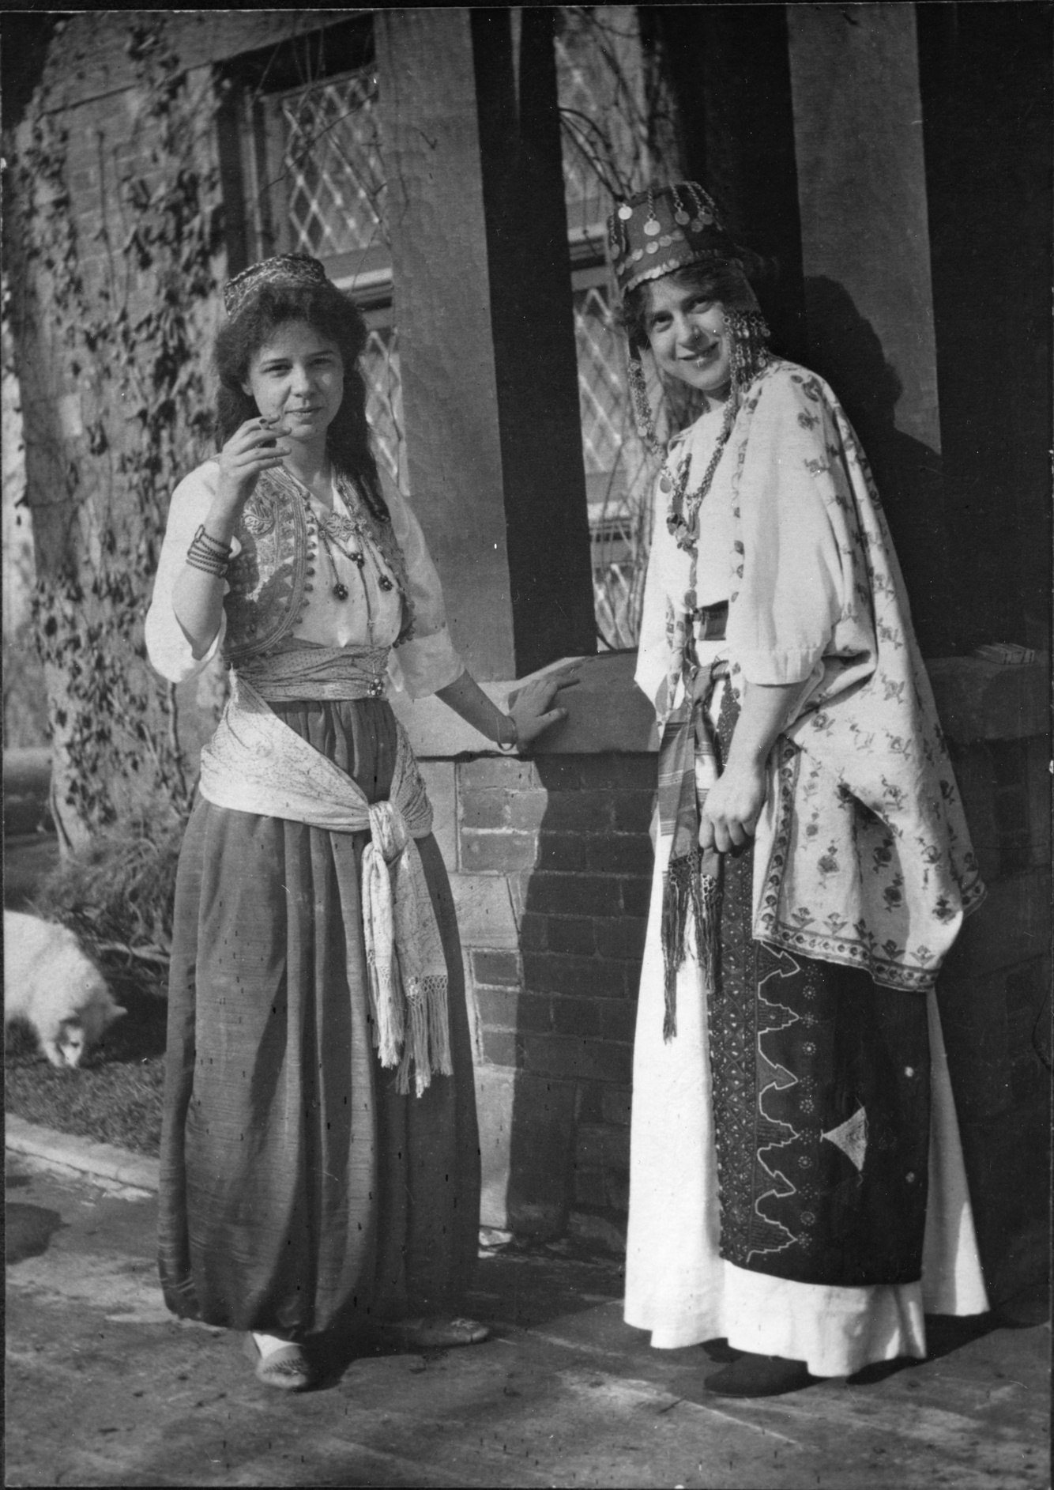




Campbell House
Fashion
1898-1924: Part Two
Learning with primary sources at the MAC: Helen Campbell’s Clothing
MAC Packs are Sponsored by
Helen Campbell and cousin, Hazel Lease, dressed in costumes probably purchased in Egypt in 1903
The Joel E. Ferris Research Archives, Campbell House Collection, 1910, L90-272

Slide 2
TIMELINE
Helen Campbell
Trip to Egypt
Helen Campbell Diary
Grace Campbell Death
born 1892
1903
1913-1917
1924
Campbell House Built
1898
European Grand Tour Trip
Helen Campbell and Bill Powell Wedding
Amasa and Grace Campbell Marriage
1909-1910
1890
Amasa Campbell Death
1917
1912

Slide 3
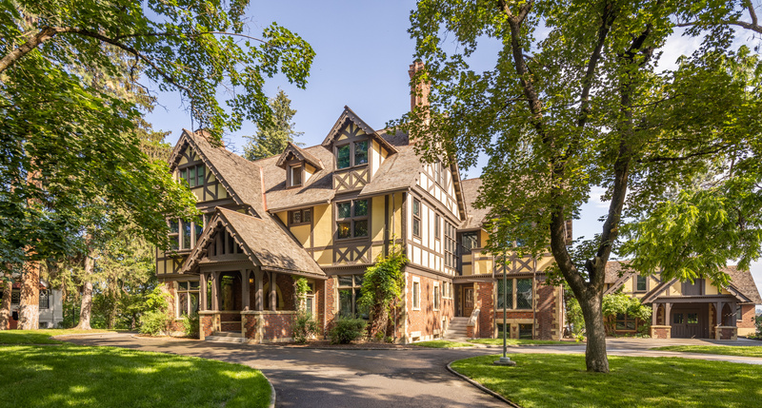
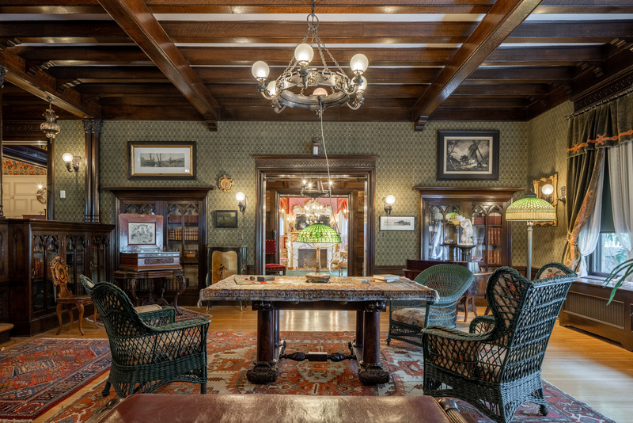
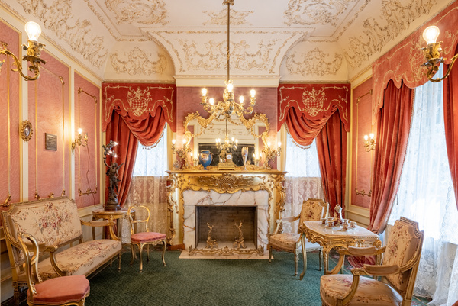

Campbell House, located on the campus of the Northwest Museum of Arts and Culture in Spokane’s Browne’s Addition, was built by Amasa and Grace Campbell in 1898.
In 1887, a group of Youngstown, Ohio investors sent Amasa B. Campbell (1845-1912) and associate John A. Finch to investigate the tales of Idaho's fabulous Coeur d'Alene Mining District. The partners quickly determined that there were fortunes to be made. They invested $25,000 in the Gem mine, built a mill to work the ore, and soon were earning thousands of dollars a month. His fortune assured, Campbell returned to Ohio to marry schoolteacher Grace Fox (1859-1924), and they moved to Wallace, Idaho, a raucous mining town that was a far cry from the sedate life of Youngstown.
The Campbell's daughter, Helen (1892-1964), was born in Spokane during the same year that labor and management conflicts erupted in the Coeur d'Alene Mining District. In 1898 Campbell and Finch moved their mining operations and their residency from Idaho to Spokane, which afforded greater security and more educational, social, and business opportunities.
The MAC has collected a vast number of primary sources including original furniture, clothing, photos, and oral histories that help us tell the story of early Spokane. In this Digital MAC Pack you will learn about the importance fashion played in the lives of wealthy families like the Campbells.
Campbell House as it looks now.
Photo Credit: Dean Davis
Helen Campbell was born in 1892 when the Campbell family was living in Wallace, Idaho. In 1898, when Helen was six years old, the family moved into their home in Browne’s Addition. Helen grew up in that home living there until after her marriage to Bill Powell in 1917. Helen donated Campbell House in 1924 to serve as the Grace Campbell Memorial Museum, now called the Northwest Museum of Arts and Culture.

Slide 4
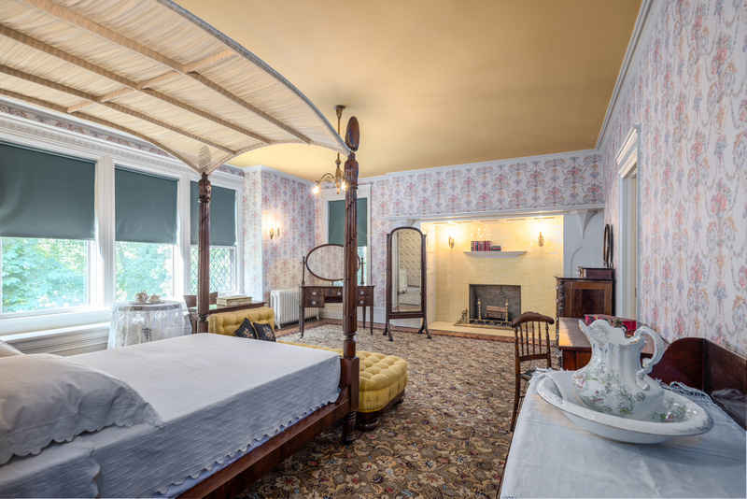
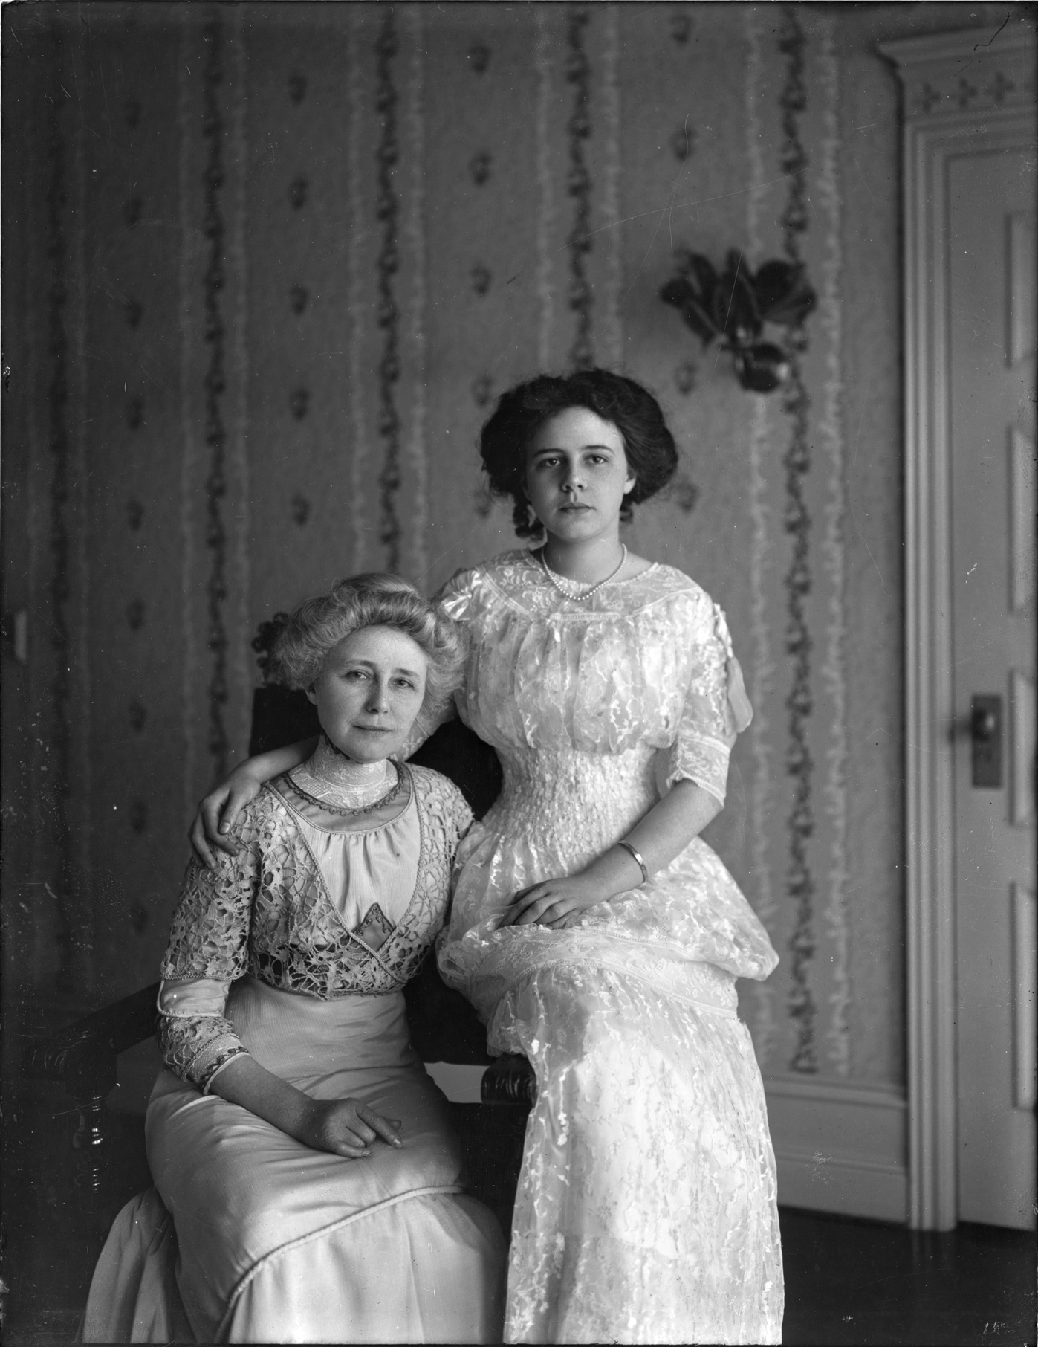
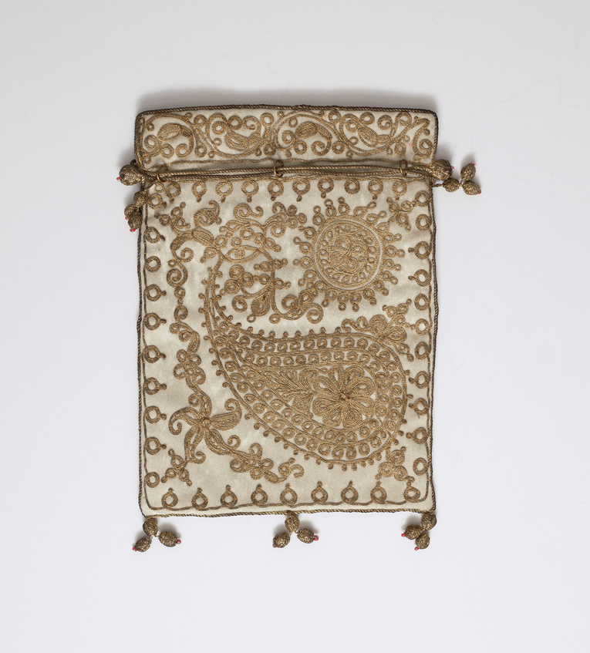
Helen Campbell’s clothing represented her family’s vast silver mining wealth and their place in Spokane society. Primary sources from the MAC’s Campbell Family collection reveal that shopping was a frequent part of Helen and her mother, Grace Campbell’s, weekly routine. Their clothing in the MAC’s collection attests to their taste in elegant and fashionable dresses.
Grace wrote checks to Spokane dressmakers such as May Stiffens-Jones and Mrs. J.M. Shaefer and jewelry stores such as Dodson’s. Grace and Helen traveled yearly to New York City to shop the latest fashions. Helen noted in her diary on Thursday, February 26th, 1914, during their New York City visit, “Took my skirt back to Hickson, then went to Meuller-Graves & found two pretty summer dresses. Mrs. Wadsworth & Vera were here. Went to "Peg O' My Heart" with Mr. Webber. Afterward got mother & went to supper. Quite nice.” The family frequently shopped at Hickson and Company’s clothing store in New York which was considered among the most fashionable retailers in 1914.
Grace and Helen’s trips to New York could be quite expensive. During their 1915 winter trip, Helen and Grace spent $3,380.99. According to the consumer price index in 2026, that trip was the equivalent of spending $108,878.59! The MAC has several dresses owned by Helen and her mother that were bought at Hickson's and Company and worn while residing in Campbell House.
Campbell House Guest Bedroom where this photo of Grace and Helen was taken in 1908.
Photo Credit: Dean Davis
Northwest Museum of Arts and Culture, 784.20,Flat draw string purse,1890-1910, Gift of Helen Campbell Powell, 1930
Grace and Helen Campbell, The Joel E. Ferris Research Archives, Campbell House Collection, 1908, L91.119.3

Slide 5
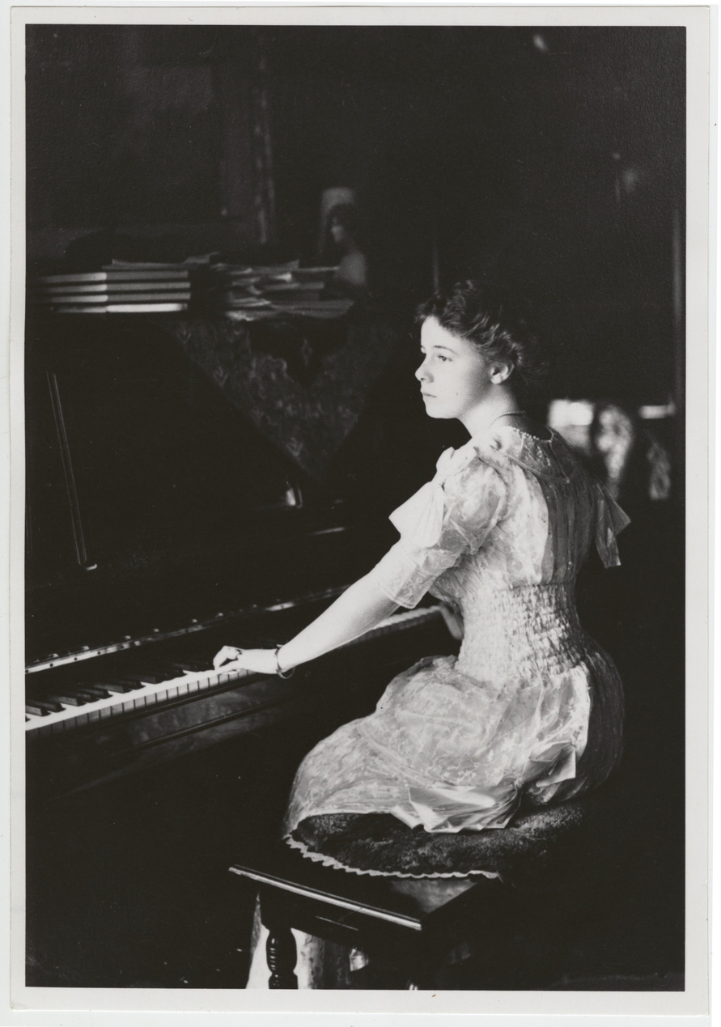
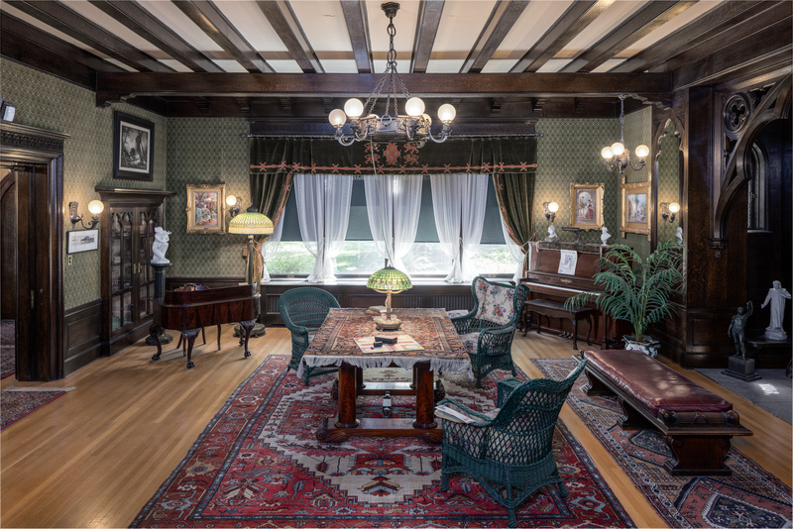
In Campbell House, Making of a Landmark, retired MAC History Curator, Marsha Rooney, noted that “Young women of Helen’s generation came of age in a very different culture than that of their parents. Modern America brought new technologies like moving pictures and automobiles; new freedoms in dance, hairstyles, and hemline; active recreation, especially golf, tennis, and camping; and new responsibilities, like women’s suffrage. There were also new worries, as a world war loomed. As a young woman of means, Helen would not need to earn a living. Instead, she was expected to perfect traditional social graces, like reading and conversation, music and arts, language lessons, decorative hand sewing, social hostess skills, and choosing appropriate dress and jewelry.” The clothing styles worn by Helen Campbell reflected those changing technologies, social mores, and world events.
Campbell House Library as it looks now. Photo on the right is Helen playing the piano in the Library. Photo Credit: Dean Davis
Helen Campbell, The Joel E. Ferris Research Archives, Campbell House Collection, 1906, L91.119.1

Slide 6
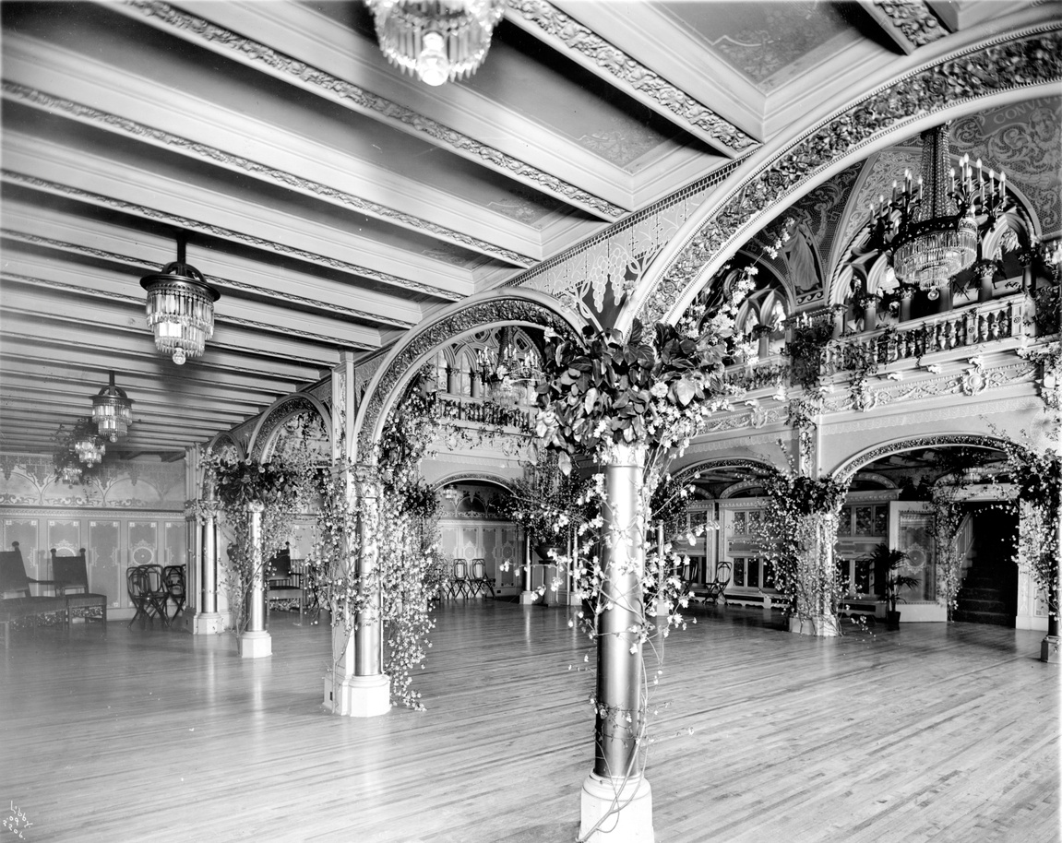
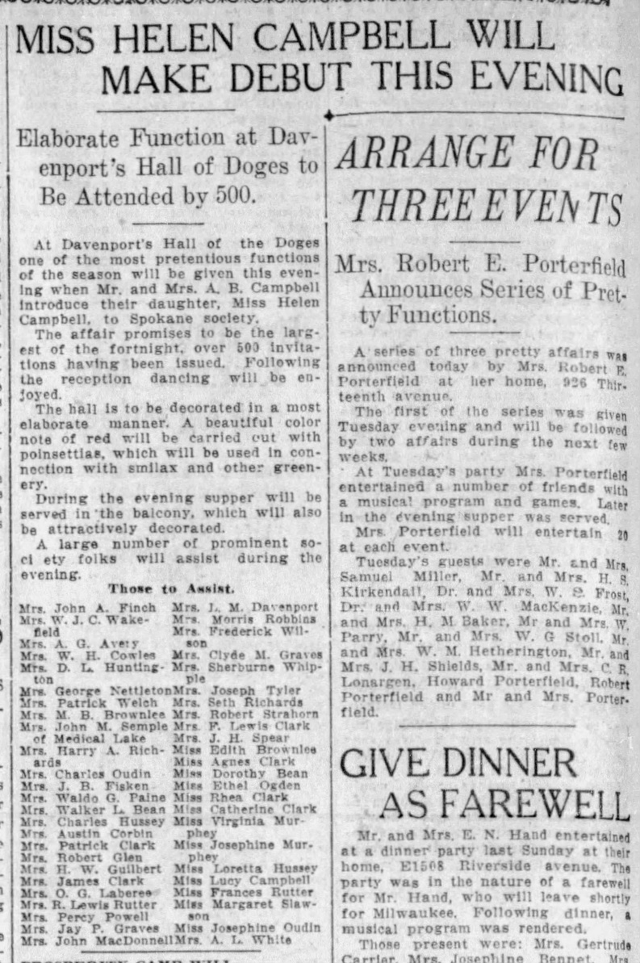
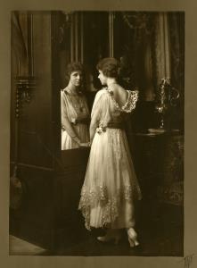
The December 6, 1911, Spokane Chronicle’s society page headline announced, “Miss Helen Campbell Will Make Debut This Evening: Elaborate Function at Davenport’s Hall of Doges to Be Attended by 500”. Helen was presented to Spokane’s elite society, and an elegant debutante dress was chosen that proclaimed her new status as an eligible, unmarried, Spokane socialite.
“At Davenport’s Hall of the Doges one of the most pretentious functions of the season will be given this evening when Mr. and Mrs. A.B. Campbell introduce their daughter, Miss Helen Campbell, to Spokane society. The affair promises to be the largest of the fortnight, over 500 invitations having been issued. Following the reception dancing will be enjoyed.”
For wealthy families like the Campbells, a debutante ball served as the first public opportunity to present their daughters to society. It was an event that both showed off their wealth and their connections within the city’s elite families. It served as an announcement that their daughter was eligible for a proper marriage to a wealthy young man. The dress she wore to the event was a reflection of her family’s wealth and social standing. The photo to the right was taken the same year as Helen’s debut into society. While we do not know for sure, this photograph of Helen may have been the dress she wore to the ball.
Spokane Chronicle, Spokane WA, Wed. December 6, 1911
Hall of Doges, The Joel E. Ferris Research Archives, 1909, L87-1.2206-09, Libby Collection. This is where he debut party was held at the Davenport.
The Joel E. Ferris Research Archives, Helen Campbell, 1911, L91-118.13, Campbell House Collection, This was taken the same year as Helen’s “Debut” into Spokane’s society.

Slide 7
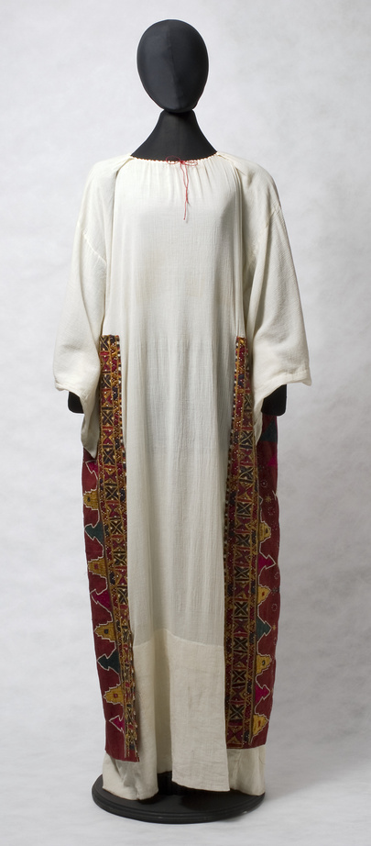
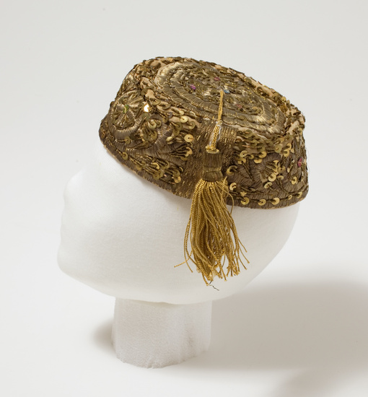
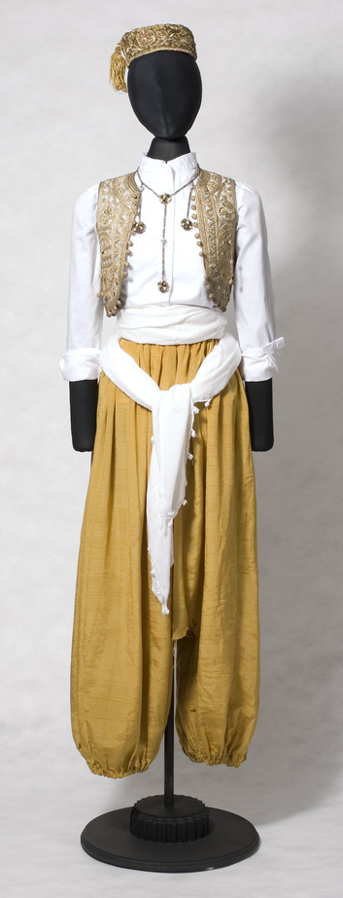
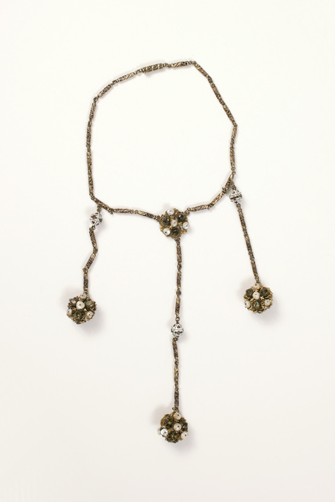
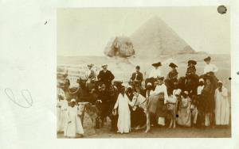
The Campbell family traveled to Egypt in 1903, probably bringing back these costumes as souvenirs. A photograph taken several years later captured Helen Campbell and her cousin, Hazel Lease, wearing the clothing in front of the Carriage House.
In a postcard that pictured the Campbell family and the Patsy Clark family on camels in front of pyramids, Grace Campbell wrote to her friend, Mrs. Finch, “Out of Alexandria Bay. My dear Mrs. Finch: Did you do this when you were in Cairo? It’s good fun for once...Never knew what dirt was until we drove through Old Cairo...Mr. Moore has no doubt told you of our automobile accident. Mace is getting on very well. Has one hand out of the cast now. The other will be out in about ten days. It is a mystery how any of us escaped being killed. Hope you are very well. All send love. Sincerely, Grace M. Campbell.” Travels to exotic locations like Egypt exposed wealthy families to new fashions from around the world.
Between 1910 and 1920, the fashion world experienced the rise in popularity of “Orientalism”. The Ballets Russes performed Scheherazade (a ballet based on One Thousand and One Nights) in Paris in 1910, setting off the craze. This new style featured draped fabrics, vibrant colors, and a column-like silhouette. “Harem” pantaloons, a ballooning pair of trousers that only the most daring of women opted to wear, were introduced in 1911. These costumes owned by the Campbell family and worn by Helen and her cousin, Hazel, epitomizes this style.
Helen Campbell and cousin, Hazel Lease, dressed in costumes probably purchased in Egypt in 1903, The Joel E. Ferris Research Archives, 1910, L90-272
Northwest Museum of Arts and Culture
4166.2, 4166.1E, 4166.1F, 4166.1, Helen Campbell Egyptian costumes, 1904-1910, Gift of June Powell, 2007
Campbell Family in Egypt, The Joel E. Ferris Research Archives, 1904, L86-479A
The Campbell Family was in Europe in 1910 when the Ballets Russes performed, but we do not know if they attended. However, we know from Helen’s Diary that she and Bill attended Ballets Russes when they came to Spokane in 1917. Helen wrote: “Fri. Jan. 19, 1917: Mother & I went to the Ballet Russe with Jo Richards. Seemed strange to be going with another man. I've gotten so used to the other. Sat. Jan. 20, 1917: To the ballet again, with Bill this time. Gorgeous orchestra. Think he enjoyed it too. To the restaurant after with the Davenports.”

Slide 8
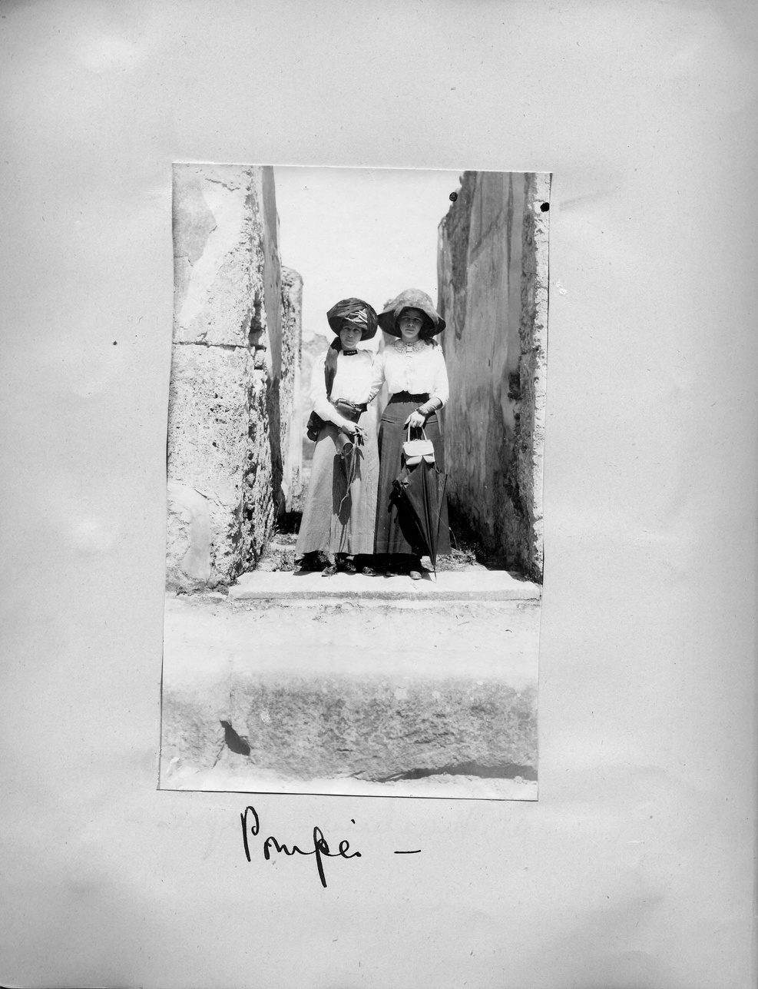
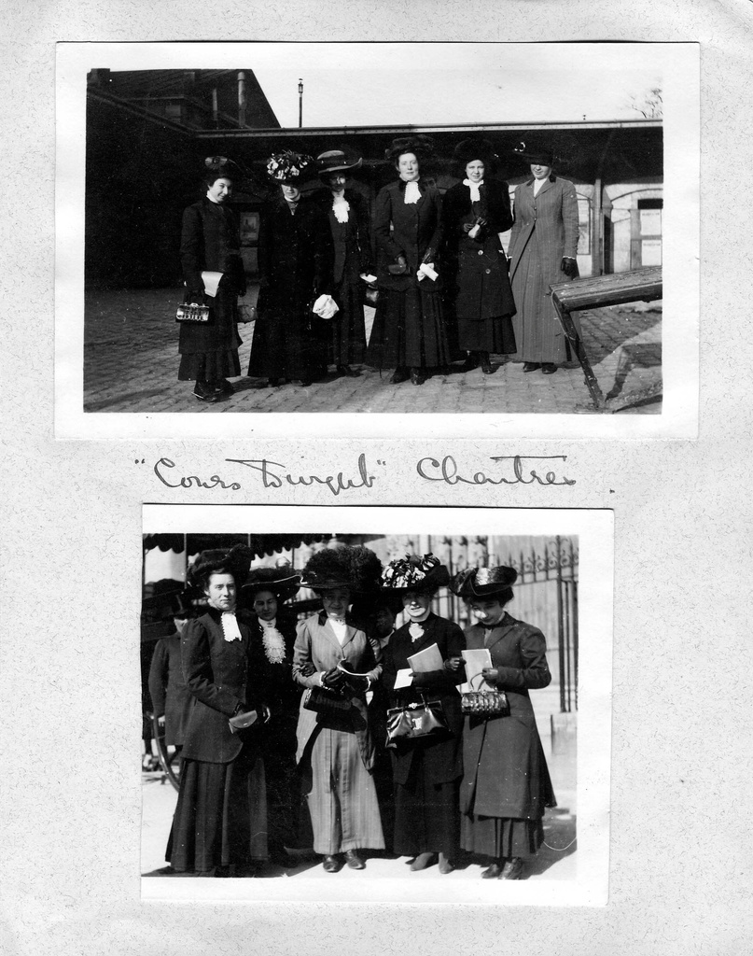
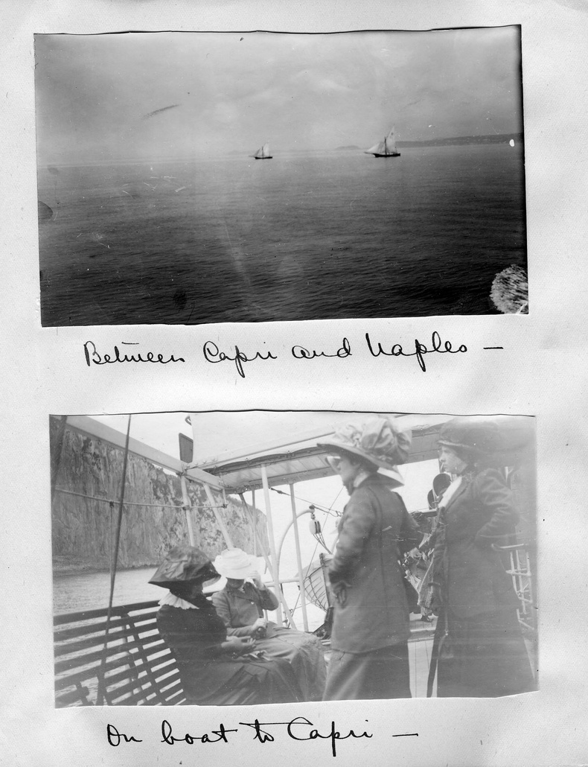
Wealthy families like the Campbells traditionally went on a “Grand Tour” of Europe to experience the museums, culture, art, historical sites, and of course, the latest fashions. Helen and her parents, Grace and Amasa did their Grand Tour of Europe from 1909-1910. While there, Helen attended finishing school in Paris. Here is a look at the wardrobe she wore while exploring European destinations such as Pompeii.
Helen Campbell Grand Tour Scrapbook Page 49. Helen visiting Pompeii, Joel E. Ferris Research Archives
Helen Campbell Grand Tour Scrapbook Page 20 Joel E. Ferris Research Archives,
Helen Campbell Grand Tour Scrapbook Page 40 Joel E. Ferris Research Archives,

Slide 9
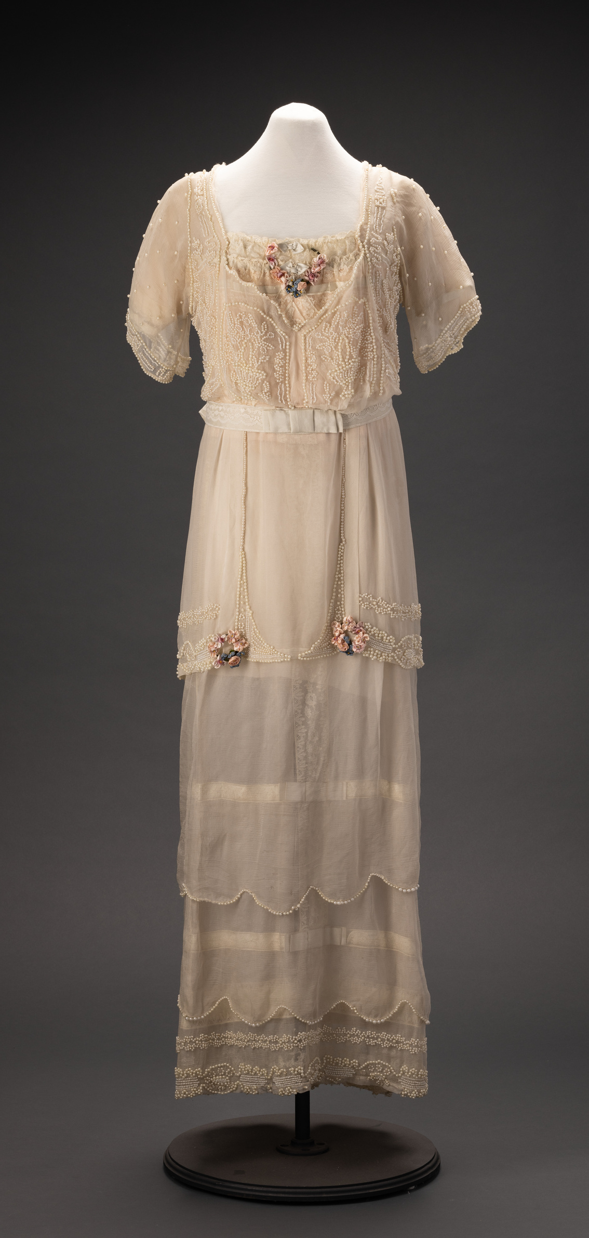
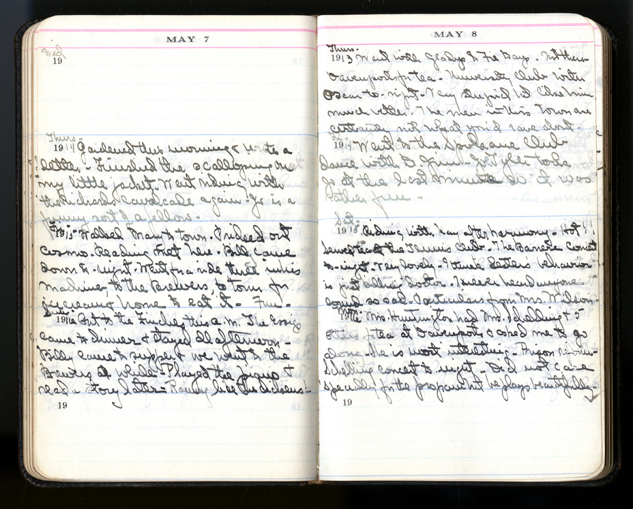
Helen Campbell was a dedicated diary writer. She kept a “Line a Day” diary that she wrote in religiously. Helen’s personality shines through with each entry. She recorded outings with friends to various Spokane locations and trips to New York, Boston, and California. She attended numerous teas at the Davenport Hotel. She went swimming and enjoyed the amusements at Natatorium Park. She spent her summers with family friends in Hayden Lake, Idaho. She golfed, played tennis, went ice skating, and camping. She attended moving pictures, theater shows, and dances. Imagine Helen wearing this dance frock while taking dance lessons at dance studios like Irene and Vernon Castle’s Dance Studio. Based on all of the activities that Helen and her friends enjoyed, you can see why women’s clothing were looser, less constricted, and shorter than previous generations. As we read her diary (1913-1917), we witness her growing affection towards Bill Powell who she would eventually marry in 1917.
Helen Campbell Diary Quotes
“Tues. Sep. 23, 1913
Luncheon at Mrs. Weavers. Willie's wedding to-night. Quite pretty but not like a wedding at all. Dance afterward. Regular "one step" party. Went with Jo Richards. Wore my ‘wedding dress’."
“Mon. Oct. 26, 1914
Got a green serge dress. Had my hair washed & made some neighborhood calls before dinner. Went up to the Husseys to-night. Bill’s car was found. Mr. Lindley wanted me to go to moving pictures.
Helen Campbell Diary, MsSc_224_1 of 3_Helen Campbell Diary (1913-'17)_5.7-8.1914 The Joel E. Ferris Research Archives,
“Sat. Nov. 13, 1915
Had my dress fitted & got a hat. Down at Jo’s most of the afternoon as he was alone. To Mrs. [Wiards] for supper. The Bean dance with Bill to-night. Why can’t men be satisfied?”
“Wed. March 22, 1916
Swimming. Bad day. Wrote Hazel & had tea with Mr. Smith. To-night wore my new dress & danced some. Mr. G is a bore. Hope Miss Crosley enjoyed her day. She has plenty of nerve.”
Northwest Museum of Arts and Culture
43096.2, Helen Campbell Frock, 1914, Gift of Valerie Powell 1985

Slide 10
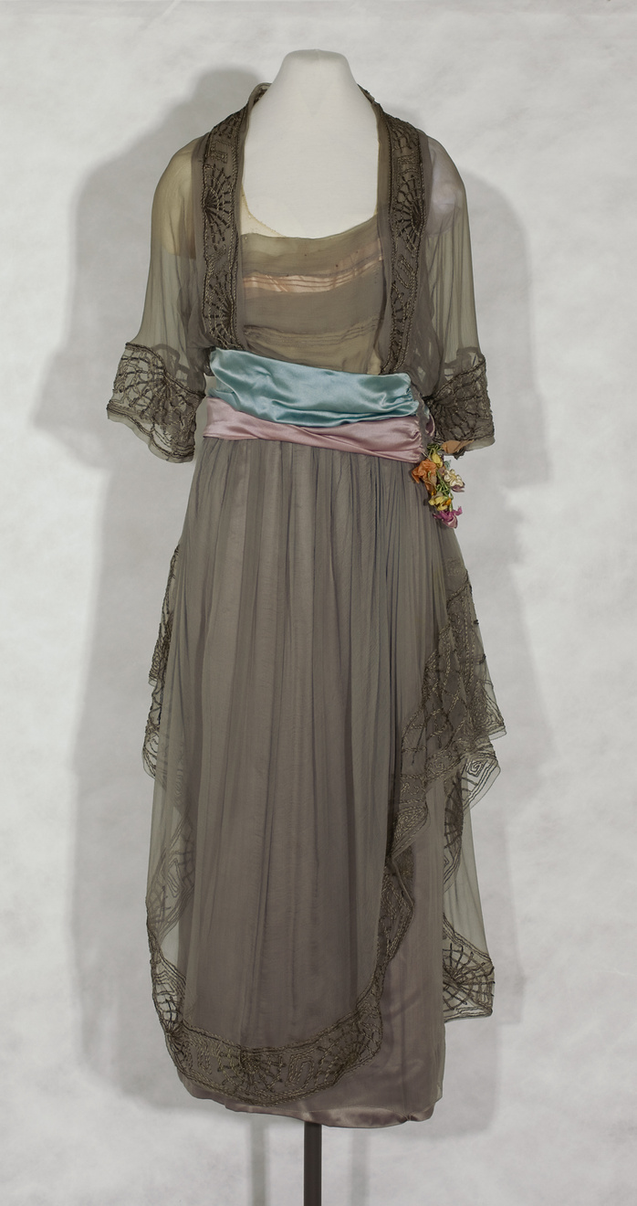
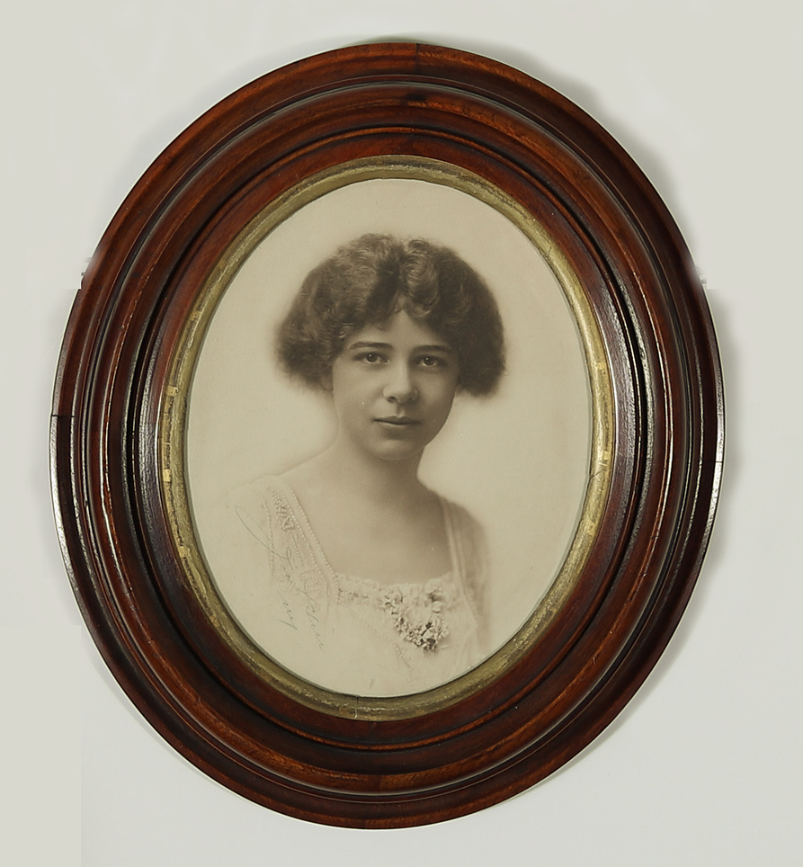
This medium gray Hickson and Company gown worn by Helen Campbell, has a silk/satin underdress with a silk organza overlay. There is a second overlay that is gathered at the waist and swings asymmetrically to one side. That layer is decorated at the edge with metallic soutache braid embellishment and pearl cotton on a wheel-like motif. A satin cummerbund wraps loosely at the waist and is decorated with a small bouquet of ribbon flowers at the closure.
Helen Campbell’s custom-made party dresses telegraph her family’s social status while hinting at the looser styles worn by her freer generation. Coming of age during the early 20th century, Helen lived on the cusp of social and technical liberations like voting and driving, which not only transformed women’s lives, but also their clothing. The tragedies of WWI resulted in swiftly changing fashions. It directly affected America’s fashion world in more than one way. Hickson and Company, one of Helen’s favorite stores, experienced their own WWI tragedy.
Caroline “Carrie” Hickson Kennedy was a fashion and hat designer, who went into the ladies’ apparel business in New York City in 1902 with her sister, Kathryn, and brother, Richard. The company was located on Fifth Avenue in New York City and was called Hickson and Company. Richard was credited as the company’s owner, but its success was attributed to Carrie’s business acumen and her designs.
Northwest Museum of Arts and Culture, 4429.1, Helen Campbell, 1913-1916, Museum Purchase 2019
Carrie and Kate were on their way to the spring fashion shows in Paris aboard the Lusitania on May 7, 1915, when it was torpedoed by the Germans during WWI. Both sisters died in the incident. Lost with the sisters was a wardrobe and jewelry collection worth $14,000.00. Richard was unable to manage the company without his sisters, and the store was no longer in business by 1920. We see in Helen Campbell’s diary that she and her mother continued to shop at Hickson’s until at least 1917 when they were in New York to buy wedding dresses for Helen’s upcoming marriage to Bill.
Northwest Museum of Arts and Culture
3965.1, Helen Campbell Gown, 1915-1917, Gift of June Powell, 2000

Slide 11
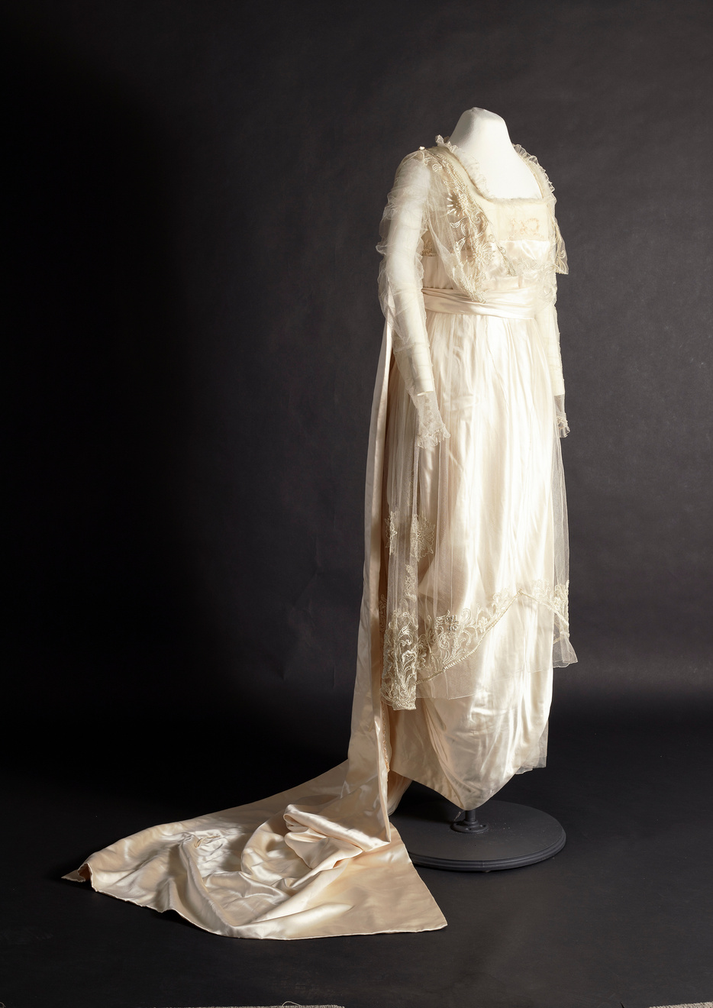
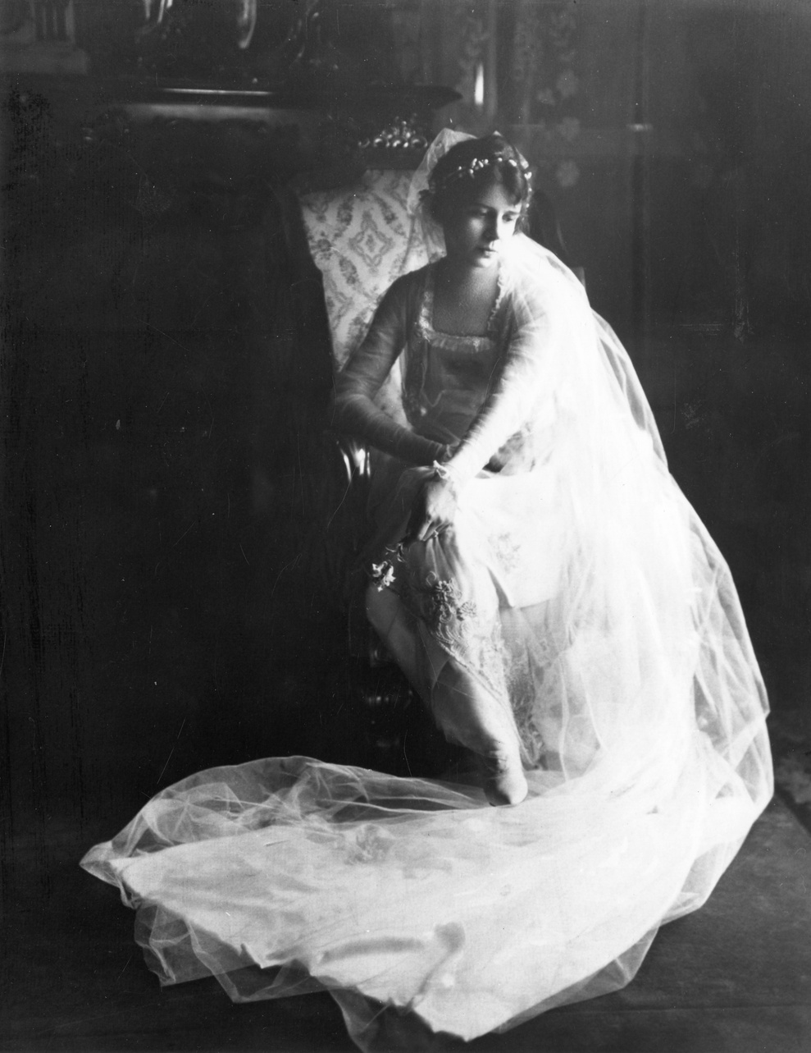
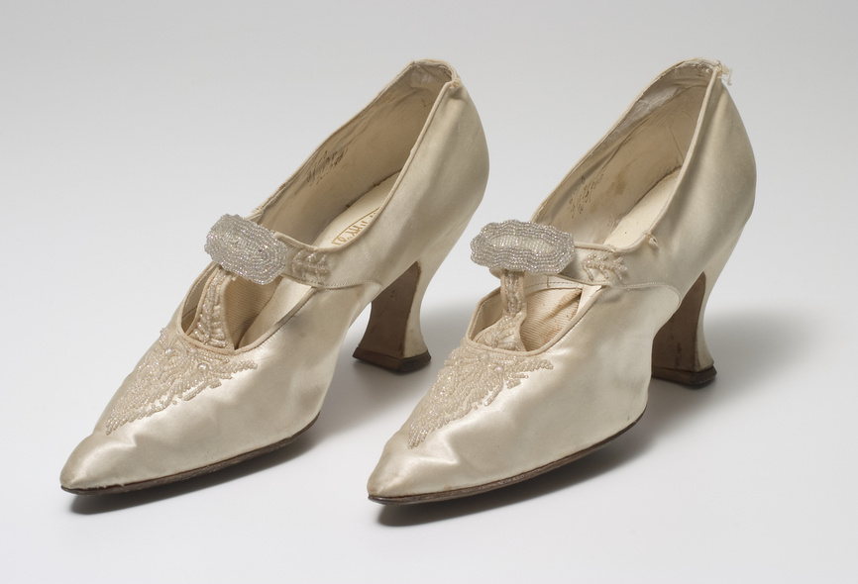
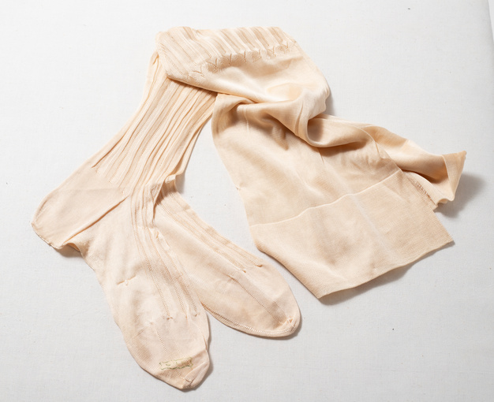
Northwest Museum of Arts and Culture
3096.1, Helen Campbell Wedding Gown, 1917, Gift of Valerie Powell 1985
After recording years of courtship in her diary, Helen married lumber businessman, William W. Powell June 27, 1917. Bill had enlisted in the army as the United States was entering WWI. Grace organized a tea to announce the engagement and a trip to New York to buy gowns. Grace and Helen bought two wedding dresses, several suits, and hats. The total for their shopping spree was $2,072.00, the equivalent of $57,600.18 in 2026.
Helen Campbell in her Wedding Gown, The Joel E. Ferris Research Archives, 1917, L91-159.41
Fashionable wedding gowns in 1917 were free flowing, featured lace, soft fabrics, and simple designs that reflected a world that was at war. The dress’ shorter length matched what other brides were wearing. She chose a white satin dress with net overlay and square neckline. It was decorated with pearls and floral embroidery. The train was made of white satin and lined with white crepe that hooked to the shoulders of the dress. She also wore a veil that was attached to a flower tiara. Shorter wedding dresses required stylish shoes with matching stocking, similar to these shoes and stockings worn by Helen’s cousin, Mary White, for her 1920 wedding.
While in New York, Helen wrote in her diary:
“Wed. March 7, 1917
Ordered “the dress” & two others at Hicksons. "It" is lovely - so simple & such long lines. To the Plaza for tea. The Finches & Clare McConnell there. She is to be married next month. At the Wilsons to-night. Asked Kay & Glad. Sat. March 24, 1917: Mother ordered her dress for the wedding at ‘Hicksons’. Got a pretty hat. Home early & wrote my beau. To tea at the Williams' apartment. Very nice indeed. Twelve people there. To ‘The Century Girl’ after. Jack did not come after all. Has gone home!”
Northwest Museum of Arts and Culture
3513.3 Mary White Wedding shoes, Gift of Mary Gordon Mellor, 1990
Northwest Museum of Arts and Culture
3513.5, Mary White Gordon’s wedding stockings, 1920, Gift of Mary Gordon Mellor 1990

Slide 12
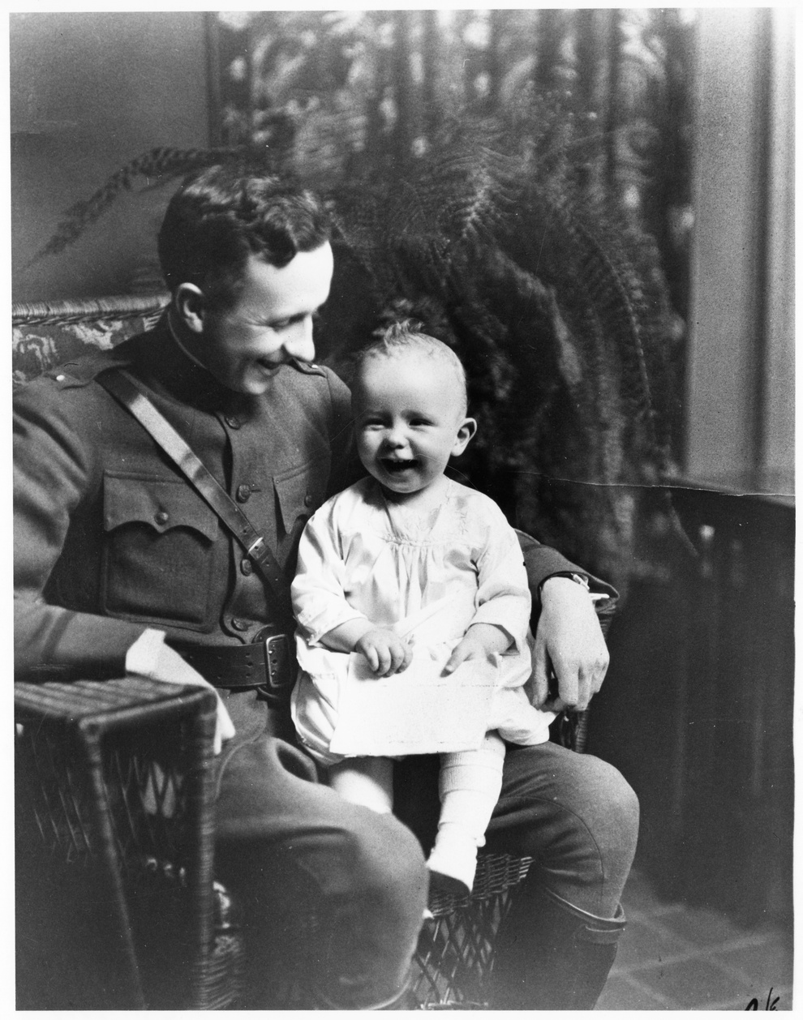
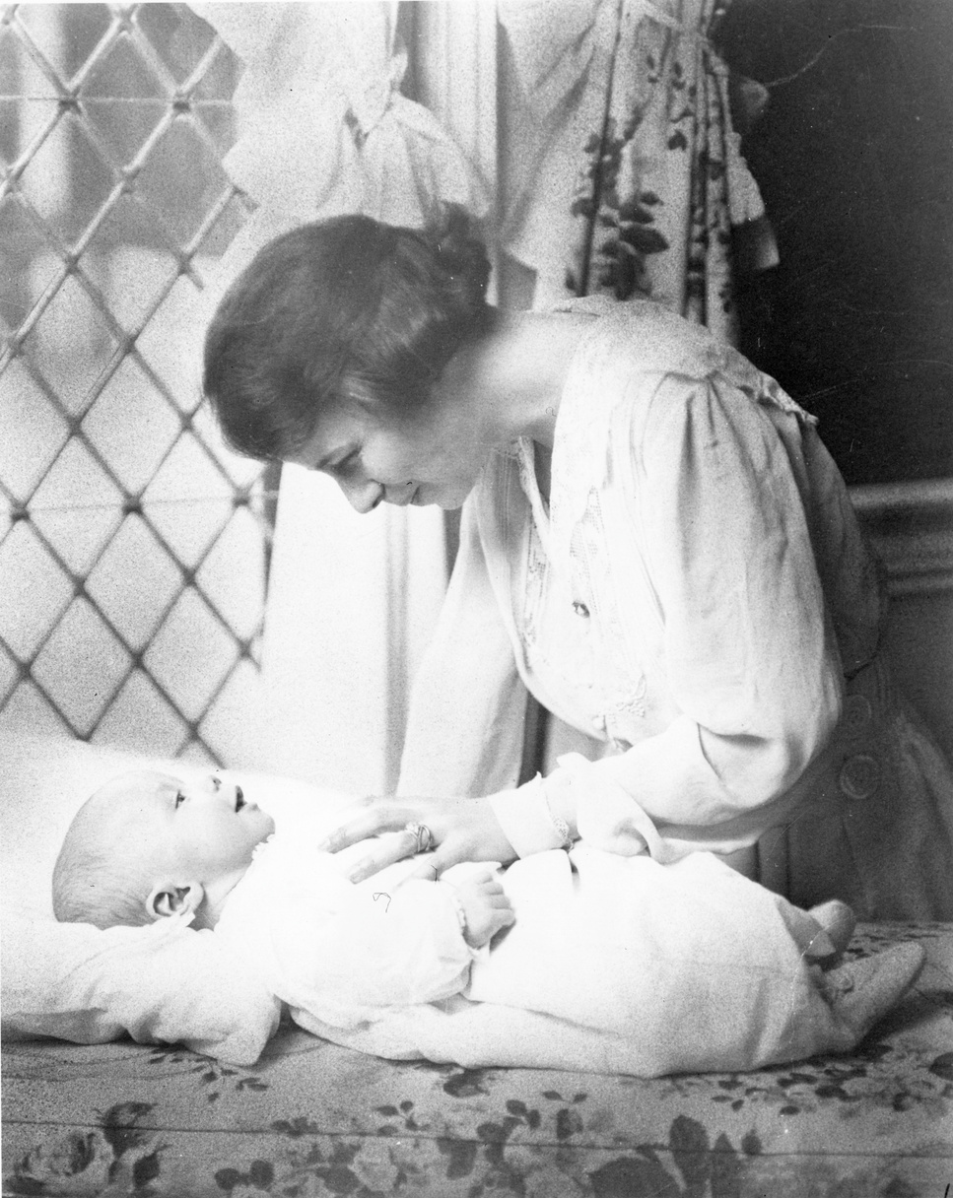
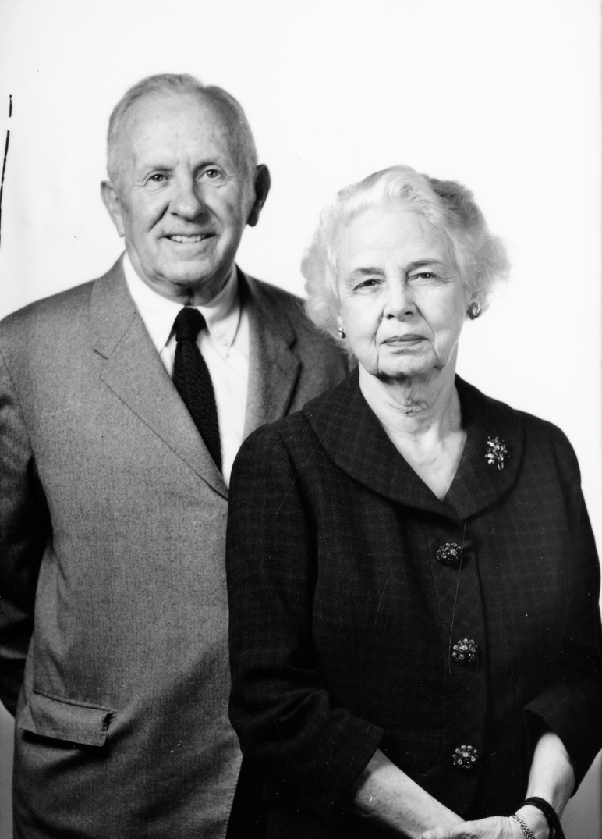
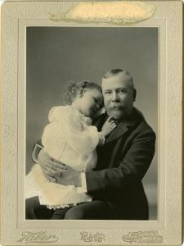
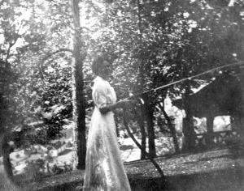
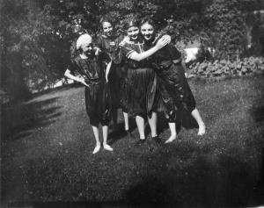
Helen, Bill, and their generation witnessed tremendous changes in technology, culture, and world events between their births at the end of the nineteenth century and their deaths in 1964 (Helen) and 1972 (Bill). Helen cast her first vote in November of 1913 during the Spokane city election after women received the right to vote in Washington State in 1910. In 1916, she cast her first vote for president, supporting Progressive Republican candidate, Charles Evans Hughes, as opposed the Democrat, Woodrow Wilson. In her diary, Helen records, “Cast my first vote for a president. Hughes...Bill took us to the Clemmer for returns. Stayed till one. Still undecided.” Bill served during WWI and their sons during WWII, with their middle son, Allan, an army pilot, dying when his B-17 crashed near the coast of western France. Their oldest son, William Jr., served in the Pacific and their youngest son, John, was a musician with the USO traveling throughout Europe.
Helen’s husband, Bill Powell and oldest son, William pictured in Campbell House, 1919
The Joel E. Ferris Research Archives L91-120.9
Helen with son, Allan, pictured in Campbell House,1920
The Joel E. Ferris Research Archives L91-120.7
When Bill and Helen were born, their families traveled via horse and carriage. By the time of their deaths, not only had radios, televisions, automobiles, and airplanes been invented, but rockets were being sent to the moon. These photos all illustrate the changes in fashion between 1897 and 1962. The changes in clothing styles reflect the changing world surrounding Bill and Helen (Campbell) Powell and the experiences of their generation.
Helen and Bill Powell, left, 1962
The Joel E. Ferris Research Archives L87-1.117-62
Helen Campbell, left, spraying water on her cousin, Mary White, 1908, The Joel E. Ferris Research Archives L91-119.4
Mary White and friends being spraying by Helen, right, 1908, The Joel E. Ferris Research Archives L91-162.73
Helen and her father, Amasa, right, 1897, The Joel E. Ferris Research Archives L86-287

Slide 13
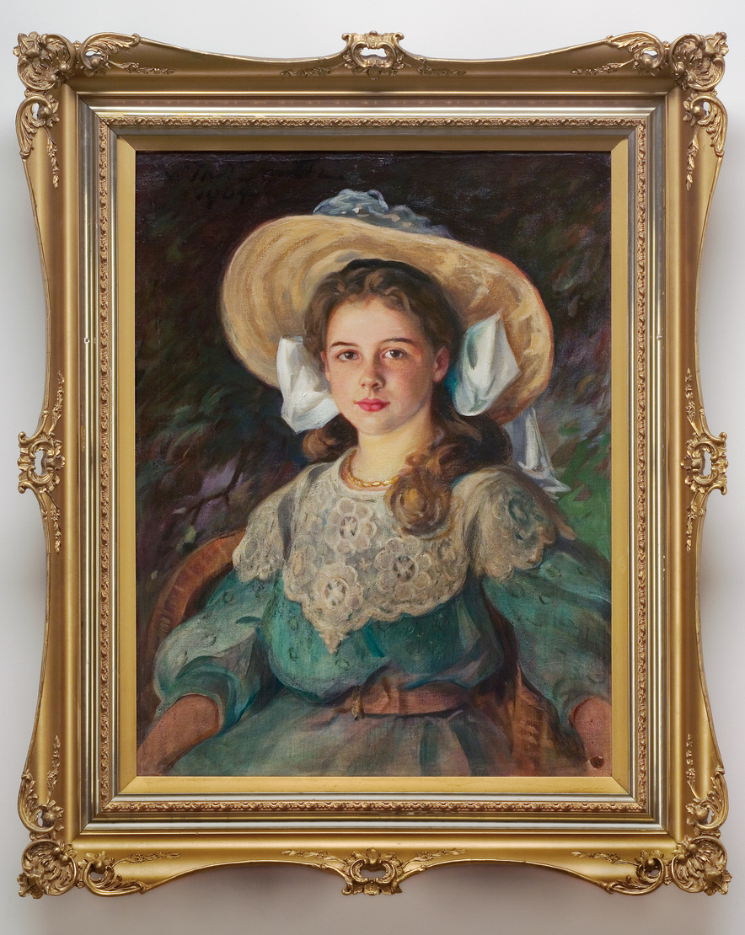
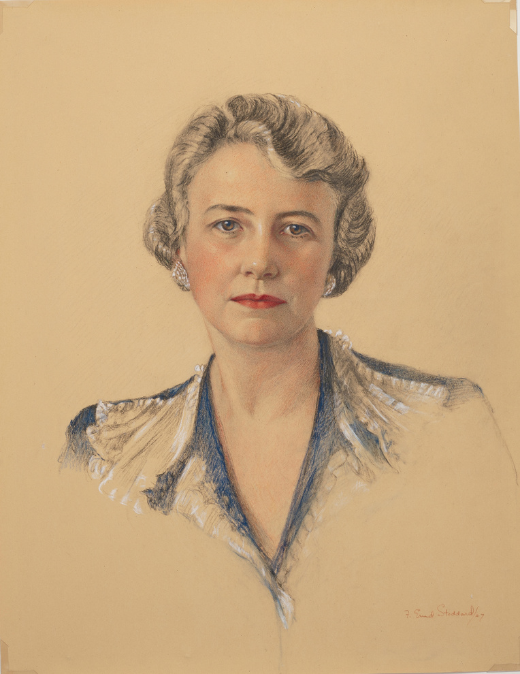
Northwest Museum of Arts & Culture
2485.3, 1904, Portrait of Helen Campbell
Studying objects and photos help us learn about the world the Campbell family lived in. Their clothing speaks to their wealth, their values, and the historical context in which they lived. Looking at their clothing helps us imagine their daily lives in Campbell House.
Gift of Mrs. W.W. (Helen Campbell) Powell
Fashion is a form of non-verbal communication. Changes in fashion from one generation to the next reflect both individual expression and societal norms. Fashion for women between the 1890s and early 20th centuries enlighten us about the evolving culture, the advances in technology, and rapid changes in world events. Helen Campbell’s clothing reflected the changes her generation experienced.
By the end of the 1920s dresses had become shorter, less restrictive, and a symbol of women’s ability to vote, drive cars, and participate more actively in society. They reflected the world’s tragic experiences in World War I, the advent of electrical appliances, airplanes, movies, and radios. These changes can be seen in how Helen Campbell and her friends, presented themselves to the world. Clothing styles would change drastically over Helen’s lifetime.
Northwest Museum of Arts & Culture
3965.2, 1947, Portrait of Helen Campbell
Gift of Mrs. June Powell, 2000
Fashion is a mirror that reflects the complex interplay between human identity, social structures, and historical contexts. We can see all of these aspects at play when studying Helen Campbell’s clothing and accessories.

Slide 14
Historians study objects, the material culture that people from the past left behind, in order to understand history. Objects are the products of human workmanship - of human thought and effort - objects tell something about the people who designed, made, and used them. What questions do historians ask themselves when they analyze objects?
  First impressions: What are your first impressions of this object? Do you have any ideas what the object might have been used for?
  A closer look at the physical features: What is it made of? Why was this material chosen? What is the texture and color? What does it smell like? Can it be held? Is it heavy or light? Is it intact, or does it look like parts are missing? Does it look new or old?
  Construction: Is it handmade or made by machine? Where was it made? Who made it?
  Function: How is this object used? Does it have a practical use or is (was) it used for pleasure? Has it been used? Is it still in use? Has the use changed? Where could it have been found? What value does it hold to you and to others?
  Design: Is it designed well? Is it decorated? How is it decorated? Is it aesthetically pleasing? Would it make a good gift? Does it remind you of anything else?
  Who may be connected with the object? What type of person might have used this object? What type of person might have made this object? What does this object tell us about the maker and user?
  Thinking further: Is this type of object still being made today? Is it still in use? If not, why do you think it isn’t used today? Should this object be in a museum collection? Why or why not?
  What do you wonder? What questions do you have about the object that you can’t answer from just looking at it?

Slide 15
Photographs provide us with images of past events. Today, historians study the content and meaning of these visual images to locate information about a particular topic, time, or event. Photographs can convey countless details about life. For historians and for us, “A picture is worth a thousand words.” Photographers can manipulate, intentionally or unintentionally, the record of the event. It is the photographer – and the camera’s frame – that defines the picture’s content. Thus, the photographer chooses what will be in the picture, what will be left out, and what the emphasis will be. When analyzing photographs, ask yourself the following questions:
  Take a closer look: Make sure to examine the whole photograph. Make a list of any people in the photograph. What is happening?
  Looking more closely: Are there any captions? A date? Location? Names of people? What kind of clothing is worn? Are there any words on signs or buildings?
  Thinking Further: If people are in the photograph, what do you think is their relationship to one another? Can you speculate on a relationship between the people pictured and someone who is not in the picture?
  What do you think happened before and after the photo was taken? Who do you think took the photo and why?
  What does this photograph suggest to you? What questions do you have about the photo? How could you try to answer them?
  What is the one thing that you would remember most about this photograph and why?
  What questions do you have about the photograph that you cannot answer through analyzing it? Where could you go next to answer these questions?

