Slide 1
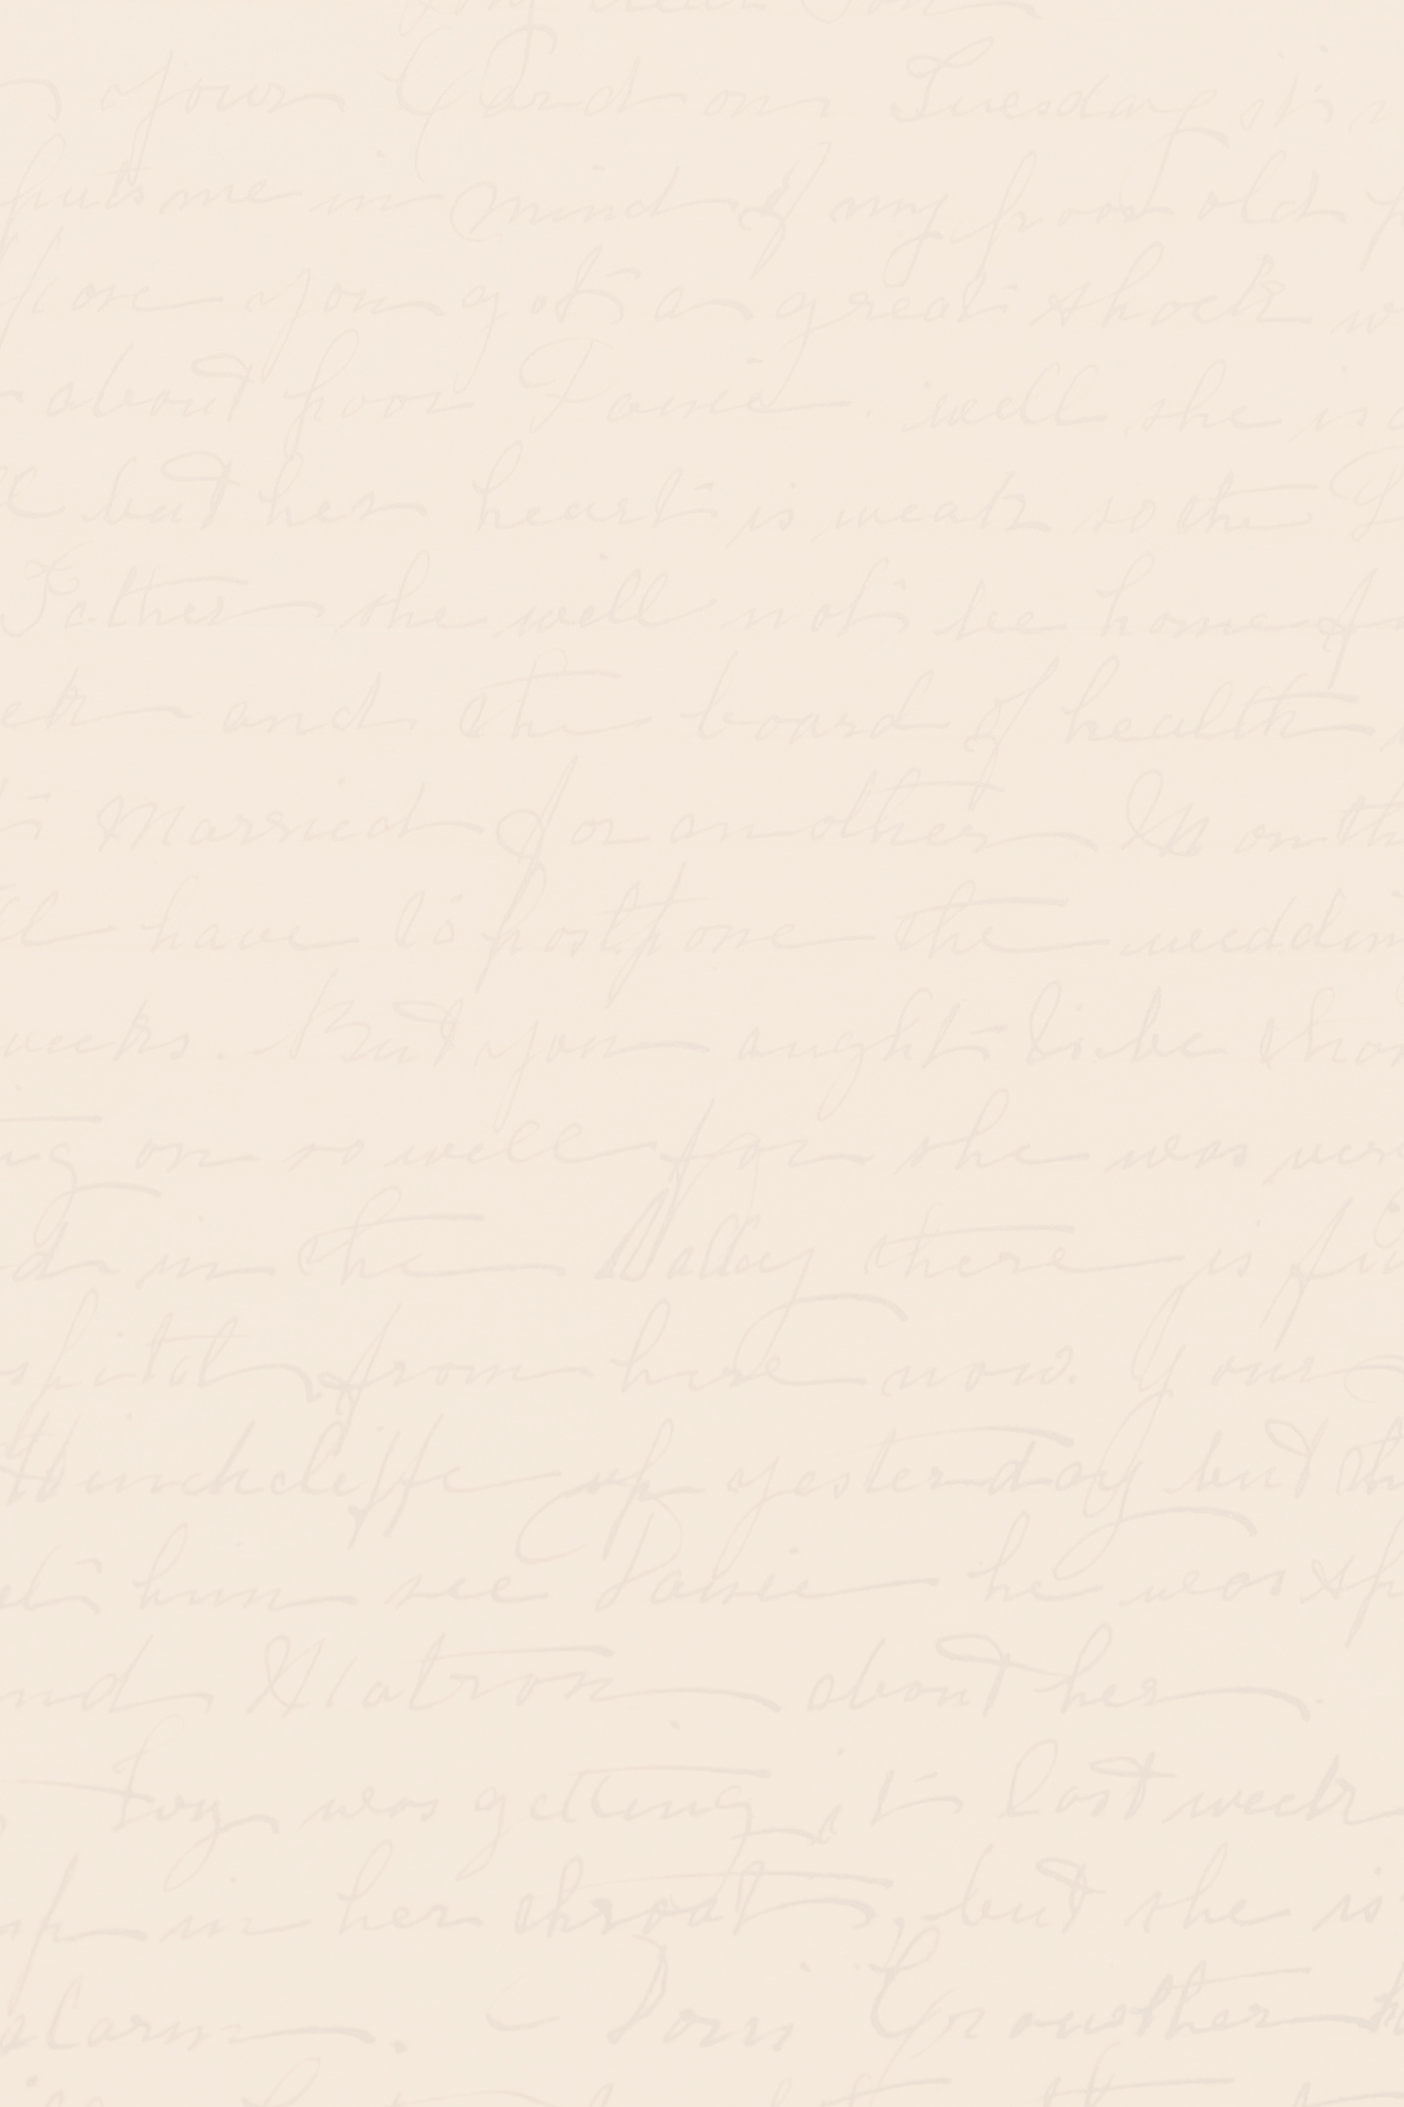
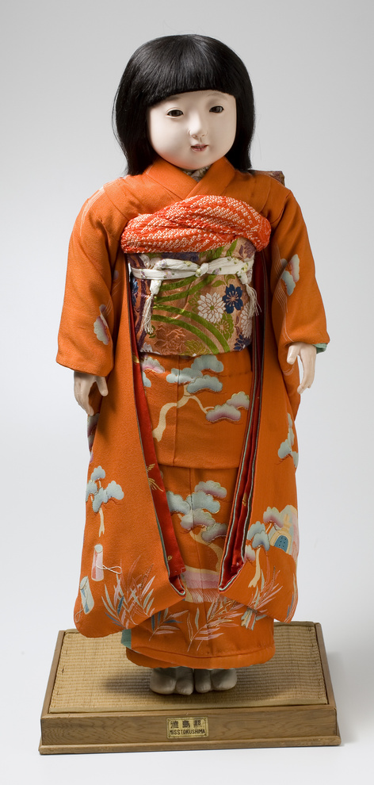
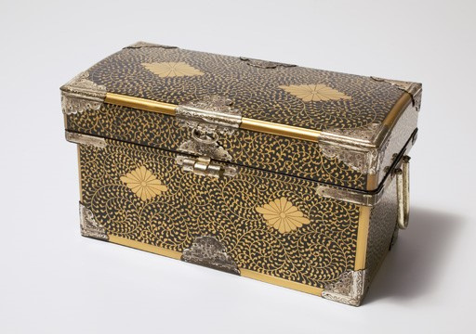
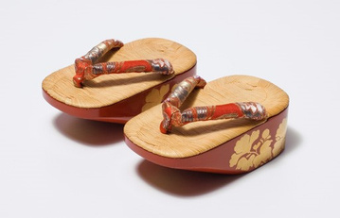


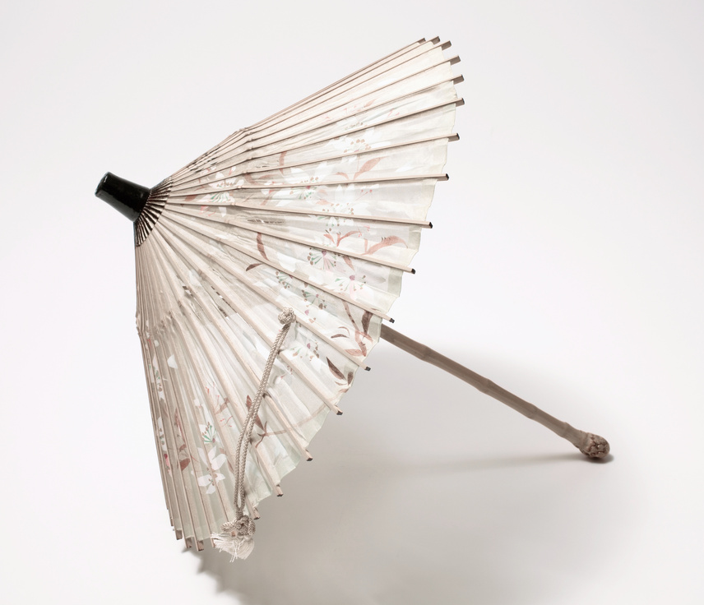

LEARNING WITH PRIMARY SOURCES: MISS TOKUSHIMA
How Do Museum Professionals learn about the past using object analysis?
MAC 812.4
MAC 812.1
MAC 812.5B
Museum Professionals use observation, Inference, and Inquiry to analyze objects, photos, documents, diaries, and personal accounts to learn about the past. You can use this method of object analysis to learn about the artifacts shown on this poster. All of these objects can be found in the MAC’s History collection.
Inquiry
Take one more look at these objects. What more can we find? What would you still like to know about these objects? What is left unanswered after your observations and inference?
Observation
Take a few minutes to look at these objects. What’s going on with these objects? What do you see? What materials are used? What do they remind you of? Do you have any similar objects in your home or at your school? Once you have made your observations, start making inferences about the objects.
Think about where you can find the answers to your questions. Have others done any research on them? Can you find secondary sources such as books, videos, or articles about these objects? Can you find primary sources such as historic newspapers, historic photos, letters, diaries, or documents about these objects?
Inference
Do you have any prior knowledge you can use to make an educated guess about these objects? When do you think they were created? Why do you think they were created? Where do you think they were created? Who do you think used them? How do you think they were used?
Use your observations and prior knowledge to help you make some educated guesses about the objects.
MAC 812.17

Slide 2

MISS TOKUSHIMA
Japanese Friendship Dolls 1927
MAC 812.4
MAC 812.17
“Say it with Dolls!”
MAC 812.1
MAC 812.5B
Miss Tokushima’s Journey from Japan to America
Miss Tokushima, the MAC’s Japanese Friendship Doll has a fascinating story that was almost forgotten. The Friendship Doll Project was the idea of Rev. Sydney L. Gulich who hoped to reverse the trend of poor relations between Japan and the United States after the passage of an anti-Japanese immigration bill in 1924.
In Japan, Viscount Shibusawa Eiichi, who was also dedicated to peace, organized a return gesture of fifty-eight dolls to be sent to the United States. These exquisitely dressed porcelain dolls were crafted by the most noted Japanese doll artisans of the day.
The dolls arrived in San Francisco on November 27th, 1927. They came with passports and were accompanied by beautiful clothing, furnishings, and tea sets. They toured the United States for several months and then, all 58 were given to museums, libraries, and cultural centers in each state. Washington state’s doll, Miss Tokushima was given to the Eastern Washington Historical Society in Spokane. She is named for the prefecture, Tokushima, on the island of Shikoku, Japan.
Gulich thought that an exchange of dolls and letters would promote understanding and good feelings between each country’s children that would continue as they became adults. The idea caught fire throughout American schools, Sunday schools, and clubs such as the Girl Scouts and Campfire Girls.
Children banded together and saved their pennies towards purchasing a doll while learning about Japanese culture. In 1927, with much fanfare, 12,739 American dolls along with letters written by children from across the country boarded a ship in the Port of San Francisco and set sail for Japan.
The dolls were displayed with pride in both countries until Japan’s attack on Pearl Harbor and the start of World War II in 1941. The American dolls in Japan were mandated by the Japanese government to be destroyed. Hiding or protecting the dolls was considered an act of treason! In the United States, the Japanese dolls were taken off display and essentially forgotten.
The dolls were an outward symbol of friendship, and the letters were the heart. One letter from New Jersey that accompanied a doll named Dorothy who was dressed in sports clothing said, “The girls in America practically live in sweaters and skirts; you see we are out of doors most of the time, playing basketball, hockey, tennis, or skating”.
Over the years, as the memories of the war faded, and relations between the two countries recovered, the story of the Friendship Dolls has been restored. About 400 American dolls have been accounted for in Japan. The Japanese Friendship Dolls in America, including Miss Tokushima, have been brought out of storage. Every year, Miss Tokushima visits Mukogawa Fort Wright Institute in Spokane during their annual Hinamatsuri celebration.
Source: Art as Ambassador by Alan Scott Pate
The dolls arrived in Japan March of 1927 in time for the country’s, Hinamatsuri, a thousand-year-old doll festival dedicated to the girls of Japan. Their arrival struck a deep, resonating cord with the Japanese. So much so, that a selection of dolls received an audience with the Emperor.

Slide 3
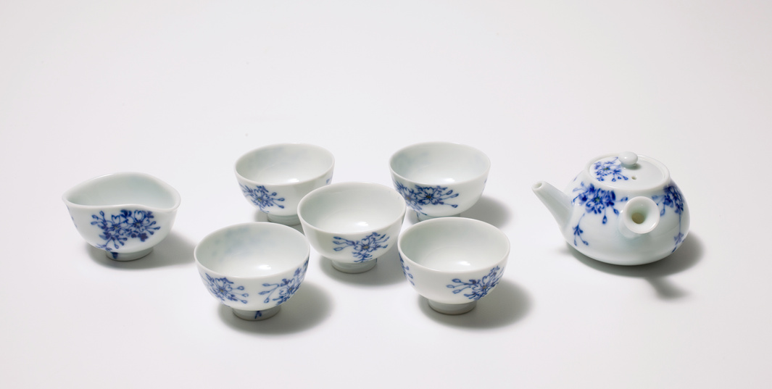
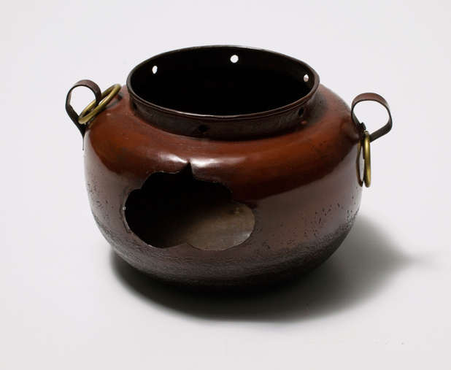
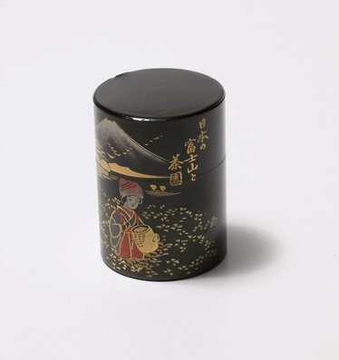
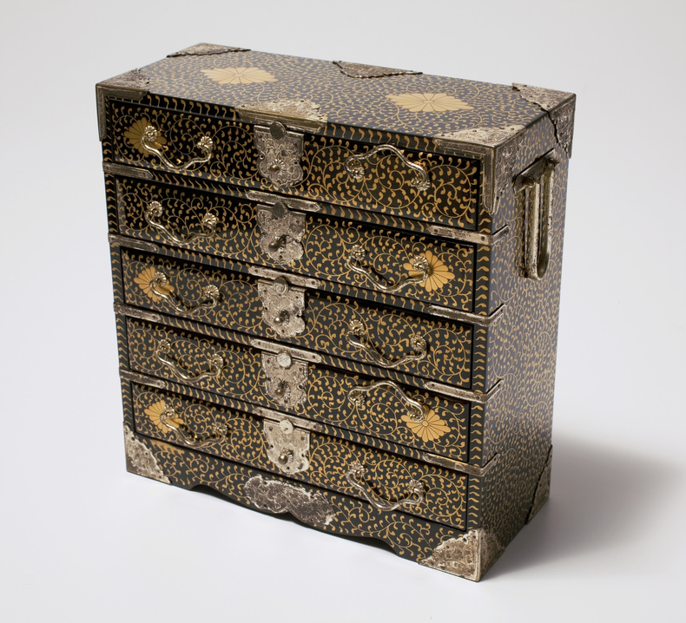
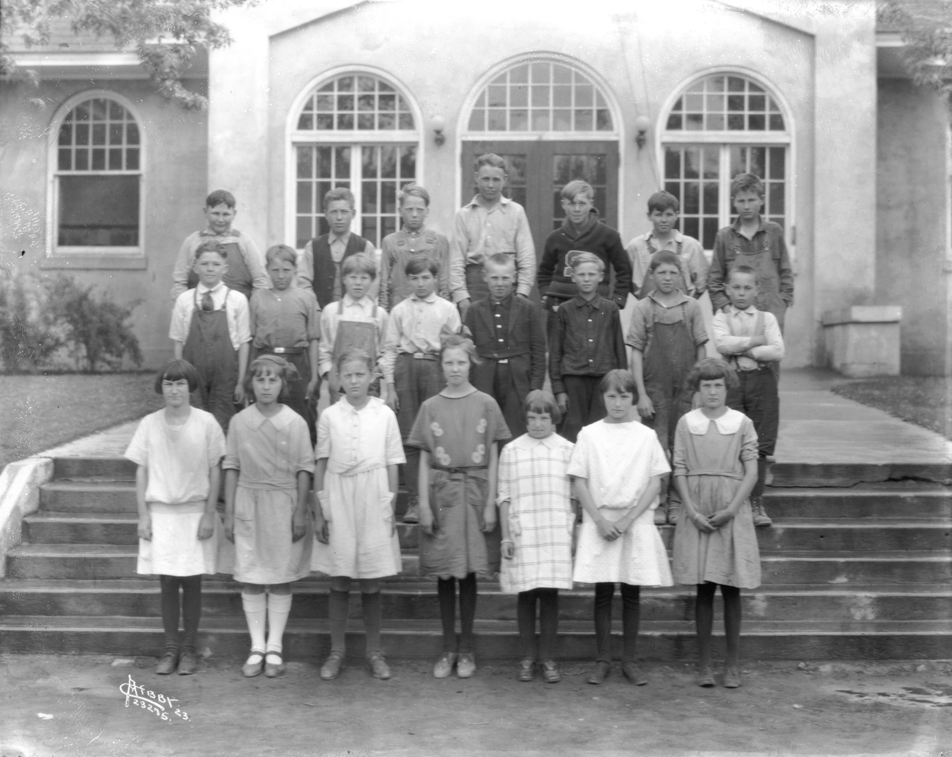
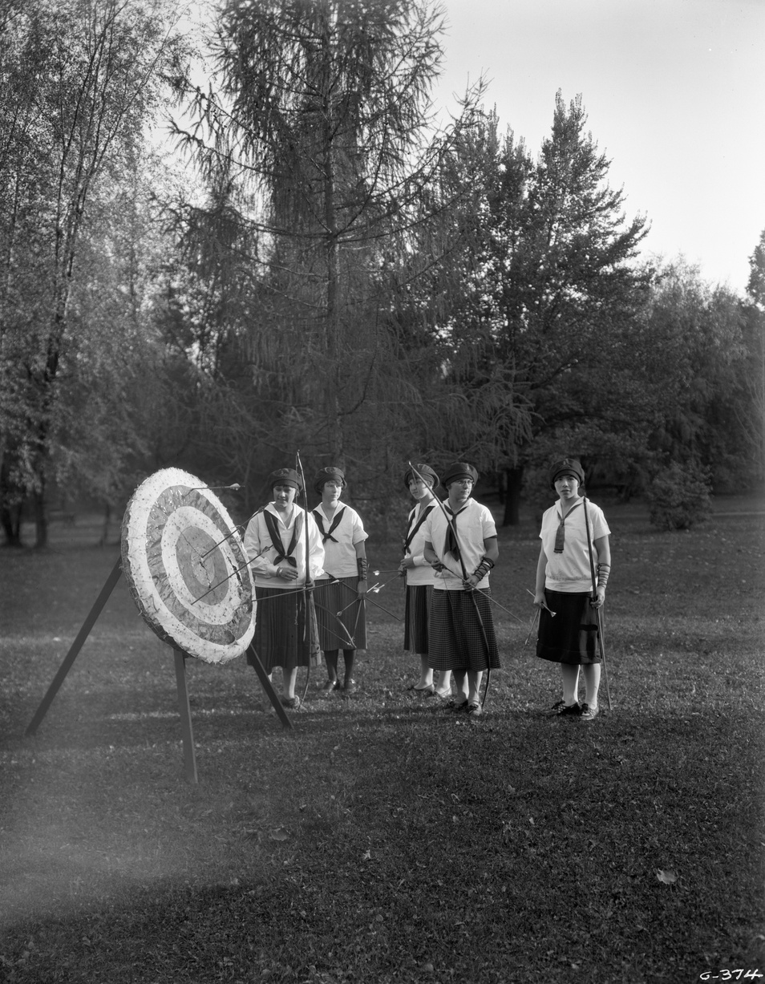
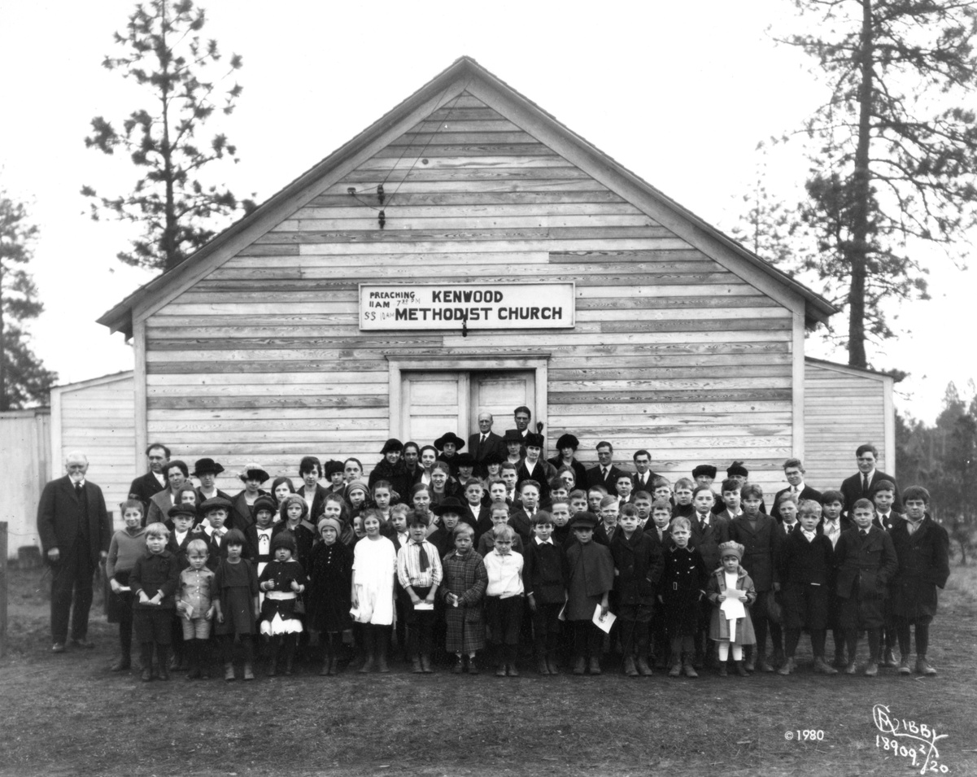
MISS TOKUSHIMA
Japanese Friendship Dolls 1927
MAC 812.4
MAC 812.17
“Say it with Dolls!”
MAC 812.1
MAC 812.5B
Miss Tokushima’s Journey from Japan to America
Miss Tokushima’s Accoutrements and Children in Spokane c1920
MAC 812.19
MAC 812.36 a b
MAC 812.11
MAC 812.30
Lowell Grade School 1923
Joel E. Ferris Research Archives L87-1.23275.23
Campfire Girls c1920 archery
Joel E. Ferris Research Archives L95-111.G-374
Sunday School 1920
Joel E. Ferris Research Archives L87-1.18909-20
Fun Fact: Miss Tokushima stands Thirty-Five inches tall which is about the height of an average three-year-old child.
Fun Fact: Hinamatsuri (Girls Day) is celebrated every year on March 3rd. and Tango no Sekku (Boys Day) is celebrated every year on May 5th.
Fun Fact: The farewell ceremony for Miss Tokushima took place on October 8, 1927, at the Tokushima Park Chiaki tower. A caption in a newspaper in Japan marking the celebration said, “Gathering at farewell ceremony at the Chiaki tower in the autumn rain, 200 students and Americans living near Tokushima [in Japan] participating. The girl students, the schools which received the blue-eyed doll donated their pennies to pay for the doll which was sent to America.”

Slide 4
MISS TOKUSHIMA
Japanese Friendship Dolls 1927
MAC 812.4
MAC 812.17
“Say it with Dolls!”
MAC 812.1
MAC 812.5B
Miss Tokushima’s Journey from Japan to America
Want to Learn more about Miss Tokushima?
Digital Links:
https://www.youtube.com/watch?v=pj2f7k4zJzM&t=10s
https://www.youtube.com/watch?v=IsqnwnCnRUk&t=13s
https://www2.northwestmuseum.org/museum/detail-japanese-friendship-doll-miss-tokushima-20627.htm
http://www.bill-gordon.net/dolls/japanese/tokushima/index.htm
https://www.spokesman.com/stories/2005/mar/04/dolls-bind-millions-in-friendship/
https://www.spokanepublicradio.org/programming/2014-12-02/inhm-the-doll-who-crossed-the-sea
https://jcc.mukogawa.edu/home/the-friendship-doll-program
Non-Fiction Books:
Art as Ambassador: The Japanese Friendship Dolls of 1927 by Alan Scott Pate
Fiction Books:
  The Friendship Doll by Kirby Larson
  Ship of Dolls by Shirley Parenteau
  Dolls of Hope by Shirley Parenteau
  Dolls of War by Shirley Parenteau

