Slide 1

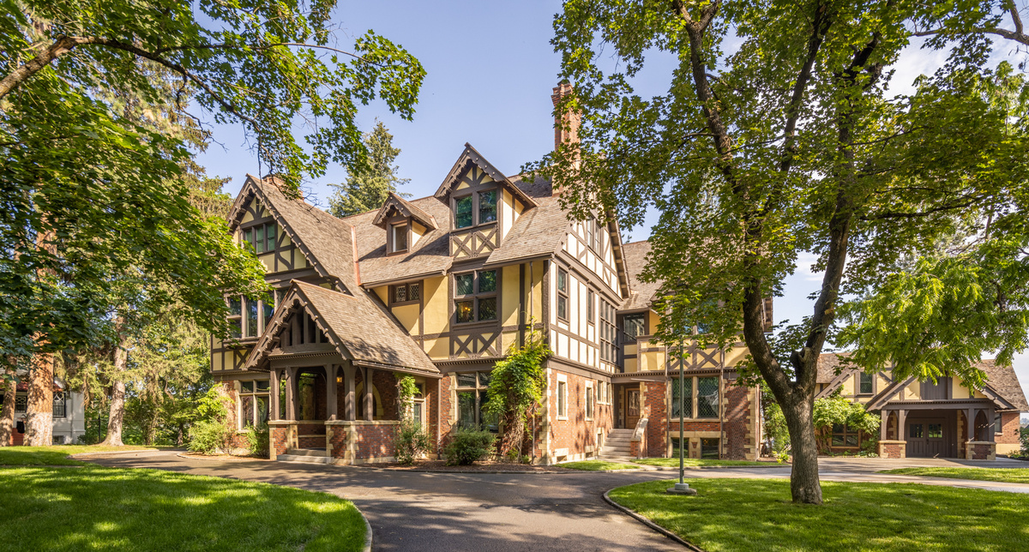

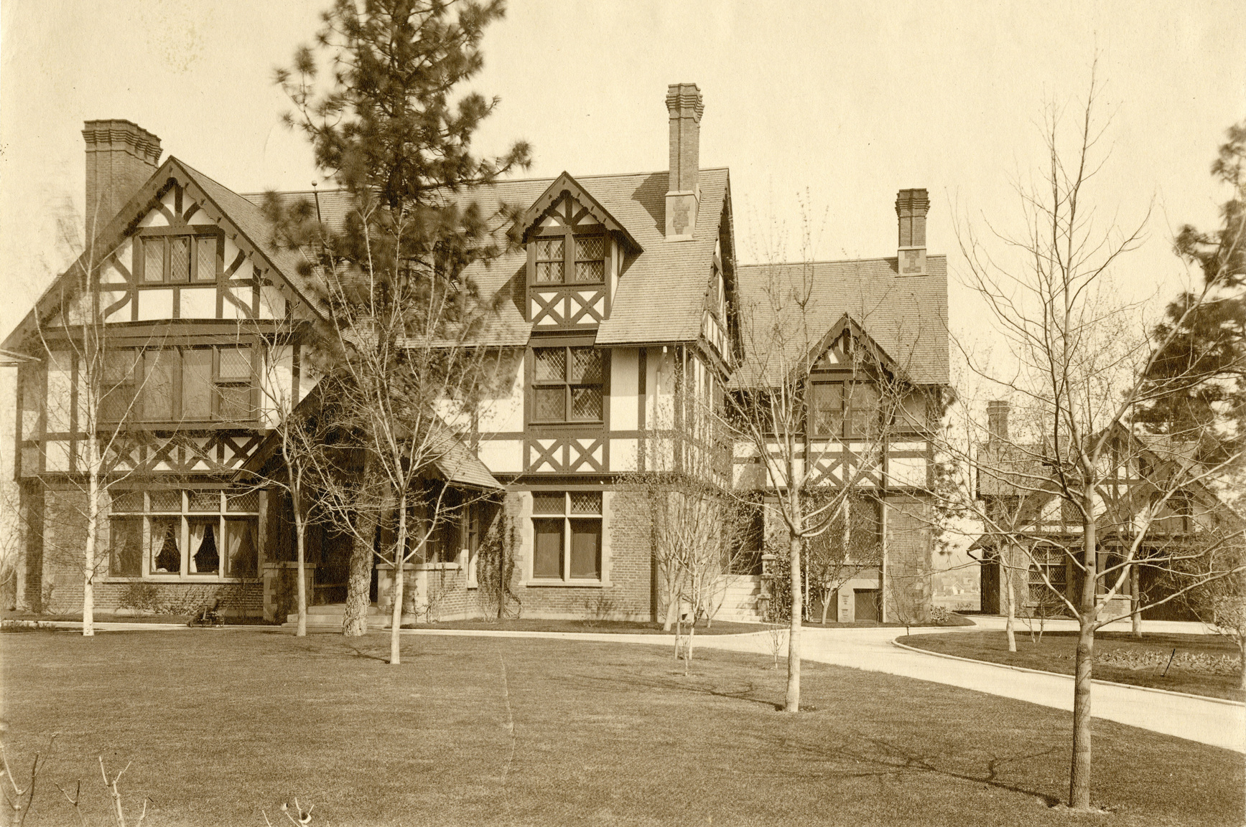



Campbell House Decorative Arts
Campbell House:
Original Objects
Part One
Campbell House as it looks now. Photo Credit: Dean Davis
Campbell House exterior, Joel E. Ferris Research Archives, L85-174.15, 1899
MAC Packs are Sponsored by

Slide 2
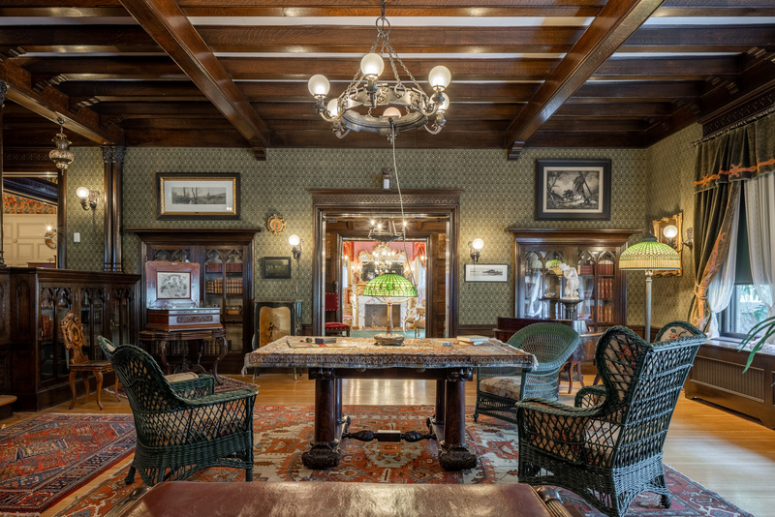
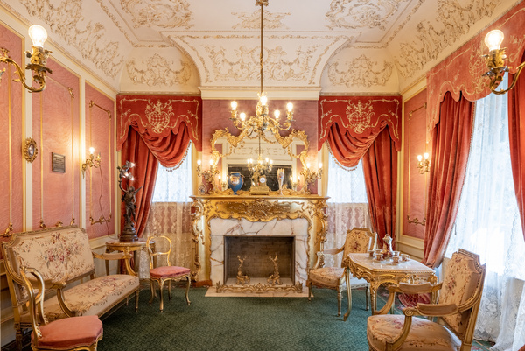
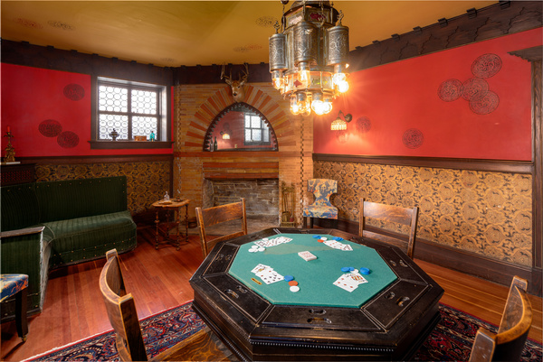
Campbell House, located on the campus of the Northwest Museum of Arts and Culture in Spokane’s Browne’s Addition, was built by Amasa and Grace Campbell in 1898. Little did they know, their home would become a museum enjoyed by generations of Inland Northwest residents and visitors.
In 1887, a group of Youngstown, Ohio investors sent Amasa B. Campbell (1845-1912) and associate John A. Finch (1852-1915), to investigate the tales of Idaho's fabulous Coeur d'Alene Mining District. The partners quickly determined that there were fortunes to be made. They invested $25,000 in the Gem mine, built a mill to work the ore, and soon were earning thousands of dollars a month. His fortune assured, Campbell returned to Ohio to marry schoolteacher Grace Fox (1859-1924), and they moved to Wallace, Idaho, a raucous mining town that was a far cry from the sedate life of Youngstown.
The Campbell's daughter, Helen (1892-1964), was born in Spokane during the same year that labor and management conflicts erupted in the Coeur d'Alene Mining District. Financial panics and the collapse of world silver prices accelerated these disputes, and Idaho governors twice placed the mining district under martial law. In 1898 Campbell and Finch moved their mining operations and their residency from Wallace, Idaho to Spokane, Washington, which afforded greater security and more educational, social, and business opportunities.
After the death of her parents, Helen, a member of the Spokane Art Association and Eastern Washington Historical Society, donated the home in her mother’s memory to be used as a museum building. They named it the Grace Campbell Memorial Museum.
Campbell House as it looks now.
Photo Credit: Dean Davis

Slide 3
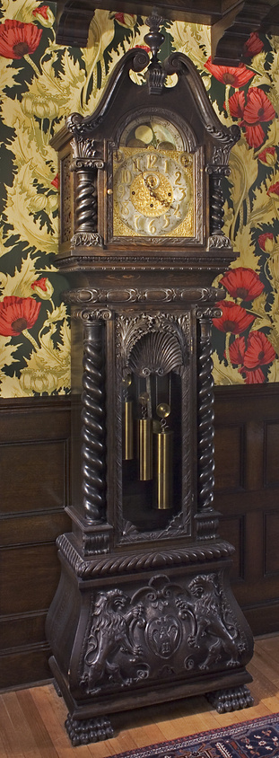
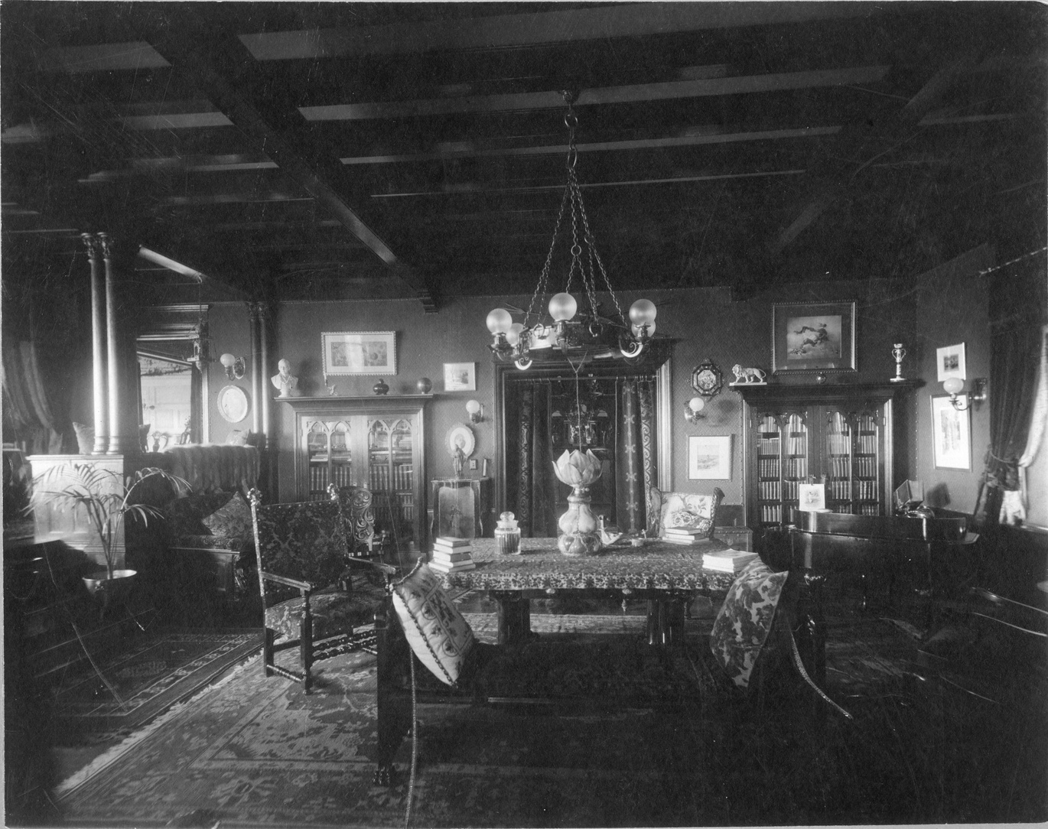
American Arts and Crafts Revival Movement
In 1897, Amasa and Grace Campbell hired architect Kirtland Cutter of Cutter and Malmgren, to design their Arts and Crafts Tudor Revival home. The interior of the home included an eclectic assortment of Arts and Crafts Revival rooms whose decor reflect different time periods, including Gothic, French Rococo, and Colonial; and different cultures that at the time was referred to as Moorish.
The Arts and Crafts Revival movement began with English educator, John Ruskin (1819-1900) and artist William Morris (1834-1896), who founded Morris and Company in 1861. Practitioners of Arts and Crafts embraced a nostalgia for a preindustrial world and a look back towards a simpler time with a nod towards the dignity of artisanship and workmanship. Industrialization had included large numbers of laborers moving from the countryside to the cities to work in dangerous factories for low pay with harsh living conditions. These men wanted to remedy that situation.
Campbell House as it looks now.
Photo Credit: Dean Davis
The movement took off in America between the 1890s and the 1920s with decorative arts craftsmen such as Stickley, Roycraft, Rookwood, and Architects Frank Lloyd Wright and Greene and Greene. In the Pacific Northwest, Spokane architect Kirtland Cutter was the go-to designer for Arts and Craft Revival homes including the Tudor Revival built by Amasa and Grace Campbell.
Northwest Museum of Arts and Culture, 784.52, 1898, Campbell Family Tall Clock, W.W. Powell Estate, 1973
While Americans felt artisanship and craftsmanship were important, they also embraced high-end machine-made products that were created for mass distribution. The decorative arts in Campbell House reflect the American Arts and Crafts movement.
Campbell House Library, Joel E. Ferris Research Archives, L91-120.29, 1910

Slide 4
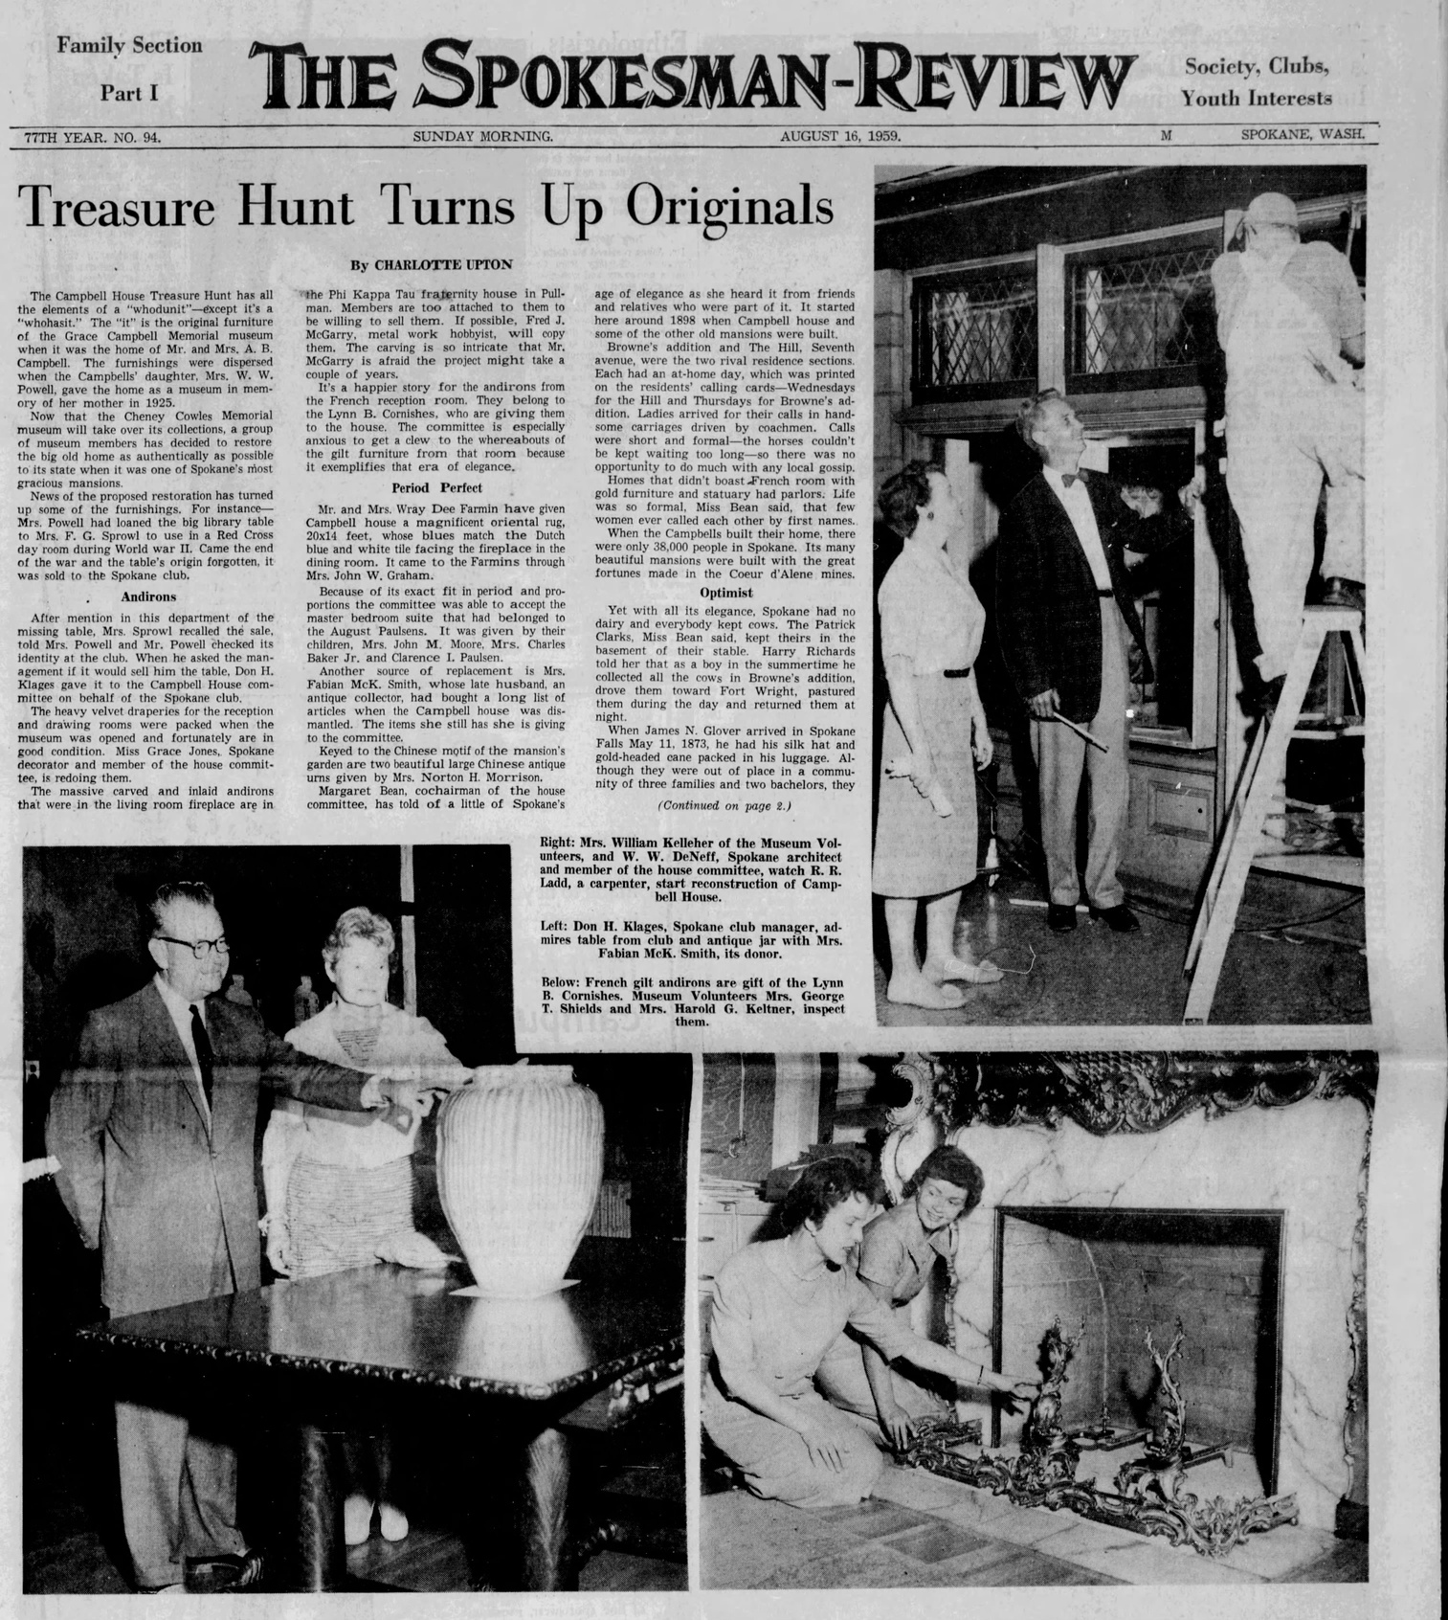
On August 16, 1959, the Spokesman Review announced, Treasure Hunt Turns Up Originals. It went on to say, “The Campbell House Treasure Hunt has all the elements of a ‘whodunit’ - except it’s a ”whohasit”. The ”it” is the original furniture of the Grace Campbell Memorial museum when it was the home of Mr. and Mrs. A.B. Campbell.”
With the construction of the new Cheney Cowles building, exhibitions and collections were moved to the new museum. A group of museum members, including Mrs. Helen Campbell Powell, who had donated her mother’s home in 1924, were planning to restore the house to what it looked like when the Campbell family resided at the residence when it was one of “Spokane’s most glorious mansions”.
Bill and Helen Campbell Powell donated much of the original furnishings and decorative arts to the museum, but some had been auctioned off, and the Campbell House committee was asking the public to help them locate original furnishings.
This Digital MAC Pack is the story about the return of original objects to Campbell House.
Spokesman-Review, August 16, 1959

Slide 5
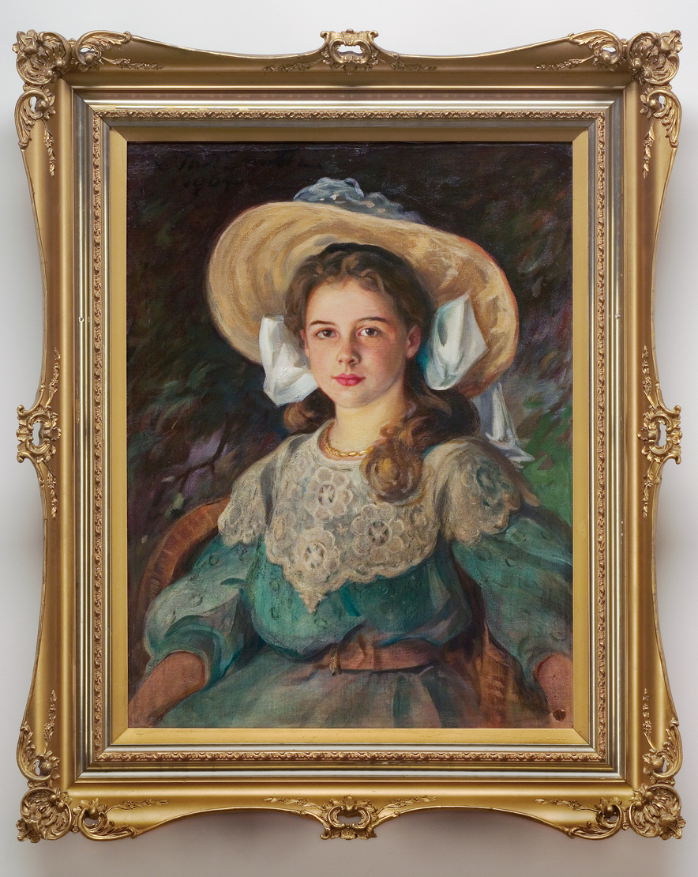
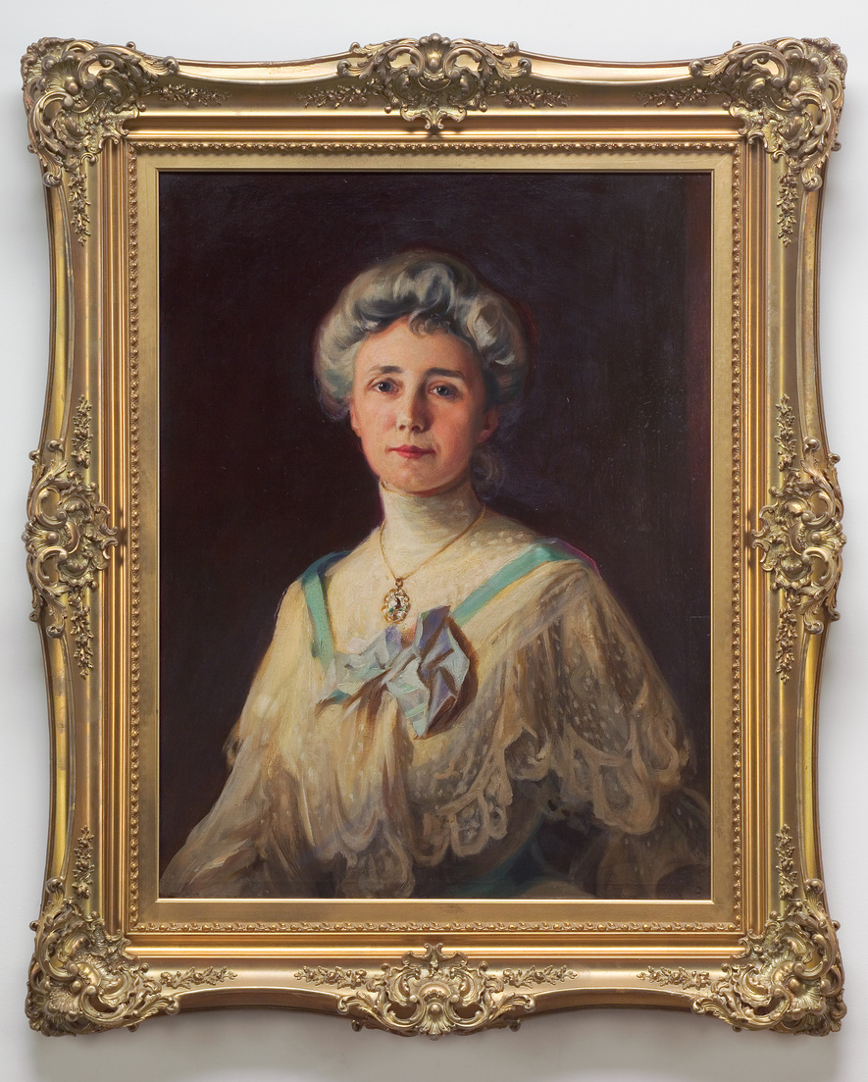
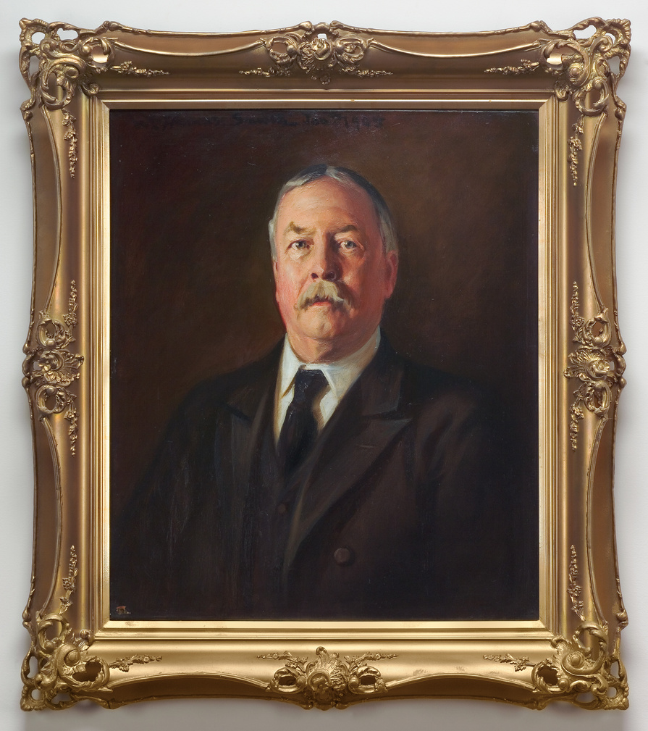
London artist W. Thomas Smith lived in Spokane from 1903 to 1910, painting landscapes and oil-on-canvas portraits “from life,” while also participating in the many activities of the Spokane Society of Washington Artists. Grace Campbell was also active with the art society, and in 1904 the Campbells commissioned Smith to paint their portraits: Amasa Campbell, age 59; Grace, age 45; and their daughter Helen, age 12. The three portraits graced their main stair hall, and Smith included his portrait of Helen in one of the many local exhibitions of his work. These paintings, a gift from Helen Campbell Powell once again reside on the main stair hall leading to the second floor bedrooms.
Northwest Museum of Arts and Culture, 2485.3, 2485.2, 2485.1, Portraits of the Campbells, 1904, Possibly a Gift of Helen Campbell Powell
Photo Credit: Dean Davis

Slide 6

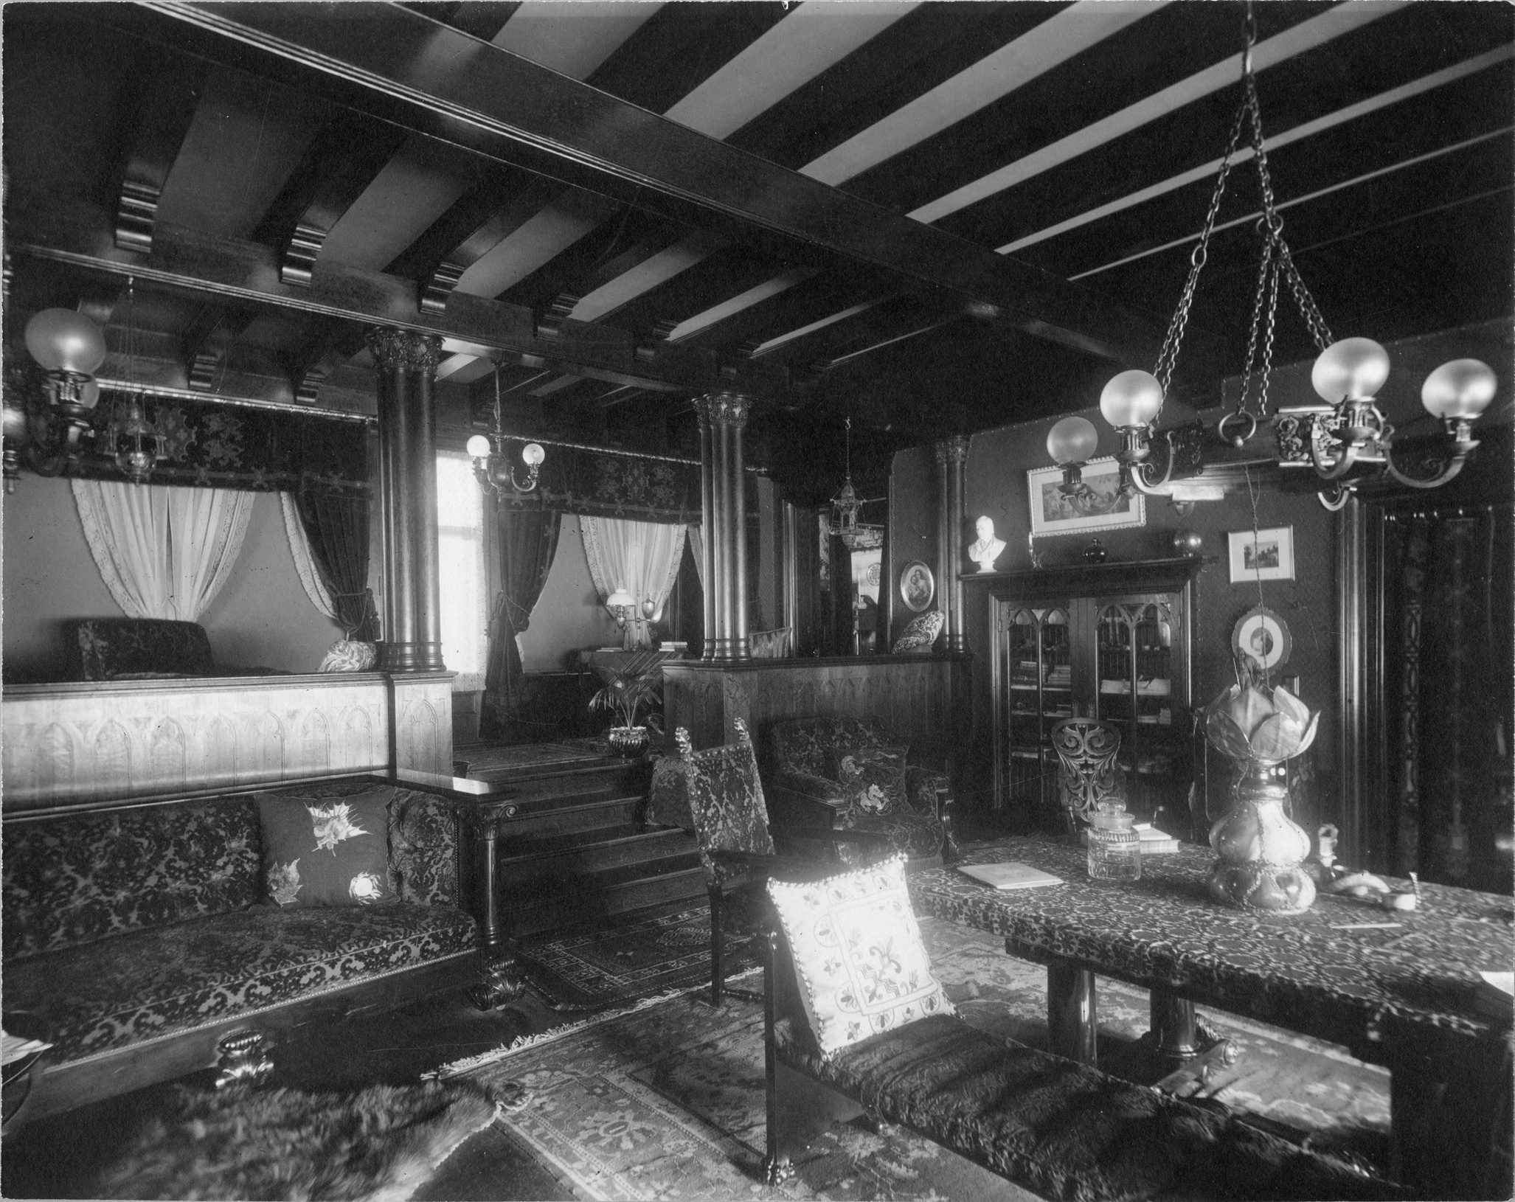
Campbell House Library, Joel E. Ferris Research Archives, L91-120.29, 1910
As you look at historic photos of the library, imagine the family spending much of their time here. What can we learn from these photos?
Campbell House Library, Joel E. Ferris Research Archives, L91-120.28, 1910
Helen Campbell Powell grew up in the house and remembered much of what it looked like during her childhood. She also donated photos of the house as it looked throughout the years. These photos of the library were taken in 1910. The museum still uses the photos to analyze how each room looked. It helps us to find clues as to how the room was used when the family lived there.

Slide 7
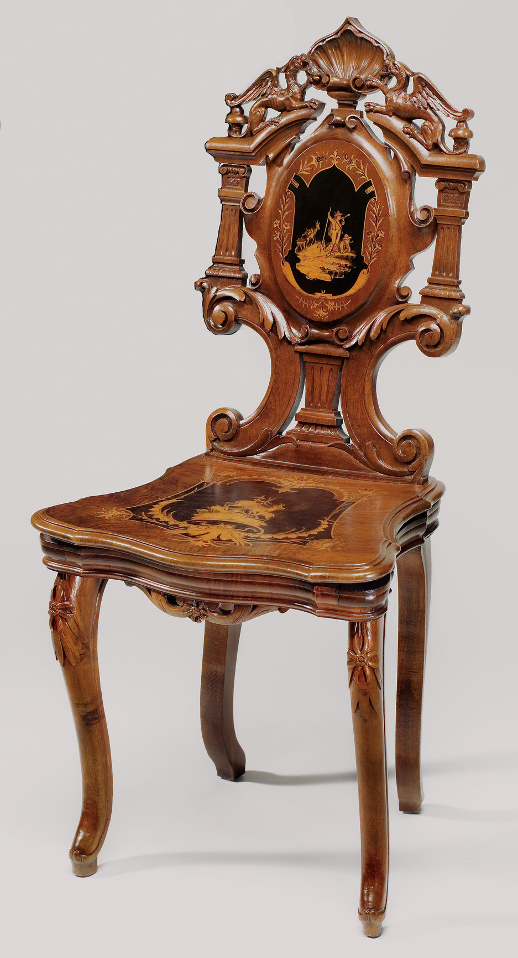
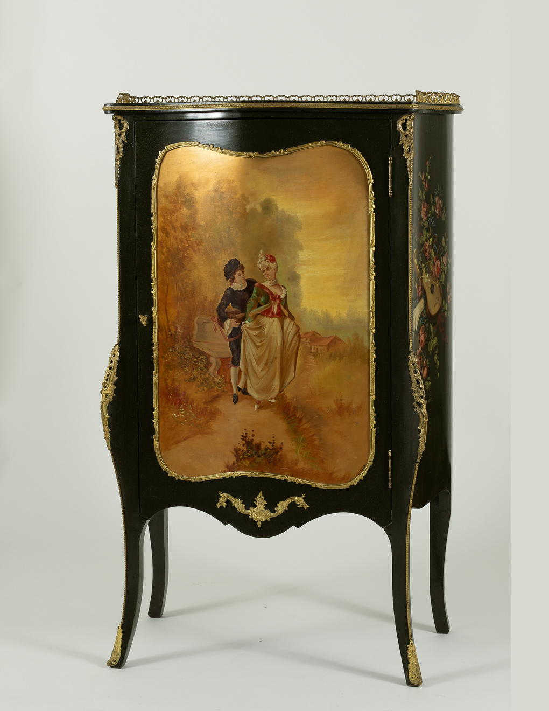
The Campbell’s library was decorated with objects bought during their travels throughout the United States, Europe, and the Middle East. In many late 19th century libraries, furnishings such as books, busts, and musical instruments illustrated a family's interests in literature, music, and world travel. The piano was a symbol of culture, and Helen Campbell enjoyed years of piano lessons, organizing her stacks of sheet music inside this "Vernis Martin" style music cabinet with painted decoration and ormolu trim (right). She and her friends gathered around the piano, danced to the Criterion, and played several European music boxes, including one tucked below the seat of the family's carved Swiss music chair (left). When you sat on the chair, music began to play. What a surprise for any un-suspecting guest!
Northwest Museum of Arts and Culture
3973.1, 1898, Music Box chair, Gift of Mr. and Mrs. John Powell, 2001
Northwest Museum of Arts and Culture
4429.10 Music Cabinet, 1898, Museum Purchase 2019

Slide 8
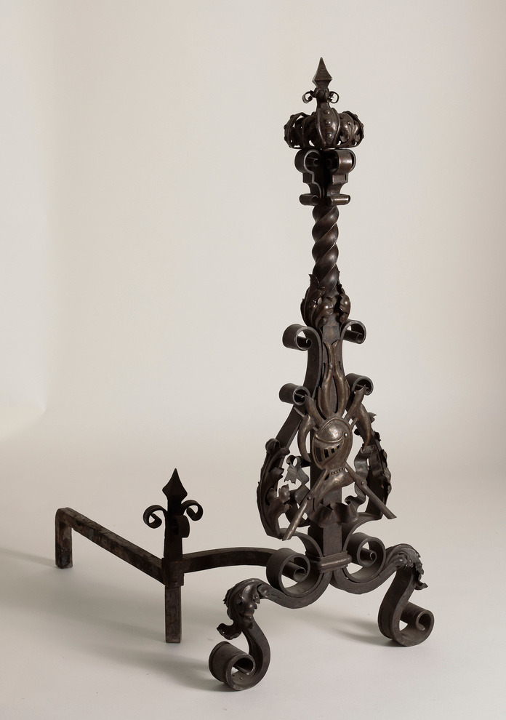
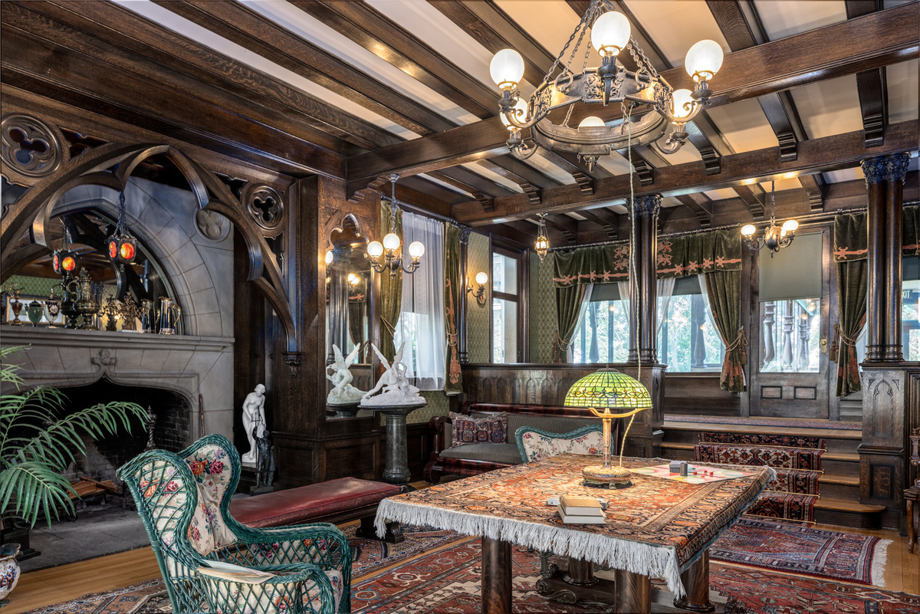
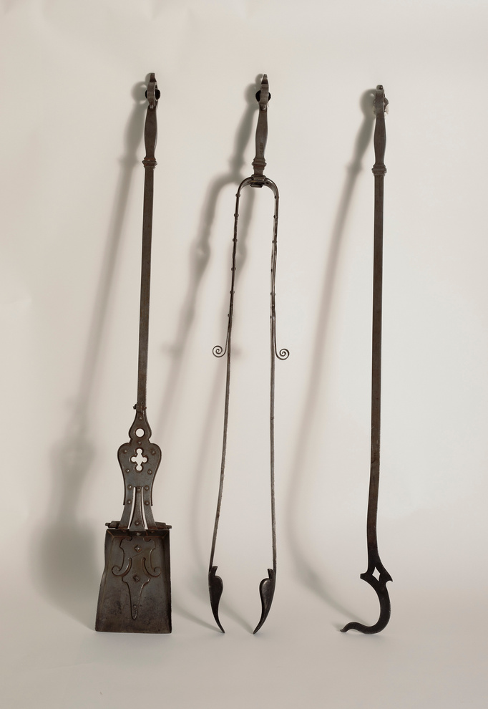
By the late 19th century, many large homes featured a form of central heating; in the Campbells new 1898 home, a wood-fired boiler sent hot water through radiators under the floors of the main public spaces. Fireplaces throughout the house provided additional heat until 1916 when the family extended the radiator system throughout their large home. Each fireplace held andirons, and sometimes a hearth fender, chosen to match the room’s design theme. This set of gothic-style fireplace tools for the large Library fireplace, complemented the room’s andirons and numerous light fixtures.
Northwest Museum of Arts and Culture
2672.1A Andiron, 1898, Museum Purchase 1978
Original to Campbell House. The fireplace set was purchased from the Phi Kappa Tau house in Pullman, WA by the Campbell House Committee. There are two different versions of how the fraternity came to possess the set. In the first version, Mr. Price, a friend of the Powells and a national officer of the fraternity, received them through the Powells for Phi Kappa Tau house in Pullman. The second version is that Mr. Price purchased them when objects were auctioned off in 1925. Which version is true? We do not know as both versions were recorded in the museum’s accession files.
Northwest Museum of Arts and Culture
2672.2 Fireplace set, 1898, Museum Purchase 1978
Northwest Museum of Arts and Culture, Campbell House Library as it looks today. Photo Credit: Dean Davis
Charlotte Upton reported in her 1959 Spokesman-Review article, Campbell House Treasure Hunt Turns Up Originals, "The massive carved and inlaid andirons that were in the living room fireplace are in the Phi Kappa Tau fraternity house in Pullman. Members are too attached to them to be willing to sell them”. By 1978, the fraternity had changed its mind and the original andirons and fireplace set now have a home in front of the library’s fireplace.

Slide 9
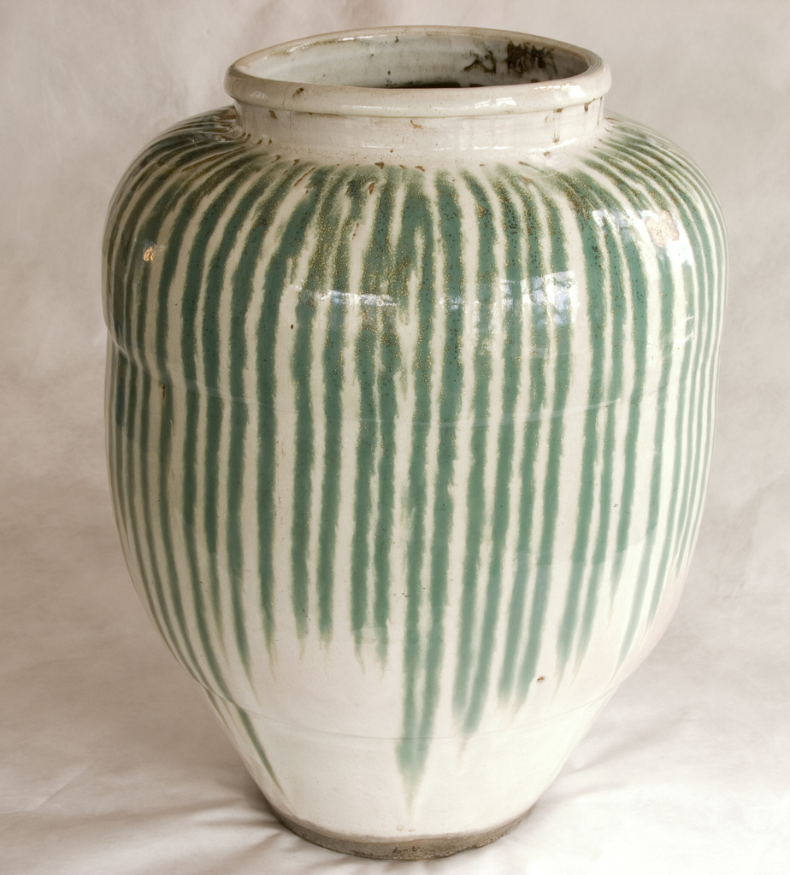
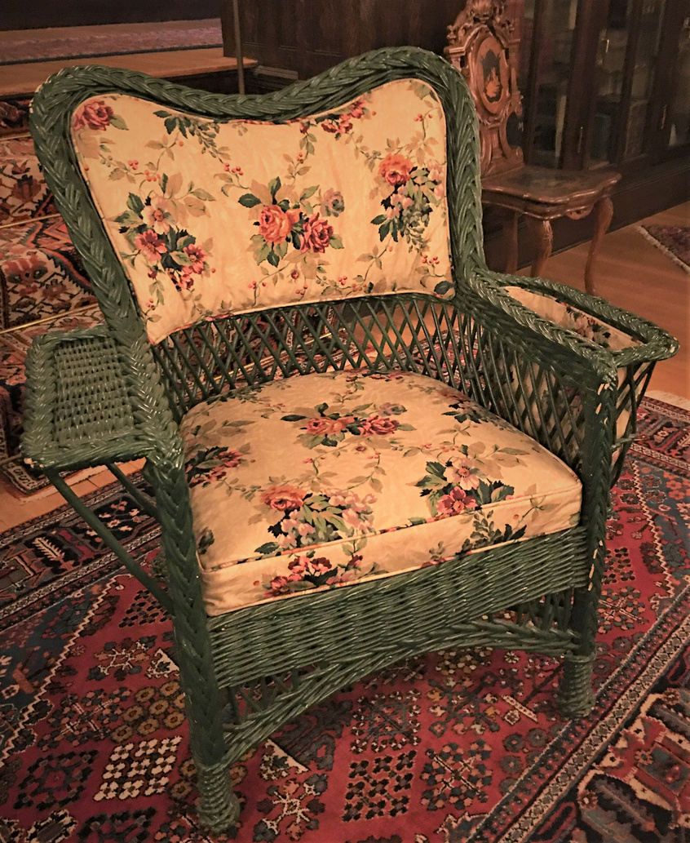
Japanese decorative arts were extremely popular after Japan opened their country up to trade with the west in 1853. This Japanese Shigaraki ware (stoneware) tea storage jar represents the enthusiasm people had for these products. This jar features a overall white Hagi glaze with dripped copper green glaze, forming green vertical stripes, characteristic of Shigasaki glazes. When the Campbells moved into their new home in 1898, they furnished it with high quality revival furniture and decorative arts, typical of wealthy families of the late 19th century. The front entry hall featured a gothic revival style as well as this antique Japanese stoneware jar repurposed as an umbrella stand. You can now find this jar in the Campbell House library.
Northwest Museum of Arts and Culture
1922.2B Wicker Chair, 1900-1910, MAC Collection
This dark green wicker armchair in “Bar Harbor” style is currently located in the Campbell House library. The chair was found in Campbell House along with several other unnumbered wicker chairs of 1890-1925 vintage, possibly original to the house. The chair and seat cushion are upholstered in reproduction linen fabric very similar to original swatch on 1898 William Otis decorator’s plan. Relatively inexpensive rattan and wicker furniture was available and respectable for both indoor and outdoor use by the mid-19th century, and its fashionableness grew as fascination with the exotic and the orient increased. The material was easily adapted to suit changing tastes and lifestyles, and by the 1890s rattan was frequently lacquered in a variety of colors and combinations. Its loose weave was considered to be ideal for ventilation and relaxation, especially for invalids and children.
Northwest Museum of Arts and Culture
4.9, 1850-1868, Gift of Mrs. Fabian Smith, 1959

Slide 10
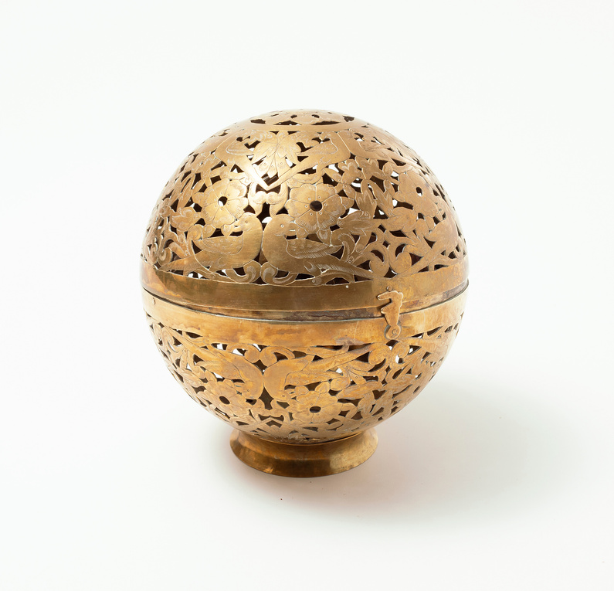
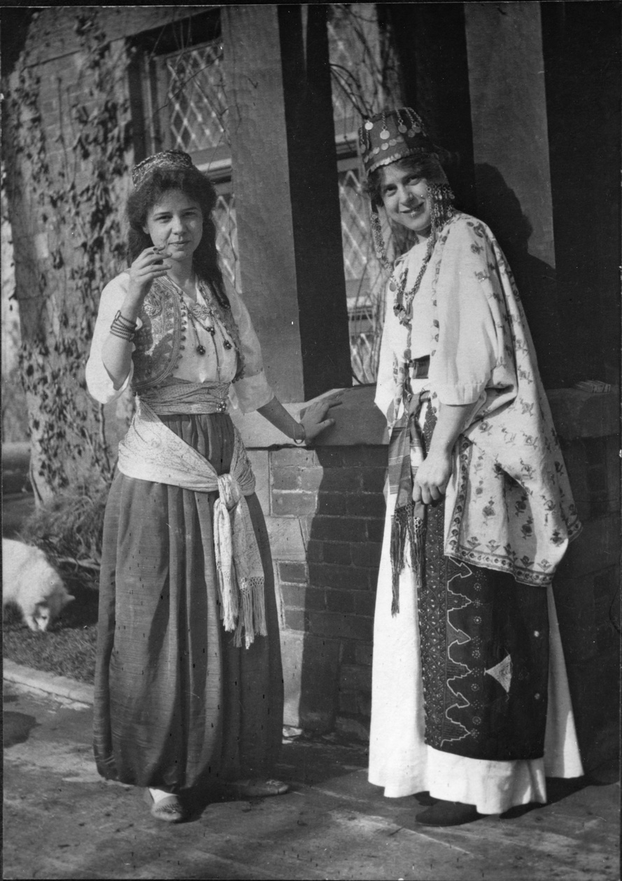
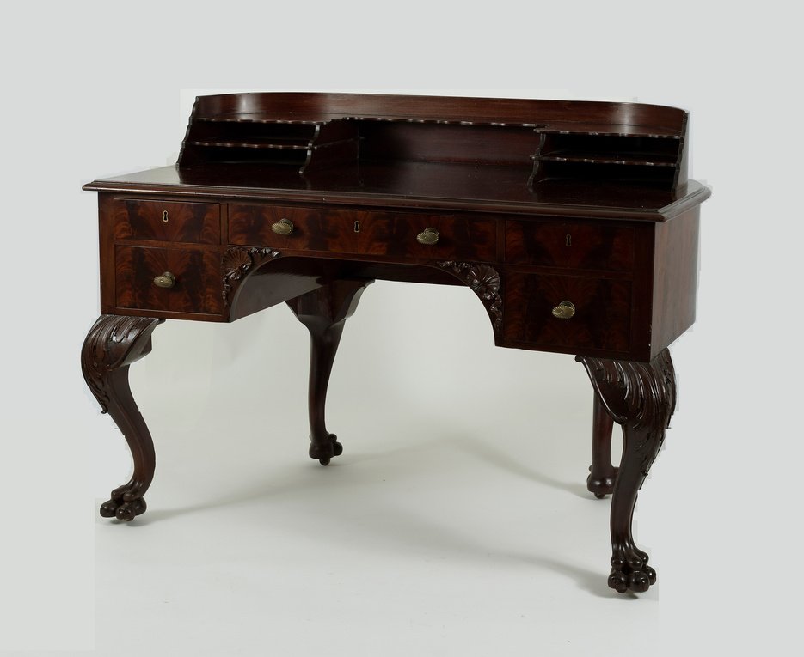
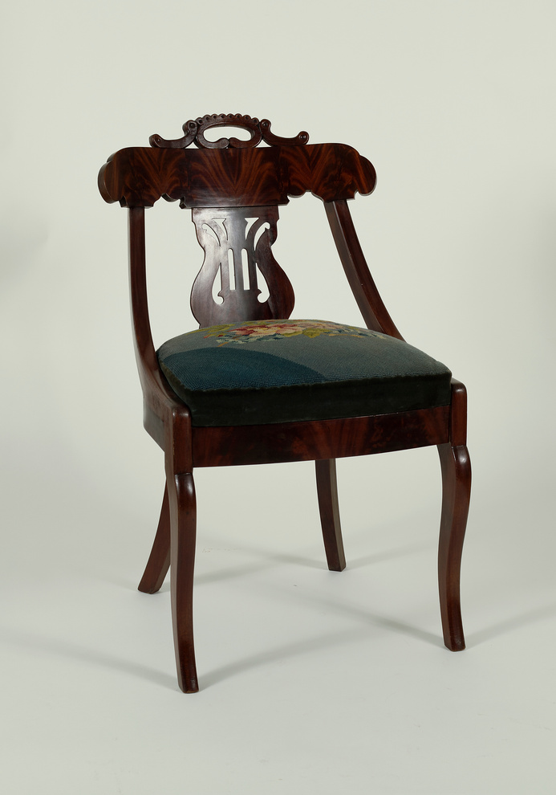
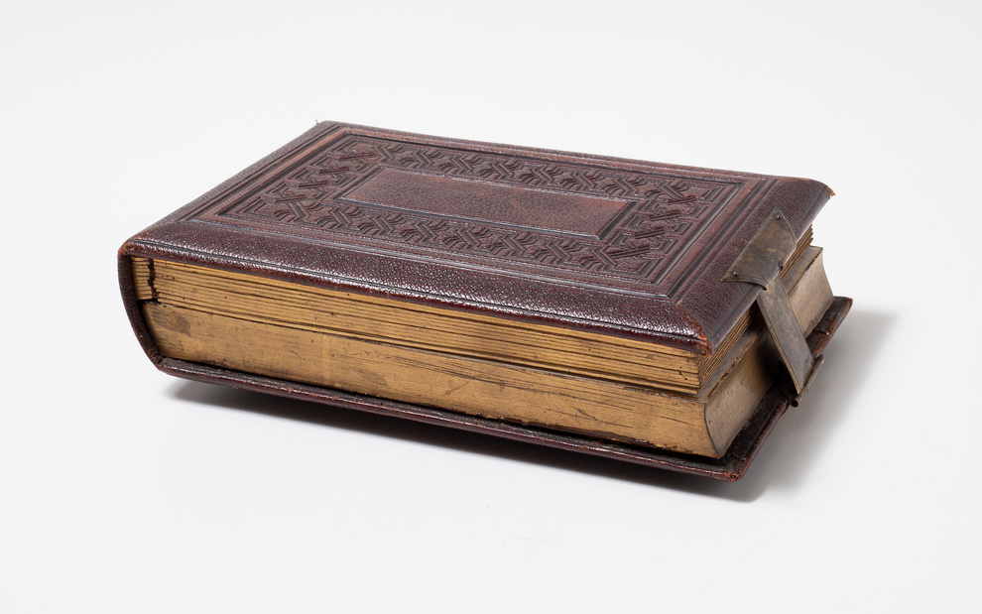
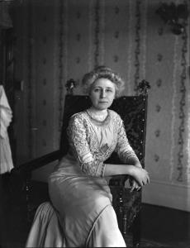
Over the 26 years that the Campbells lived in this home, they added many travel souvenirs and personal items to the room interiors. In addition to alabaster sculptures and carved music boxes from Europe, they favored popular "Oriental" (Middle Eastern) brass objects, including a brass ewer (pitcher) and this decorative pierced oil lamp, displayed on tables, mantel, or above the bookcases. Currently, this brass oil lamp is sitting prominently on Grace Campbell’s writing desk located in the Campbell House library. Not only did the family purchase souvenirs during their travels, they also brought back clothing as seen in this photo of Helen Campbell and her cousin in 1910.
Northwest Museum of Arts and Culture
4429.17, Pierced Brass oil lamp,1898-1905, Museum Purchase, 2019
Helen Campbell and cousin, Hazel Lease, dressed in costumes probably purchased in Egypt in 1903, The Joel E. Ferris Research Archives, 1910, L90-272
Imagine Mrs. Campbell sitting down at this writing desk to write letters, invitations, and thank you notes to friends and family. Writing letters was an important part of Mrs. Campbell’s daily routine. It was how she kept in touch with family and friends, as we now do via email and text.
Like it does in families today, photography played a prominent role in documenting the Amasa B. Campbell family's life. Local photographer, Roye, took numerous formal portraits of Grace and Helen inside their home and also created an artistic album illustrating four seasons of the Campbell's home exterior and grounds. Family portrait photographs appeared, both framed and unframed, in several interior room photos. This leather-covered photo album contained not only Campbell family photos, but also a music box.
Northwest Museum of Arts and Culture
4429.9, Mahogany writing desk chair, Museum Purchase, 2019
Grace Campbell pictured in the guest bedroom, The Joel E. Ferris Research Archives, 1910-1920, L91-119.8
Northwest Museum of Arts and Culture
4429.8, Mahogany writing desk, 1898, Museum Purchase, 2019
Northwest Museum of Arts and Culture
3212.2, 1890-1910 Music Box Photo Album, Gift of Mrs. Valarie Powell, 1987

Slide 11
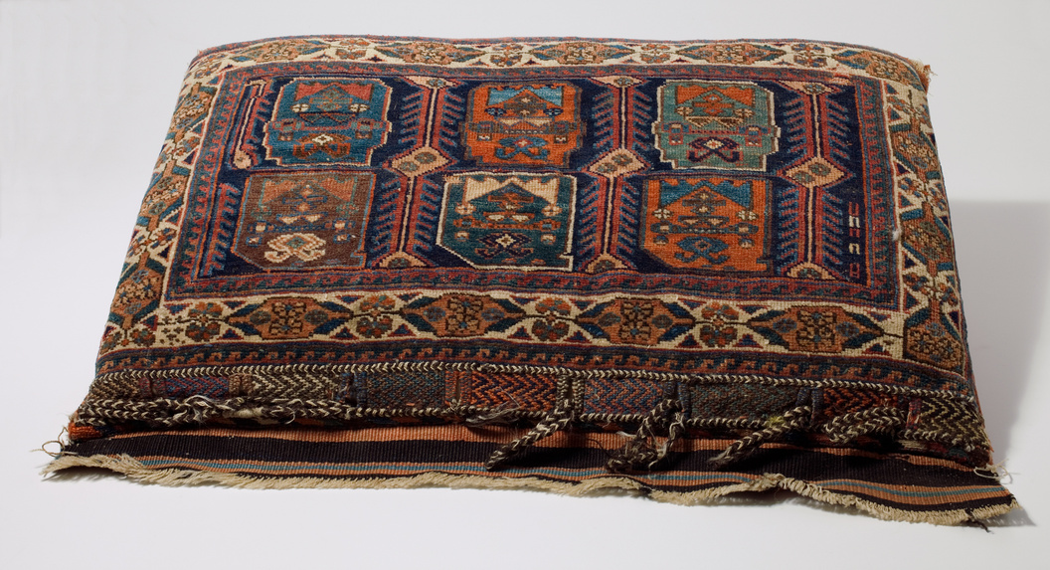
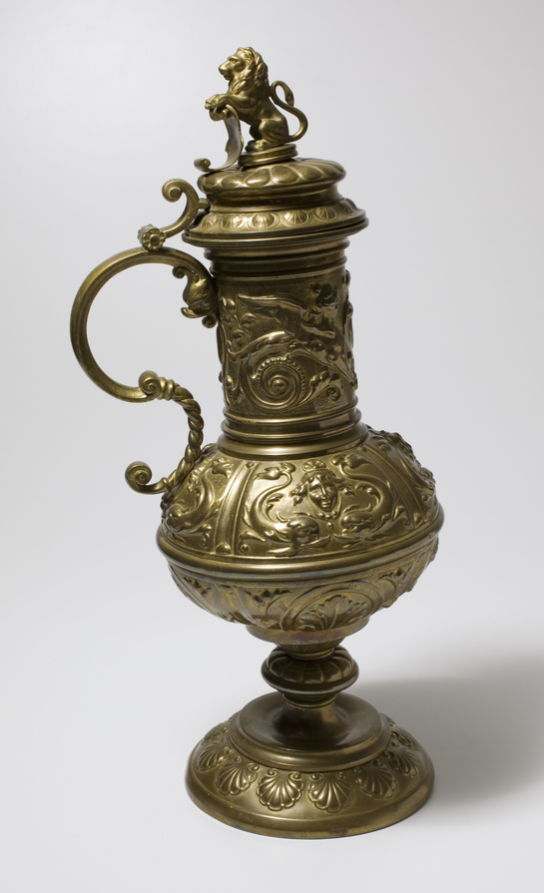
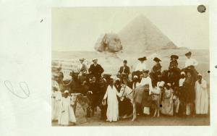
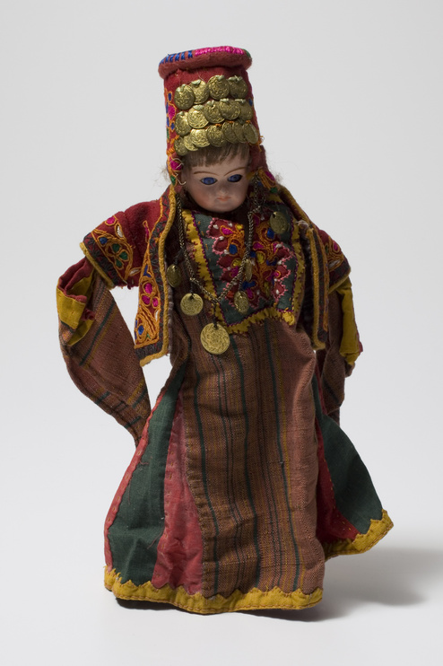
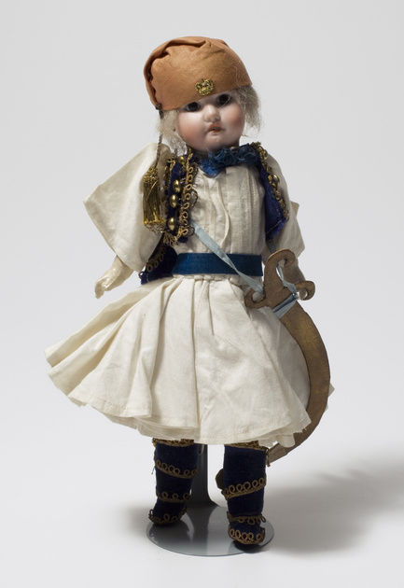
In a postcard that pictured the Campbell family and the Patsy Clark family on camels in front of pyramids, Grace Campbell wrote to her friend, Mrs. Finch, “Out of Alexandria Bay. My dear Mrs. Finch: Did you do this when you were in Cairo? It’s good fun for once...Never knew what dirt was until we drove through Old Cairo...Mr. Moore has no doubt told you of our automobile accident. Mace is getting on very well. Has one hand out of the cast now. The other will be out in about ten days. It is a mystery how any of us escaped being killed. Hope you are very well. All send love. Sincerely, Grace M. Campbell.”
Late 19th century interiors grew increasingly cosmopolitan, often combining both domestic and foreign objects, such as Arts and Crafts from pre-industrialized countries. Oriental rugs became extremely popular, and small versions like saddlebags were re-configured into decorative pillows. The Campbell family may have brought this 19th century bag home from their 1904 trip to Egypt, then fashioned it into a decorative pillow.
Northwest Museum of Arts and Culture
4309, Camel Saddle Blanket Pillow, 1890-1895, Estate of John Powell, 2013
Like many young well-to-do girls of her time, Helen Campbell (1892-1967) enjoyed collecting dolls representing different countries, like this Greek soldier doll and Jordanian Bride Doll. Popular fascination with world exploration grew through the 19th century.
Northwest Museum of Arts and Culture, 784.11, 784.10, 1885-1905, Gift of Mrs. Helen Campbell Powell, 1930
Postcard of Campbell Family in Egypt, The Joel E. Ferris Research Archives, 1904, L86-479A
Northwest Museum of Arts and Culture
4228.1, Brass Urn or Ewer, 1898-1910, Gift of the Koontz Family in memory of Glen and Evelyn Koontz

Slide 12
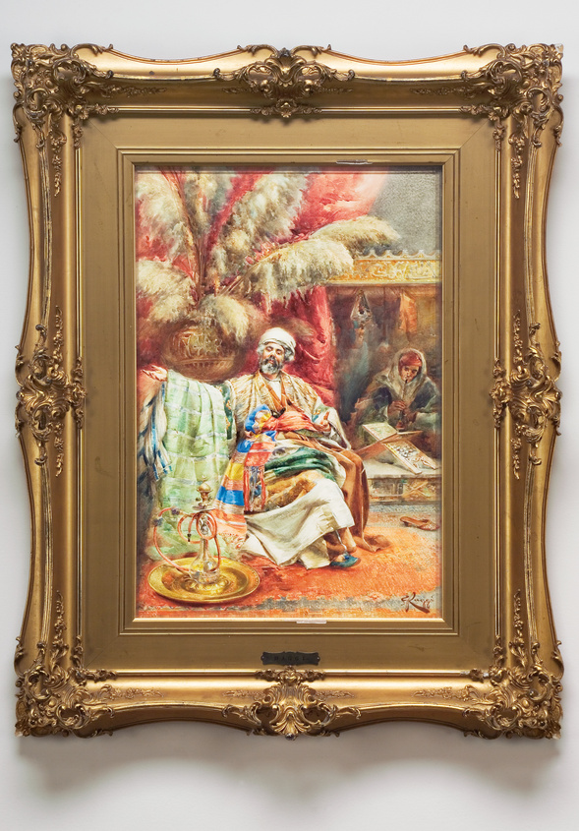
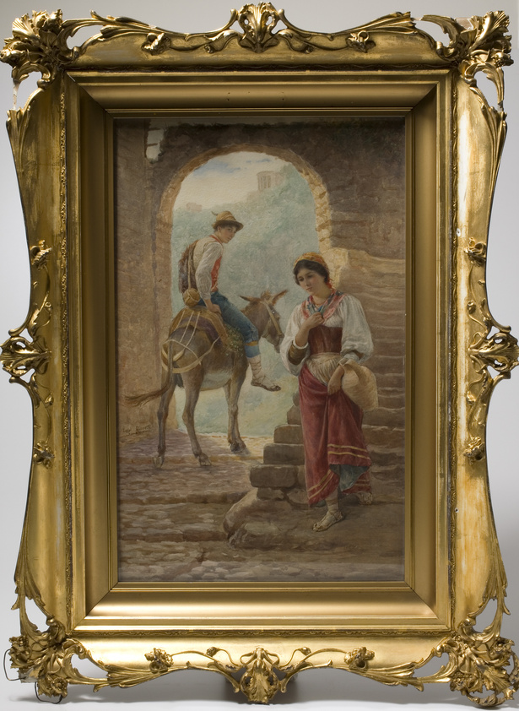
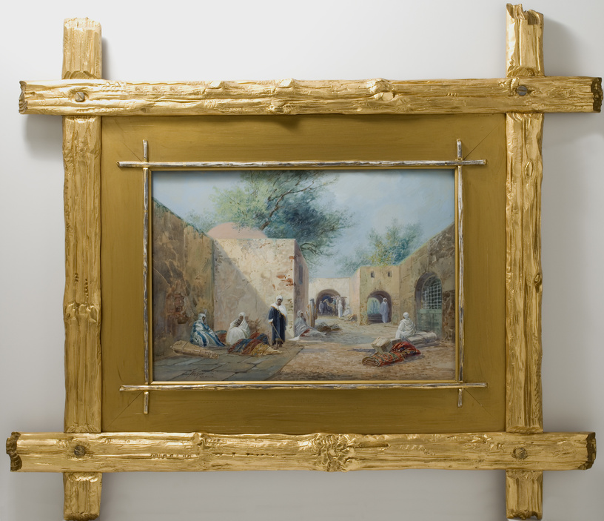
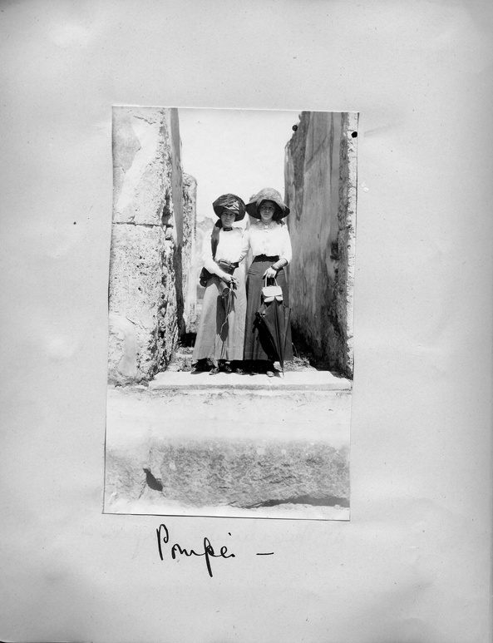
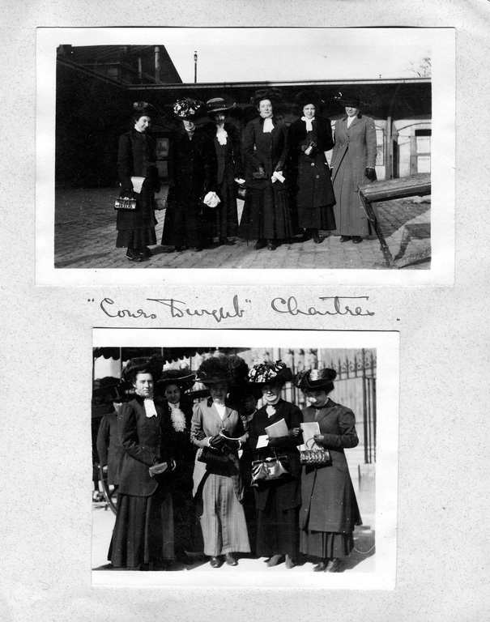
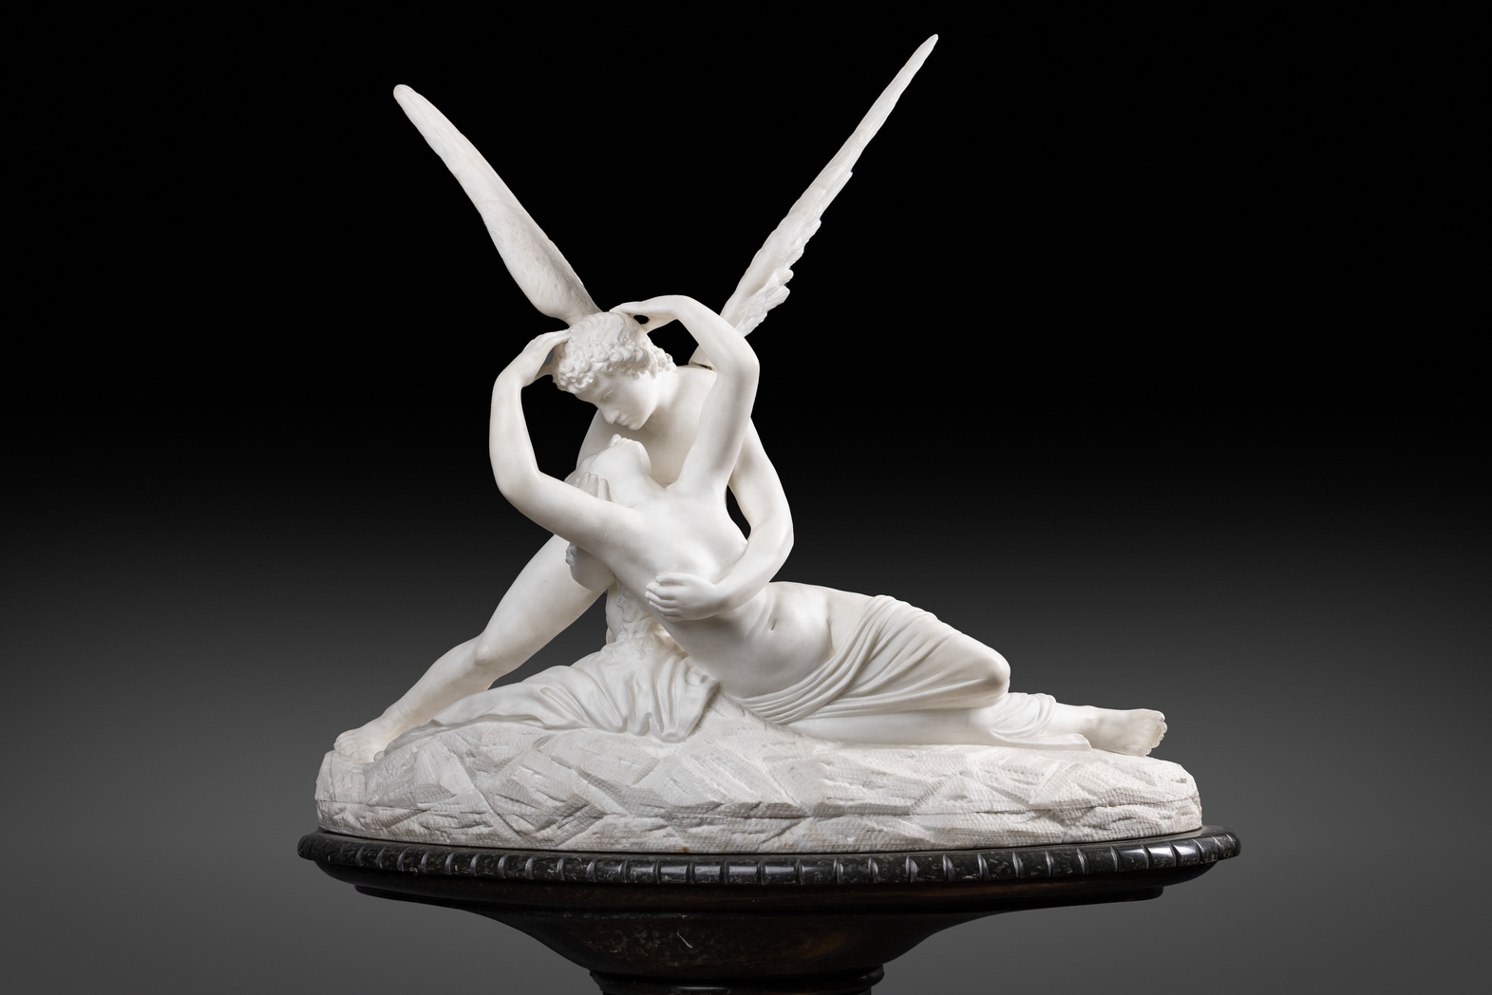
The Campbell Family went on their Grand Tour of Europe between 1909 and 1910. While in Europe, Helen Campbell attended finishing school in Paris and Mr. Campbell had surgery to remove cancerous tumors from his throat. However, much of what they did while in Europe was travel to various countries and visit museums and historical sites such as Pompeii.
Like their peers, they bought copies of original art they saw while in Europe. Just as now, people liked to purchase souvenirs from their travels and display them in their living rooms. Pictured is art bought by the Campbells during their travels that are now featured in the library.
Northwest Museum of Arts and Culture, 784.36, Watercolor of Man and Water Pipe, 1875-1900, Gift of Mrs. Helen Campbell Powell, 1960
Northwest Museum of Arts and Culture, 784.37, Young Italian Couple, 1904, Gift of Mrs. Helen Campbell Powell, 1960
Northwest Museum of Arts and Culture, Campbell House Grand Tour Scrapbook, pages 49
Helen Campbell Grand Tour Scrapbook Page 20 Joel E. Ferris Research Archives,
Northwest Museum of Arts and Culture, 2483.13, Psyche Revived By The Kiss of Eros, 1903-1910, MAC Collection
Northwest Museum of Arts and Culture, 2486.1, Young Italian Couple, 1875-1900, gift of Mrs. W. W. Powell, May 1950

Slide 13
If common, everyday pieces of furniture like this table located in the Campbell House Library could talk, it would have stories to tell! The August 16, 1959, Spokesman Review article, “Treasure Hunt Turns Up Originals” told the story of this table’s return to Campbell House where it had resided from 1898-1924. Helen Campbell Powell had moved this table to her home on Spokane’s South Hill after the death of her mother. The table inhabited their home, as she and Bill raised their three sons. During WWII, their sons joined the fight with the eldest, William Jr. serving in the Pacific. Their youngest son, John, served in the USO, traveling through Europe as a musician entertaining the troops. Their middle son, Allan, served as an army pilot. Tragically, while returning from his ninth mission on January 5, 1944, Allan crashed near the coast of western France. For a year he was listed as missing before being declared dead. Just as many families during WWII, the Campbell family was forced to face the heartbreak of losing their son and brother.
In the 1959 newspaper article, Treasure Hunt Turns Up Originals, we learn the story of what happened to the table during WWII, and how it was returned to Campbell House in 1959. The article recounted that Helen Campbell Powell had loaned the table to her friend, Mrs. F.G. Sprowl to use in a Red Cross Day room during the war. At the end of the war, the table’s origins had been forgotten, and the table was sold to the Spokane Club. Knowing that the museum was looking for Campbell House original furniture, Mrs. Sprowl recalled the sale and told Bill and Helen they should check with the Spokane Club. Bill Powell called the director of the Club to inquire about purchasing the table back for Campbell House. Learning the story of the table, the manager, Don H. Klages let Bill know they would donate the table to the museum. This was a happy ending for Campbell House, but the story raises the question of why was the origins of the table forgotten in the first place? Could it have been the tragedies of the war faced by families such as the Powells made material possessions such as tables, not that important in the scheme of things?
Campbell House Library, The Joel E. Ferris Research Archives, 1910, L91-120.29
Campbell House Library as it looks today. Photo Credit: Dean Davis
Northwest Museum of Arts and Culture, Campbell House Library Table, 1821.1, 1898, Gift of The Spokane Club

Slide 14
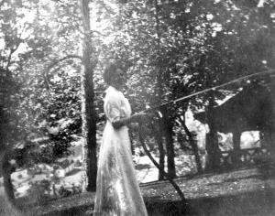
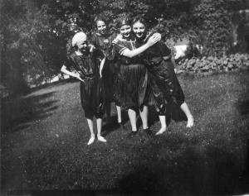
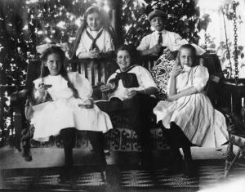
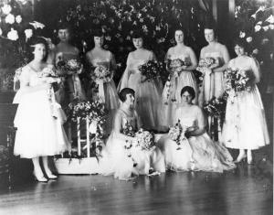
Helen Campbell spraying her cousin, Mary White, and friends in the backyard of Campbell House, The Joel E. Ferris Research Archives, 1908, L91-162.78
Mary White and friends being sprayed in the backyard of Campbell House, The Joel E. Ferris Research Archives, 1908, L91-162.73
Mary White and friends on the Campbell House veranda, The Joel E. Ferris Research Archives, 1908, L91-162.80
Both photographs and museum objects, such as those found in the Campbell House, have stories to tell. They tell us about the life of a family and their place during the era in which they lived. They tell us how people entertained themselves, the advancement of technology, and architectural fashions. They tell us about people’s interest in the world around them as well. Architecture, decorative arts, and photographs of homelife are a mirror that reflects the complex interplay between human identity, social structures, and historical contexts. Objects, decorative arts, and photographs in a historic house tell us the story of a home. Examine these photos. What do these photos tell us about the family’s home life?
Helen Campbell wedding party in the Campbell House Library, The Joel E. Ferris Research Archives, 1917, L91-120.13

Slide 15
Historians study objects, the material culture that people from the past left behind, in order to understand history. Objects are the products of human workmanship - of human thought and effort - objects tell something about the people who designed, made, and used them. What questions do historians ask themselves when they analyze objects?
  First impressions: What are your first impressions of this object? Do you have any ideas what the object might have been used for?
  A closer look at the physical features: What is it made of? Why was this material chosen? What is the texture and color? What does it smell like? Can it be held? Is it heavy or light? Is it intact, or does it look like parts are missing? Does it look new or old?
  Construction: Is it handmade or made by machine? Where was it made? Who made it?
  Function: How is this object used? Does it have a practical use or is (was) it used for pleasure? Has it been used? Is it still in use? Has the use changed? Where could it have been found? What value does it hold to you and to others?
  Design: Is it designed well? Is it decorated? How is it decorated? Is it aesthetically pleasing? Would it make a good gift? Does it remind you of anything else?
  Who may be connected with the object? What type of person might have used this object? What type of person might have made this object? What does this object tell us about the maker and user?
  Thinking further: Is this type of object still being made today? Is it still in use? If not, why do you think it isn’t used today? Should this object be in a museum collection? Why or why not?
  What do you wonder? What questions do you have about the object that you can’t answer from just looking at it?

Slide 16
Photographs provide us with images of past events. Today, historians study the content and meaning of these visual images to locate information about a particular topic, time, or event. Photographs can convey countless details about life. For historians and for us, “A picture is worth a thousand words.” Photographers can manipulate, intentionally or unintentionally, the record of the event. It is the photographer – and the camera’s frame – that defines the picture’s content. Thus, the photographer chooses what will be in the picture, what will be left out, and what the emphasis will be. When analyzing photographs, ask yourself the following questions:
  Take a closer look: Make sure to examine the whole photograph. Make a list of any people in the photograph. What is happening?
  Looking more closely: Are there any captions? A date? Location? Names of people? What kind of clothing is worn? Are there any words on signs or buildings?
  Thinking Further: If people are in the photograph, what do you think is their relationship to one another? Can you speculate on a relationship between the people pictured and someone who is not in the picture?
  What do you think happened before and after the photo was taken? Who do you think took the photo and why?
  What does this photograph suggest to you? What questions do you have about the photo? How could you try to answer them?
  What is the one thing that you would remember most about this photograph and why?
  What questions do you have about the photograph that you cannot answer through analyzing it? Where could you go next to answer these questions?

